Slide 1
Remembering César Chávez:
A Legacy for Peace, Justice, and Non-Violence
A Teaching Toolkit Developed for the
CSUSM Commemoration of the 20th Anniversary of the Cesar E. Chavez statue
March 27-31, 2017
Notes:
http://www.history.com/topics/cesar-chavez

Slide 2
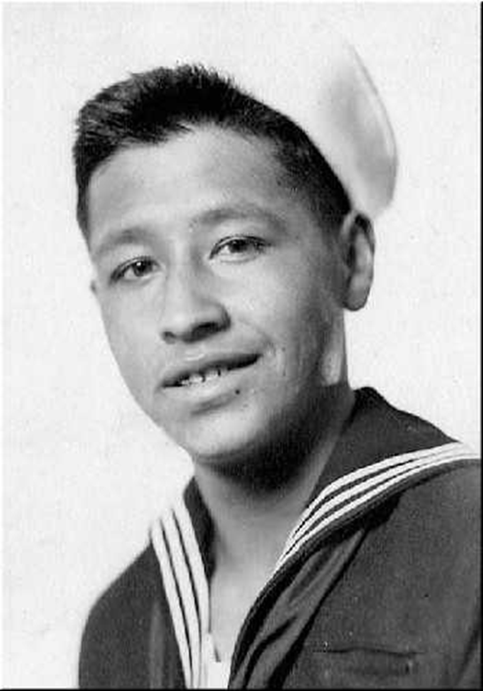
César E. Chávez
(March 31, 1927 – April 23, 1993)

Slide 3
Biographical Resources
Cesar Chavez Foundation: About Cesar
California Department of Education
(English)
(Spanish)
United Farm Workers
AFL-CIO
History Channel Fast Facts
New York Times Obituary (April 24, 1993)

Slide 4
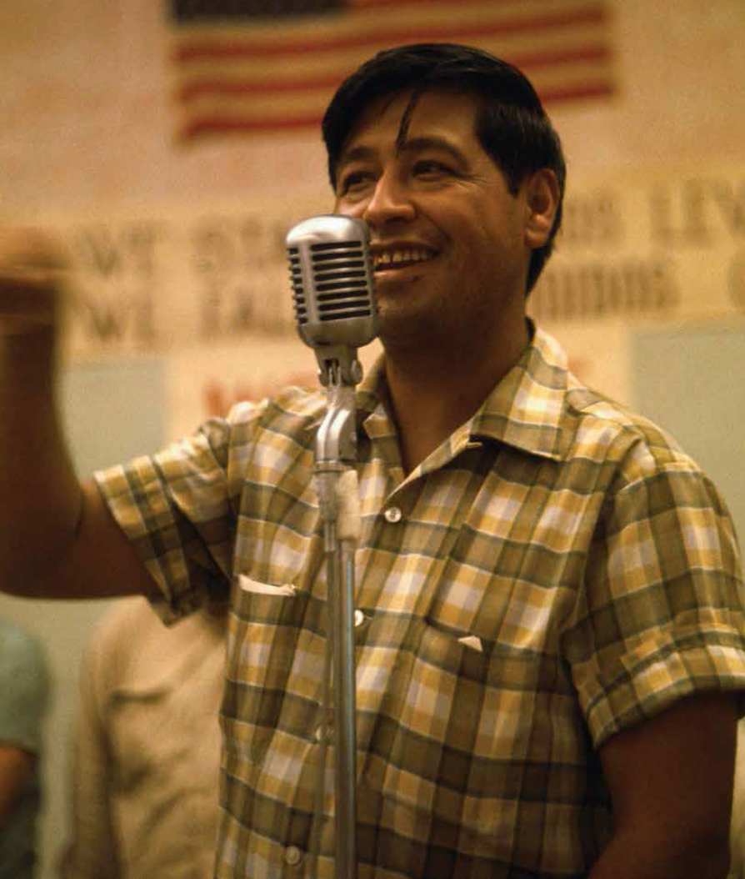

Slide 5
Photo Collections
Farmworker Movement Documentation Project, UC San Diego
Cesar Chavez Foundation Photo Gallery
California Department of Education Photograph Archive
Bob Fitch Photography Archive of Cesar Chavez, Stanford University
“A Civil Rights Photographer and a Struggle Are Remembered” New York Times (2013)
Calisphere, University of California

Slide 6
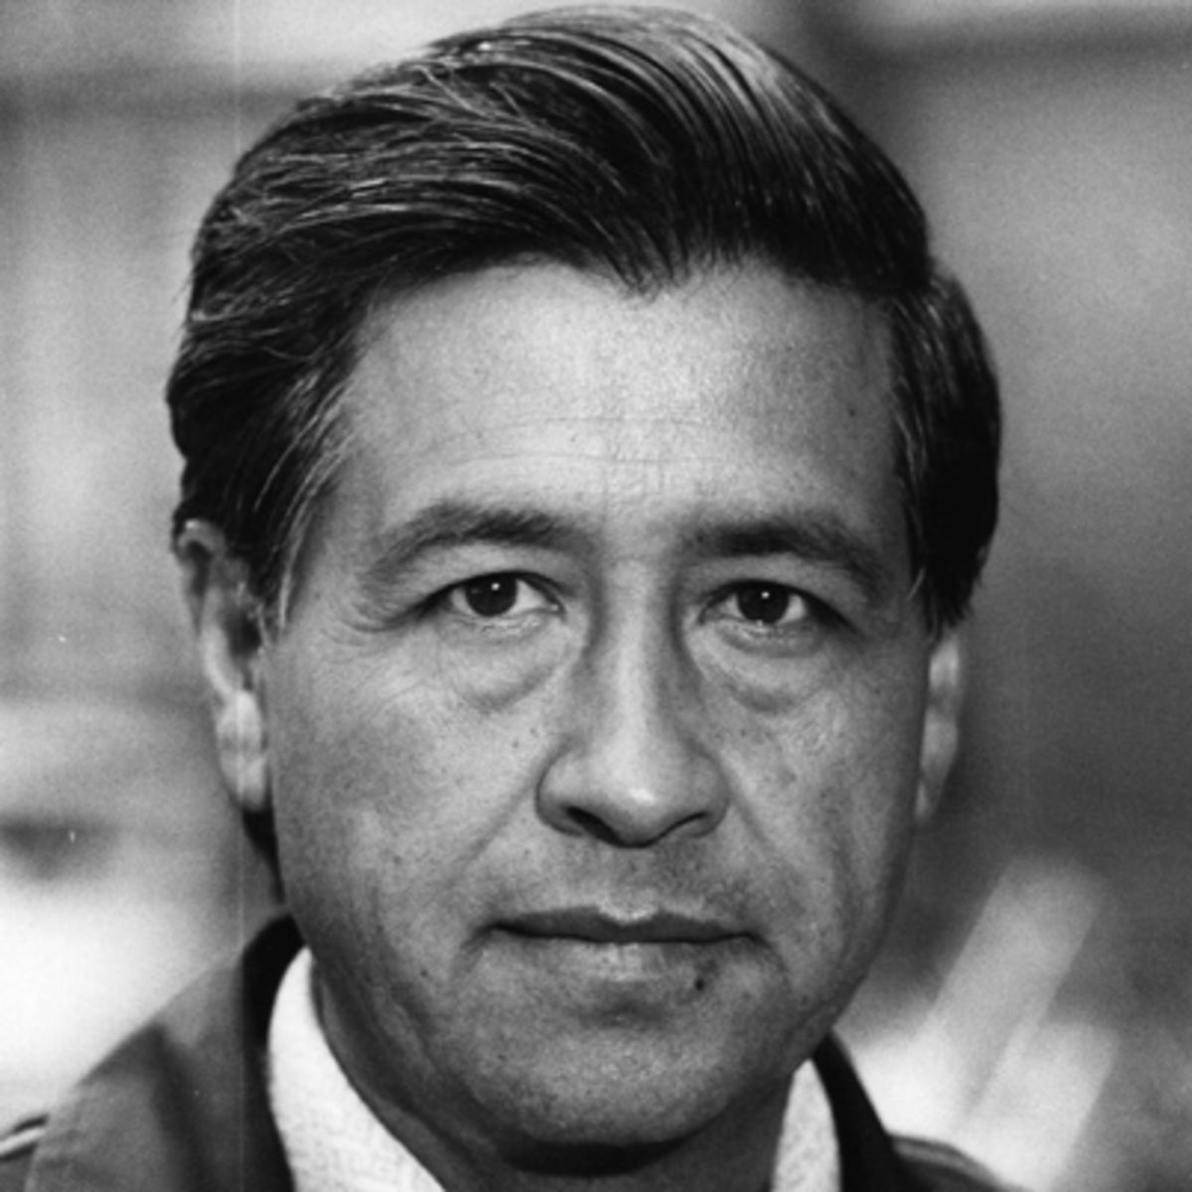

Slide 7
Select Books
Steven W. Bender, One Night in America: Robert Kennedy, Cesar Chavez, and the Dream of Dignity (Routledge 2015)
César Chávez, An Organizers Tale: Speeches (Penguin Classics, 2008)
Matthew Garcia, From the Jaws of Victory: The Triumph and Tragedy of Cesar Chavez and the Farm Worker Movement (University of California Press, 2014)
Jacques E. Levy, Cesar Chavez: Autobiography of La Causa (University of Minnesota Press, 2007)
Peter Matthiessen, Sal Si Puedes (Escape If You Can): Cesar Chavez and the New American Revolution (University of California Press, 2014)
Miriam Pawell, The Crusades of Cesar Chavez: A Biography (Bloomsbury Publishing, 2014)
Randy Shaw, Beyond the Fields: Cesar Chavez, the UFW, and the Struggle for Justice in the 21st Century (University of California Press, 2010)
Notes:
http://www.ufw.org/

Slide 8
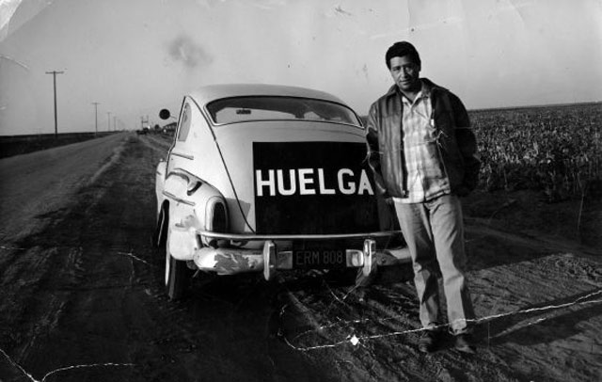
Notes:
http://www.ufw.org/

Slide 9
Films
Chicano! History of the Mexican-American Movement (PBS; available at CSUSM Media Library)
Cesar’s Last Fast (available at CSUSM Media Library)
Fight in the Fields (British production)
The Fight in the Fields: Cesar Chavez and the Farmworkers’ Struggle (Paradigm Productions)
The Fight in the Fields Study Guide
Viva La Causa (Teaching Tolerance; available at CSUSM Media Library)
Viva La Causa (Teachers Guide from Teaching Tolerance)

Slide 10
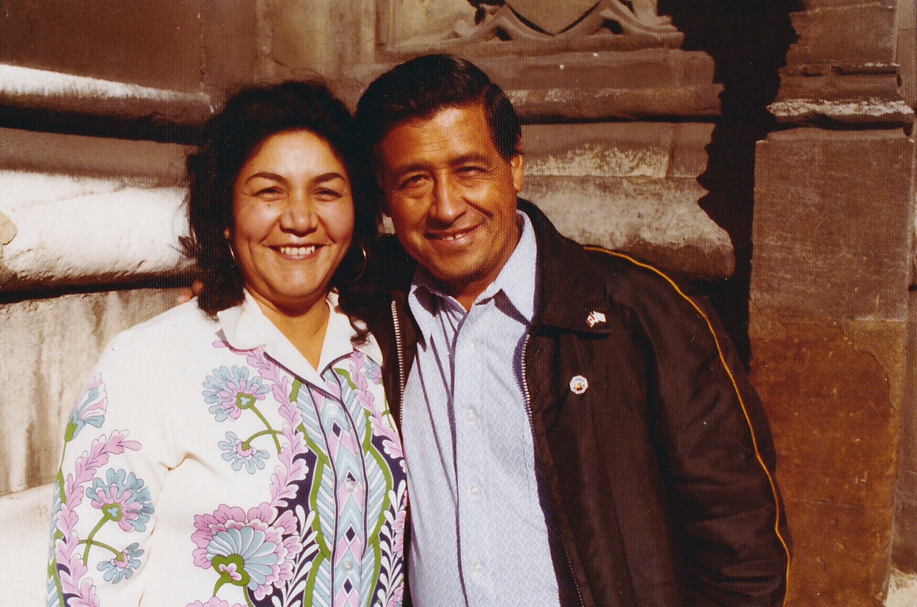
César and Helen Chávez
Notes:
Helen Fabela Chávez (1948–1993)

Slide 11
Ten Core Values of César Chávez
1. Service to Others – Service that is predicated on empowering others; engendering self-help, self-determination, and self-sufficiency versus charity.
2. Sacrifice – Sacrifice that is spiritual; that is courageous and steadfast in its willingness to endure great hardship for others.
3. A Preference to Help the Most Needy – A concerted effort to support programs that reach the most needy, the most dispossessed, the most forgotten people in society no matter how difficult the challenge that choice may bring.
4. Determination – Determination that is characterized by an attitude that with faith, steadfast commitment, patience, and optimism, human beings can prevail against all odds.
5. Non-Violence – Invoking non-violence as the most powerful tool for achieving social/economic justice and equality; action that requires boldness and courage versus meekness and passivity.
Notes:
http://www.chavezfoundation.org/

Slide 12
Ten Core Values
6. Acceptance of all People – An essential ingredient for success in organizing diverse forces to achieve social change, create community, and actualize democracy is the acceptance of all people; an absolutely indispensable necessity to the well-being of this country.
7. Respect for Life and the Environment – Respect that holds as sacred the land, the people, and all other forms of life.
8. Celebrating Community - Sharing the joyous and respectful expression of cultural diversity through the reinforcement of the values of equity and responsibility to and for one another.
9. Knowledge - The pursuit of self-directed learning and the development of critical thinking and constructive problem solving skills; overcoming ignorance through education.
10. Innovation – A creative capacity to find pragmatic strategies and tactics to resolve problems and situations that often seem insurmountable to others.

Slide 13
Robert F. Kennedy, Jr. and César Chávez

Slide 14
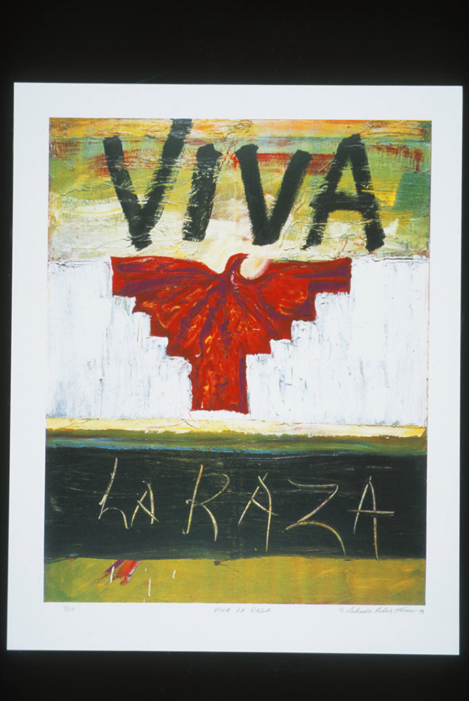
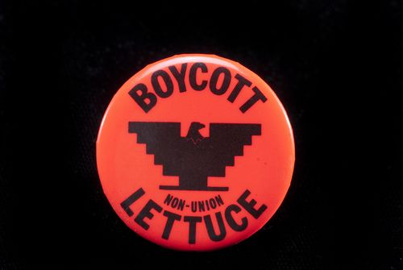
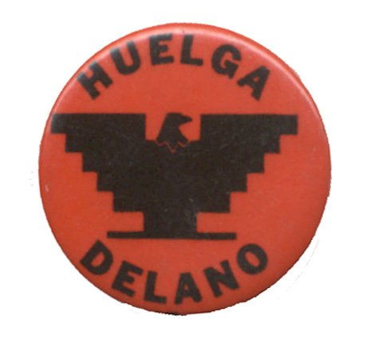
Symbols of La Causa
Notes:
http://www.takepart.com/article/2014/04/02/cultural-history-ufw-flag
http://oac.cdlib.org/ark:/13030/hb7779p1ww/?layout=metadata&brand=oac4

Slide 15
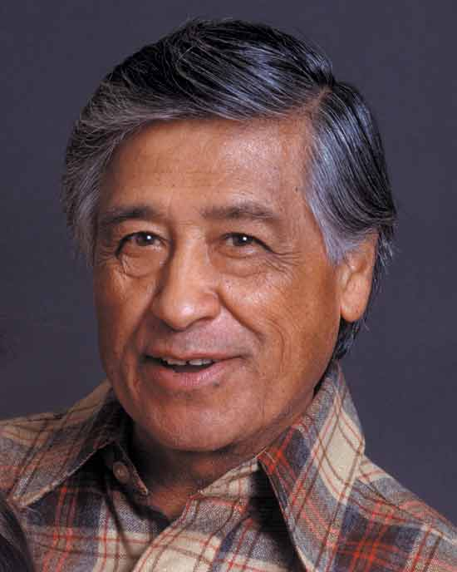
Notes:
Click image to link to Cesar Chavez interview on Charlie Rose (1992)

Slide 16
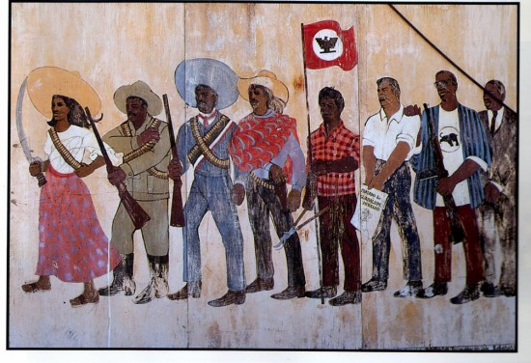
César Chávez Murals

Slide 17
Additional Resources
Oral Histories about the Farmworkers’ Movement, including interviews with Chavez
Welga! Filipino American Labor Archives, oral histories and images, UC Davis
FBI Files on Cesar Chavez

Slide 18
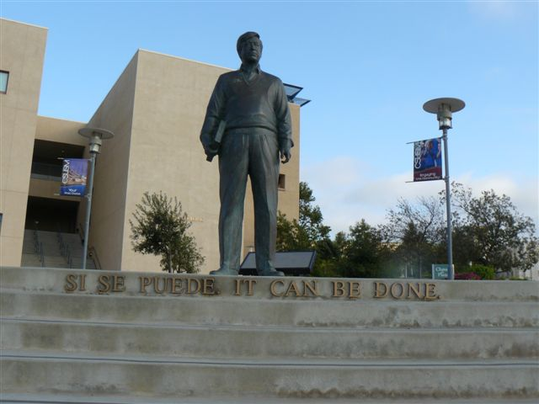
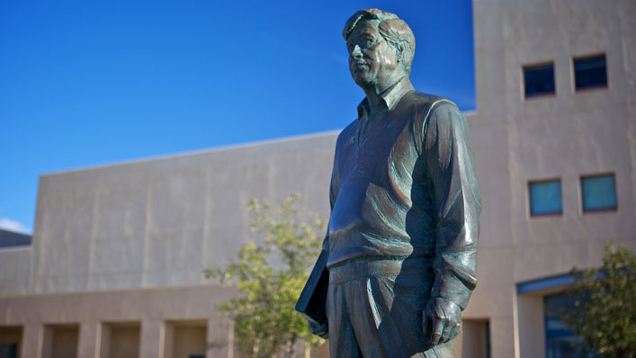
César Chávez statue at CSUSM

Slide 19
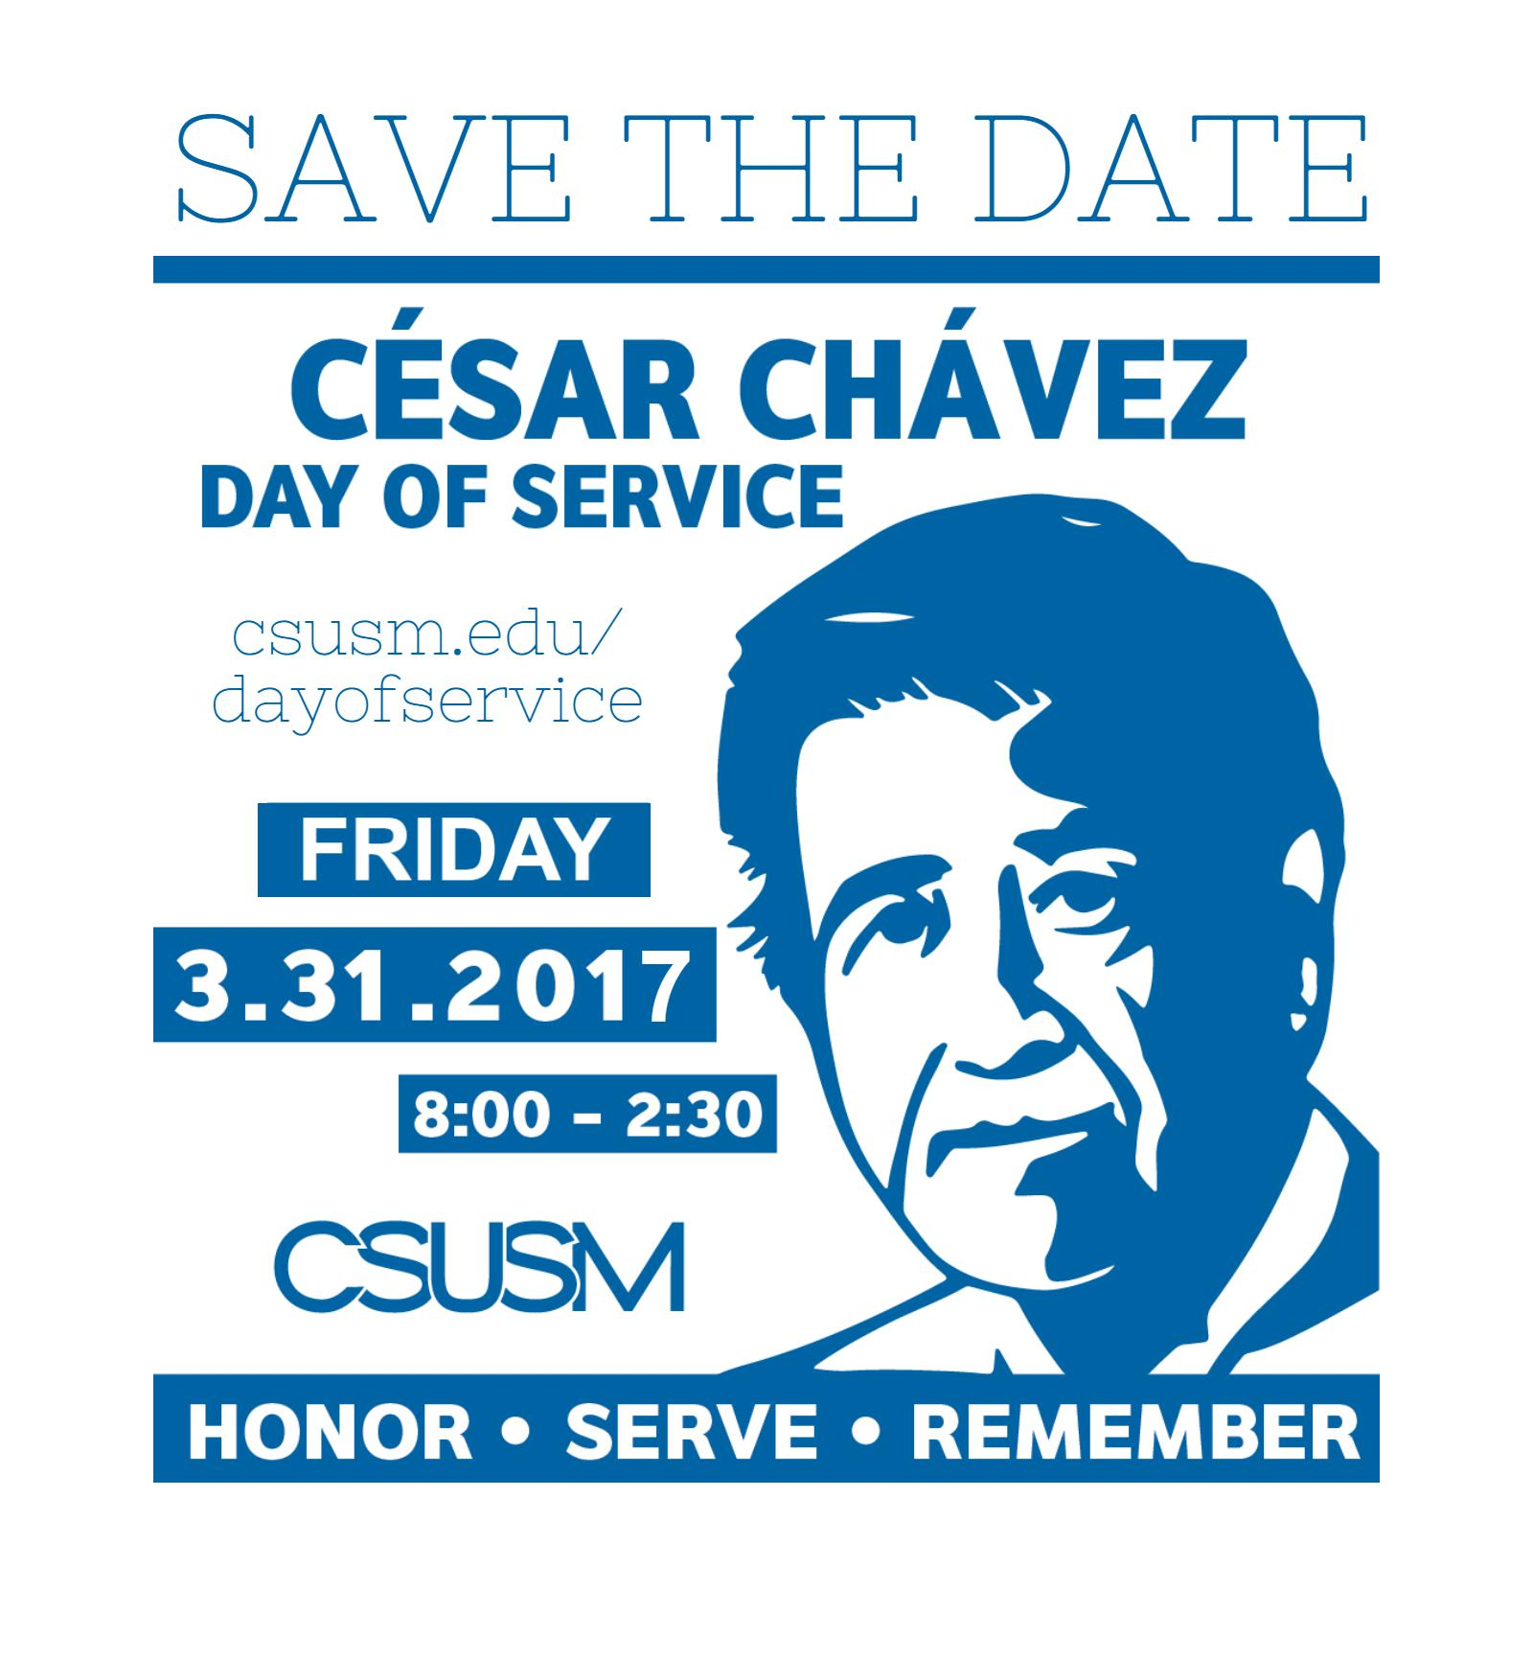
More information on how to get involved is posted on the
Community Engagement website.

Slide 20
César Chávez Week 20th Anniversary Planning Committee
Maria Mendoza-Bautista, Associate Director of Latin@ Center
Dr. Cynthia Chávez Metoyer, César Chávez Planning Committee Chair; Faculty Director of the Office of Internships; Professor, Political Science.
Melanie Chu, Outreach Librarian; Common Read Coordinator
Minerva González, Director of Pathways to Academic Success and Opportunities (PASO)
Floyd Lai, Associate Director of Multicultural Programs
Dr. Carmen Nava, Professor and Chair, History
Dr. Ben Nienass, Assistant Professor, Political Science
Dr. Arcela Nuñez-Álvarez, Research Director, National Latino Research Center
Dr. Rebeca Perren, Assistant Professor, Marketing
Dr. Kimber Quinney, Assistant Professor, History; Campus Coordinator, American Democracy Project
Laurie Schmelzer, Student Services Professional, College of Science and Mathematics
Lourdes Shahamiri, Catalog and Curriculum Coordinator, Academic Programs
Ariel Stevenson, Diversity Coordinator, Office of Diversity, Educational Equity and Inclusion

