Slide 1
University Police
Robert Williams
Emergency Manager

Slide 2
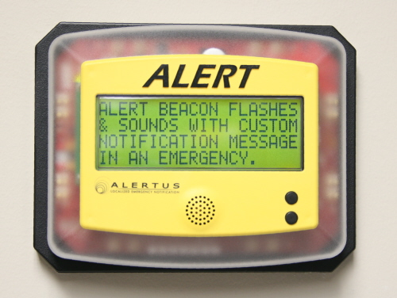
Emergency Notification
System
Only Used for Campus Emergencies
* Cell Phone - most important communication method of the system. Smart Phone technology enables you to receive texts, calls and/or emails anywhere on or off campus.

Slide 3
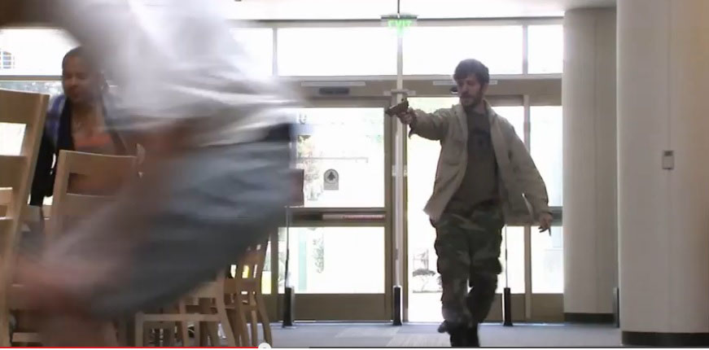
Shooter on Campus
Situational Awareness
Hearing or Seeing active gun fire or you can see the assailant in your immediate area
Not Hearing or Seeing gun fire or commotion in your immediate area

Slide 4
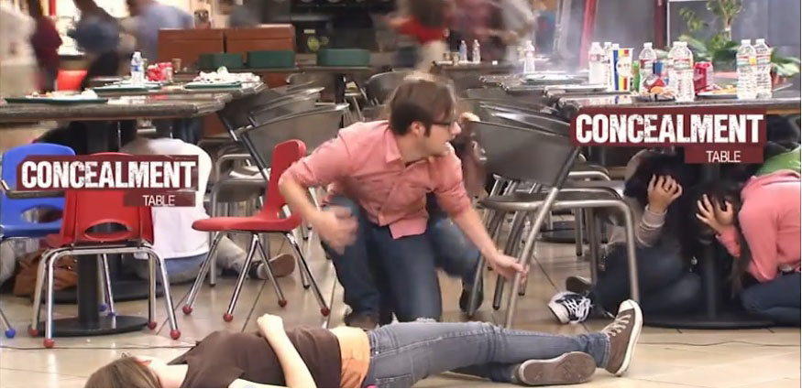
Shooter on Campus
Hearing or Seeing Assailant - Active Gun Fire
Try to find a way out of the location
Use cover and concealment or any available means to get out
If you can’t move safely out of your location, hide or get to a room or area where you can lock down

Slide 5
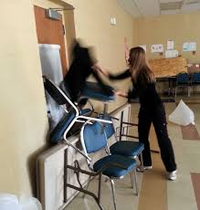
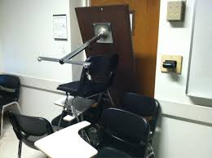
Shooter on Campus
No Active Gun Fire or Commotion
Stay calm, quickly move to an area or room where you can lockdown (Safe Room)
Identify Safe Rooms in advance

Slide 6
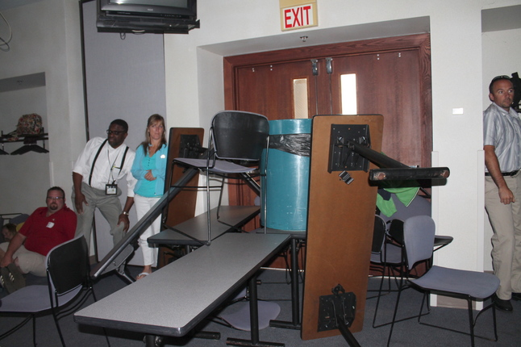
Identify a Safe Room
Lockdown and Barricade (Classroom - safe room)
Stay away from windows
Turn off all lights
Silence cell phones, check for alert notifications and updates
Make a plan, work together

Slide 7
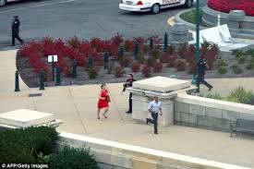
If Outdoors
If outdoors move quickly, try to seek cover (walls, cars, even bushes if necessary)
Exterior building doors and doors on card access system will lockdown
If possible, move to the exteriors of the campus or even off campus

Slide 8
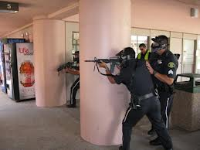
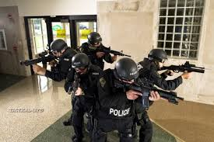
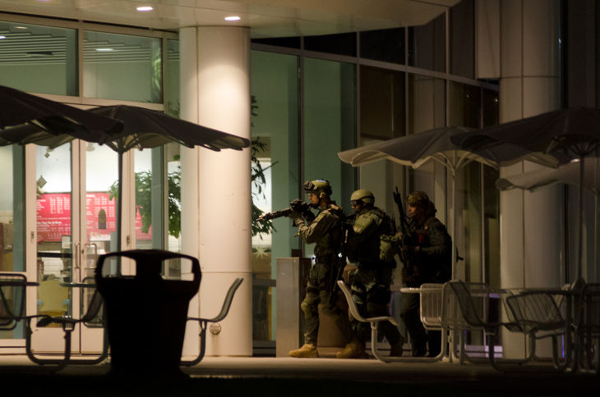
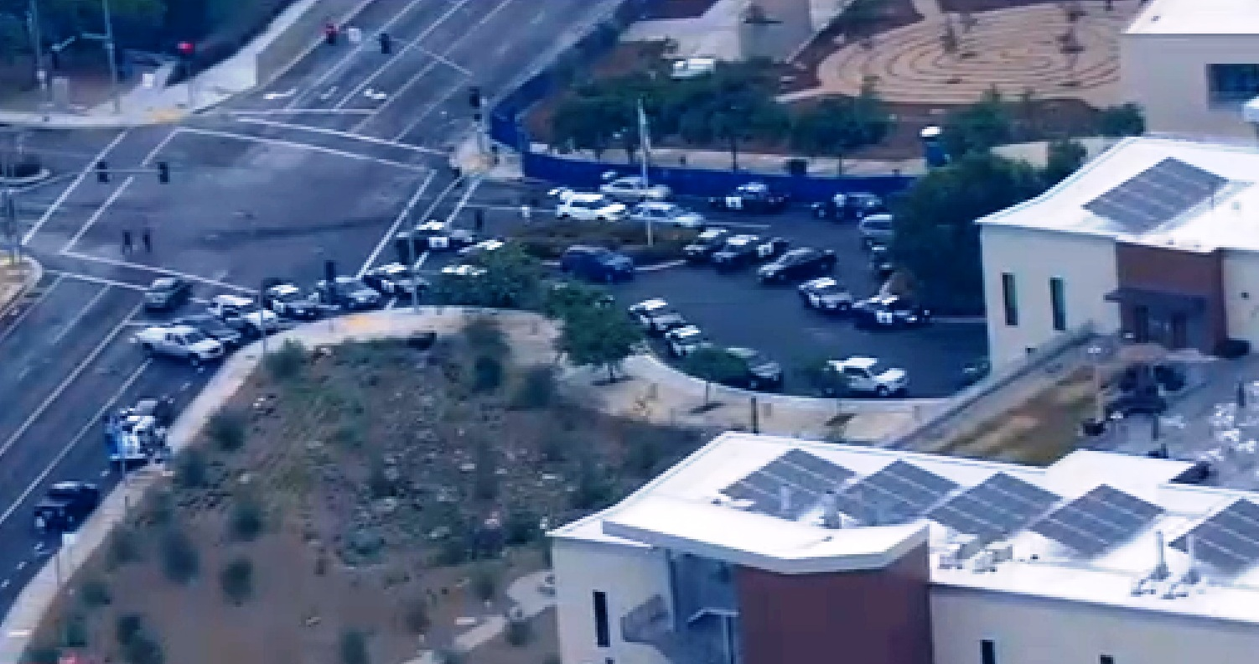
Police Response
If you encounter a police response:
Remain calm, keep your hands visible at all times
Put down any objects you may be carrying
Avoid yelling, screaming, or running toward officers
Officers may shout commands, follow their instructions
First officers on scene will not stop to help injured or help evacuate the building

Slide 9
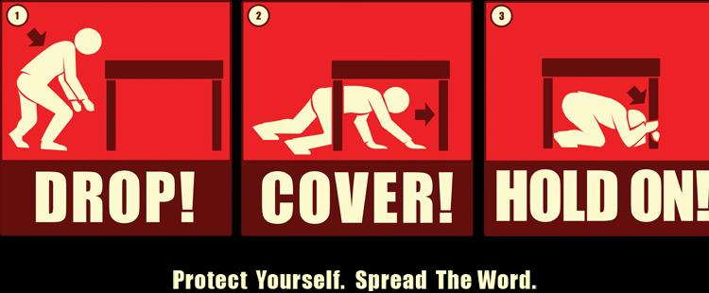
Earthquake
Drop - Drop to the floor.
Cover - Take cover under a sturdy desk, table or other furniture.
Hold – Hold On
If you are in a hallway, drop to the floor against an interior wall—protect your head and neck with your arms.
If you are with visitors, shout “Earthquake! Duck, Cover and Hold!”
Do not enter or exit the building during the shaking - there is danger from falling debris.
Do not use the elevators.
Do not re-enter building until given all clear.
BE PREPARED FOR AFTERSHOCKS!!

Slide 10
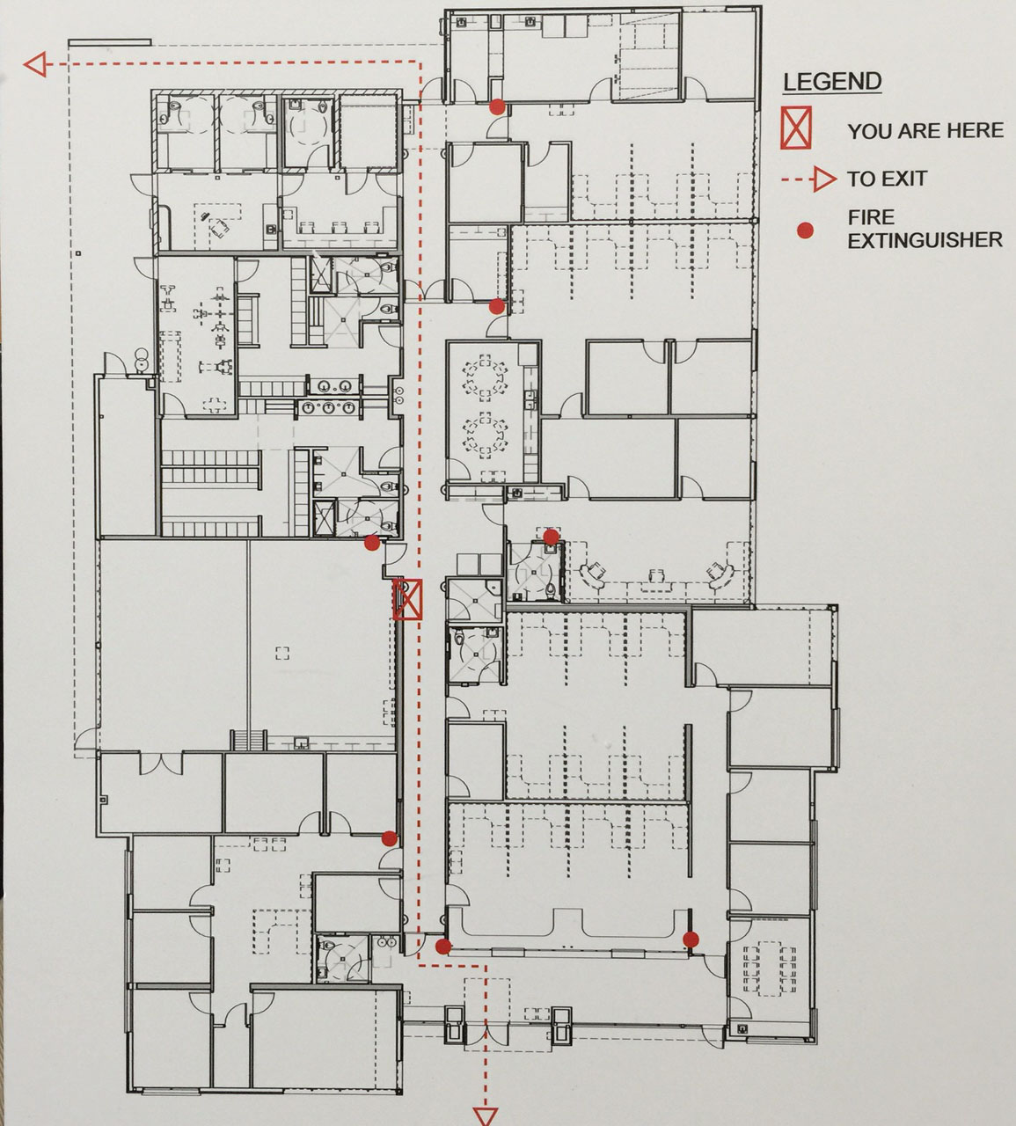
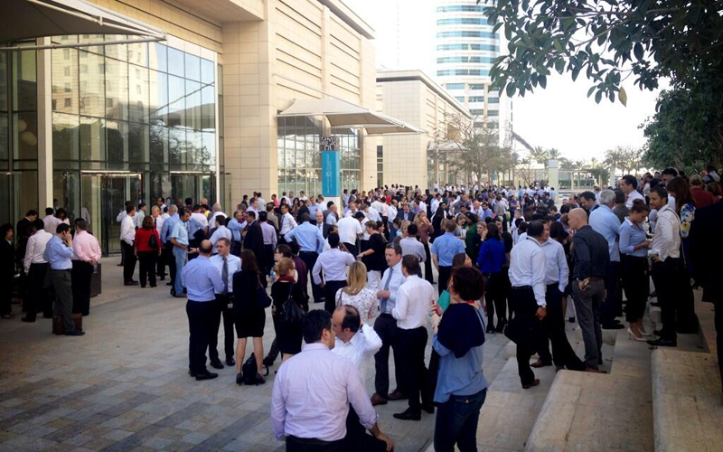
Building Evacuation
Fire, Odors, Hazardous Materials, etc.
Take valuables (keys, purses, laptops)
Walk quickly to the nearest exit, do not use elevators
Proceed to evacuation zone
Keep walkways and roads clear for emergency personnel and vehicles
Never re-enter building until given all clear

Slide 11
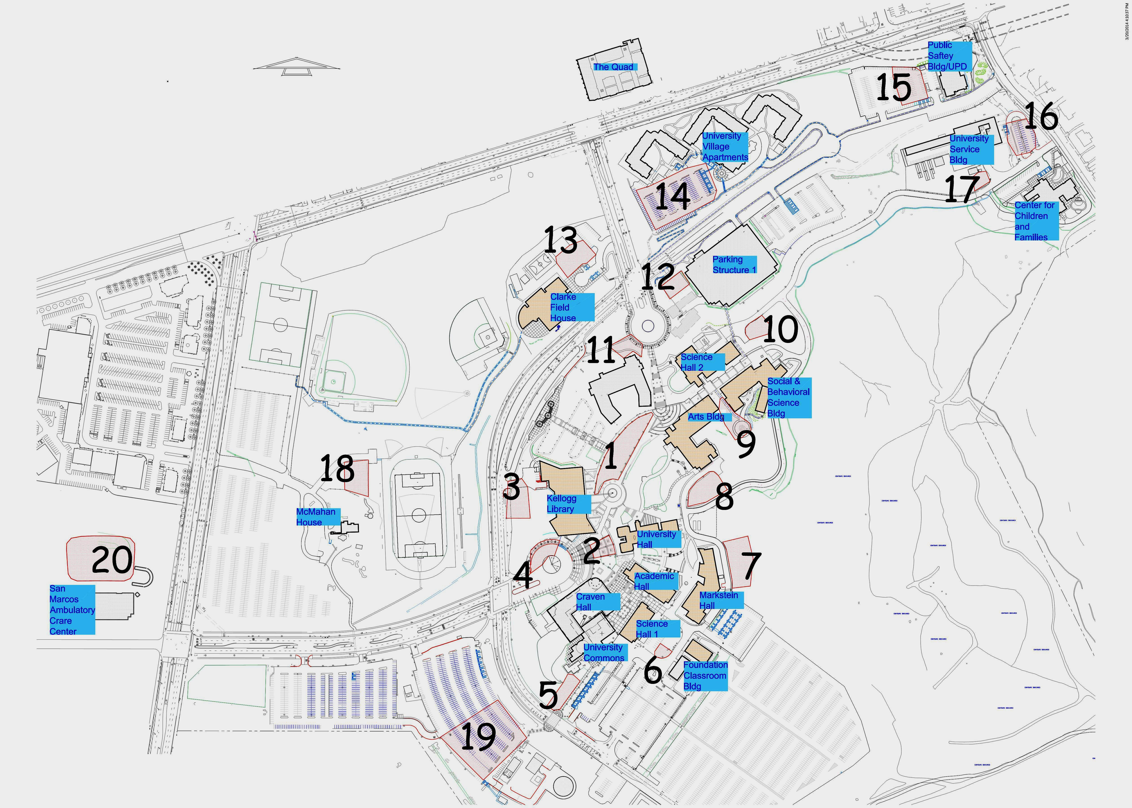
Evacuation Zones
Find location closest to your building

Slide 12
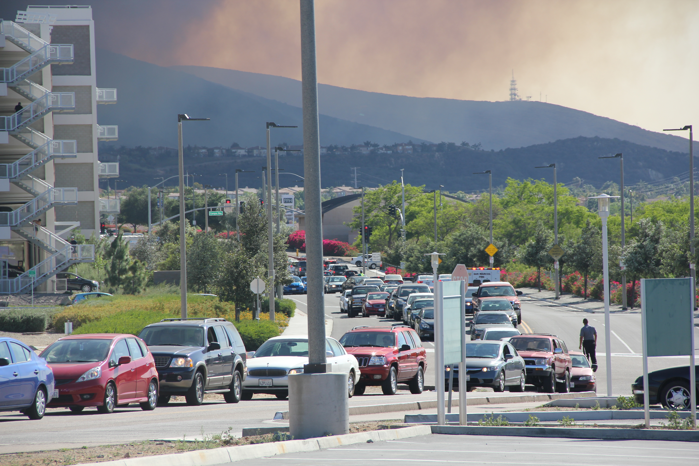
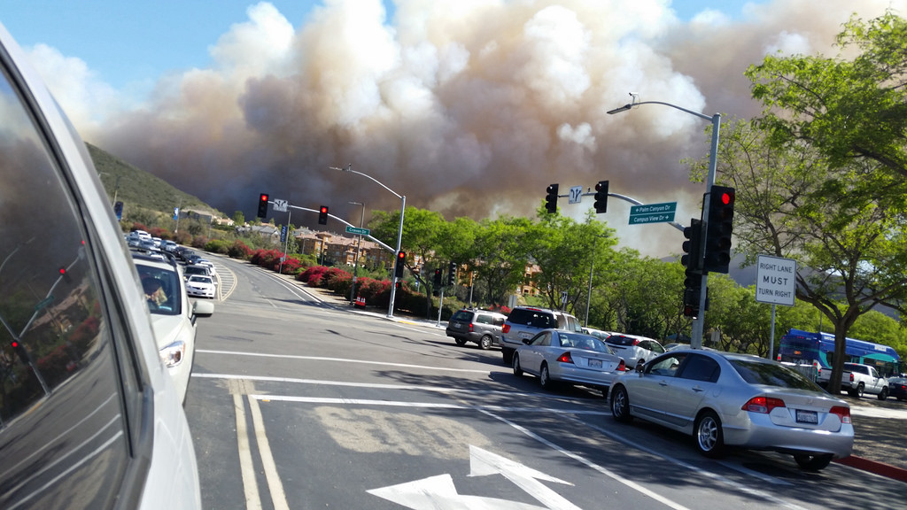
Campus Evacuation
Full campus evacuation - (Emergency Notification)
Make sure to take your valuables (cell phone, IPad, laptops, etc.)
If you do not have a way off campus, buses will be provided
Be patient!
Never re-enter campus until evacuation is lifted

Slide 13
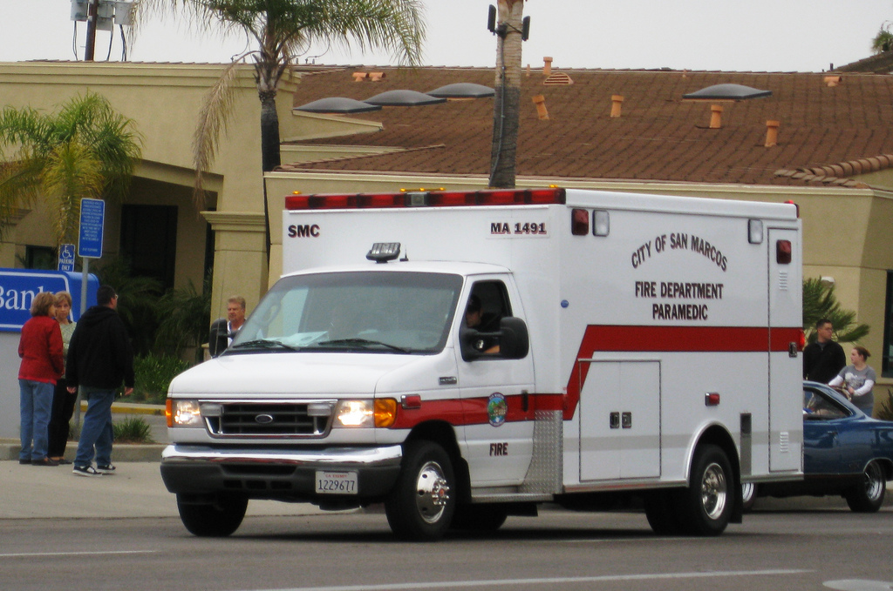
Medical Emergencies
Immediately contact University Police for all medical emergencies or injuries
Give your name.
Describe the nature and severity of the medical problem.
Give the campus location of the victim.
Provide an estimated age and gender of the victim.
Describe whether or not the victim is conscious and breathing.
Look for emergency medical ID and give all information to the Police or Dispatcher.
NOTE: All University Police Officers are trained in basic first aid, CPR and AED use.

Slide 14
Violence Prevention
Our Campus has a Violence Prevention / Student Response Team:
Work through incidents that may threaten the safety and well being of students, faculty, staff and the campus
Help prevent future incidents from occurring
Violence Prevention Representation
University Police
Human Resources
Disable Student Services
Legal Council
Academic Affairs
Student Housing
Student Health and Counseling
Student Affairs
UARSC
Student Response Team
Dean of Students
Student Health and Counseling
University Police
Housing
Student Life and Leadership

Slide 15
QUESTIONS?
Douglass Miller
dmiller@csusm.edu
760-750-4553
Robert Williams
rwilliam@csusm.edu
760-750-4503

