Slide 1
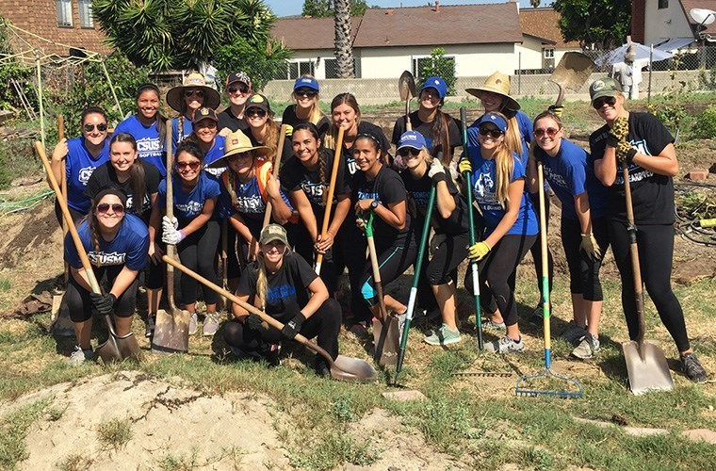
CSUSM Softball Digs Community Service
Notes:
The Cal State San Marcos softball team volunteered with the North County Community Services' Edible Garden Project on Saturday morning in Oceanside.
The Cougars dug up and restructured old garden beds so seeds can be planted to feed underprivileged preschoolers in North San Diego County. The also cleaned, organized and hauled supplies in preparation of building a new shelter.

Slide 2
Topics
Goal 1 → Graduating Our Student-Athletes
NCAA Eligibility Requirements
NCAA Progress toward Degree
Academic Support Resources
Your Involvement

Slide 3
Our Student-Athletes
54.5%
3.0+ GPA Spring 2015
273
11 4.0 GPA Fall 2014 or Spring 2015
13
Teams
56
3.5+ GPA Fall 2014 or Spring 2015
$700k+
Scholarships

Slide 4
NCAA Transition Timeline
2014-15 Year 1 Candidacy
2015-16 Year 2 Candidacy
2016-17 Year 3 Provisional
2017+ Active Member

Slide 5
NCAA Eligibility Requirements
12 units minimum enrollment per term
2.00 GPA minimum: campus and cumulative
24 units per year
6 units max from summer
As of Spring 2016 -- Pass a minimum of 9 units per term

Slide 6
NCAA Progress toward Degree
Juniors and Seniors must take courses toward a declared major
Proactive educational planning
Major prep course sequence
Meeting with Faculty Advisors

Slide 7
Academic Support Resources
Dept of Athletics Mentoring Program
Tutoring
Campus Support Resources
Mid Semester Progress Reports

Slide 8
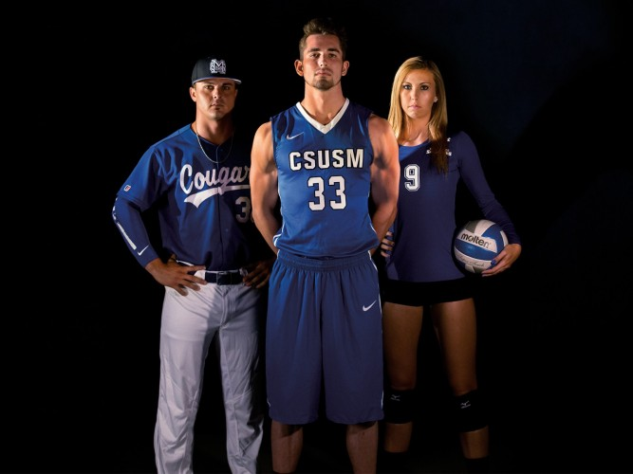
Your Involvement
Complete the Mid-Semester Progress Reports
Interest List of Faculty Champions
Reach Out
Ben Cherry bcherry@csusm.edu Faculty Athletics Representative
Todd Snedden tsnedden@csusm.edu Associate AD for Academics
David Nathanson dnathanson@csusm.edu Coordinator, Student Athlete Support Services
Attend an Event

Slide 9
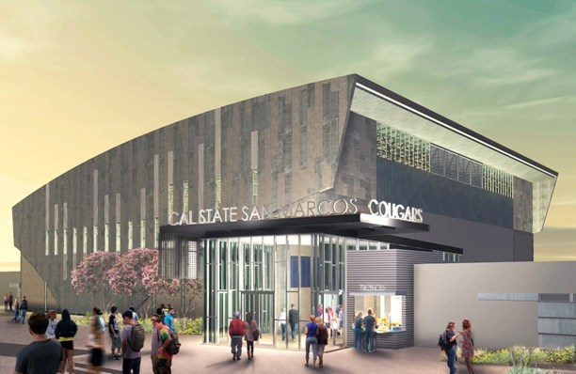
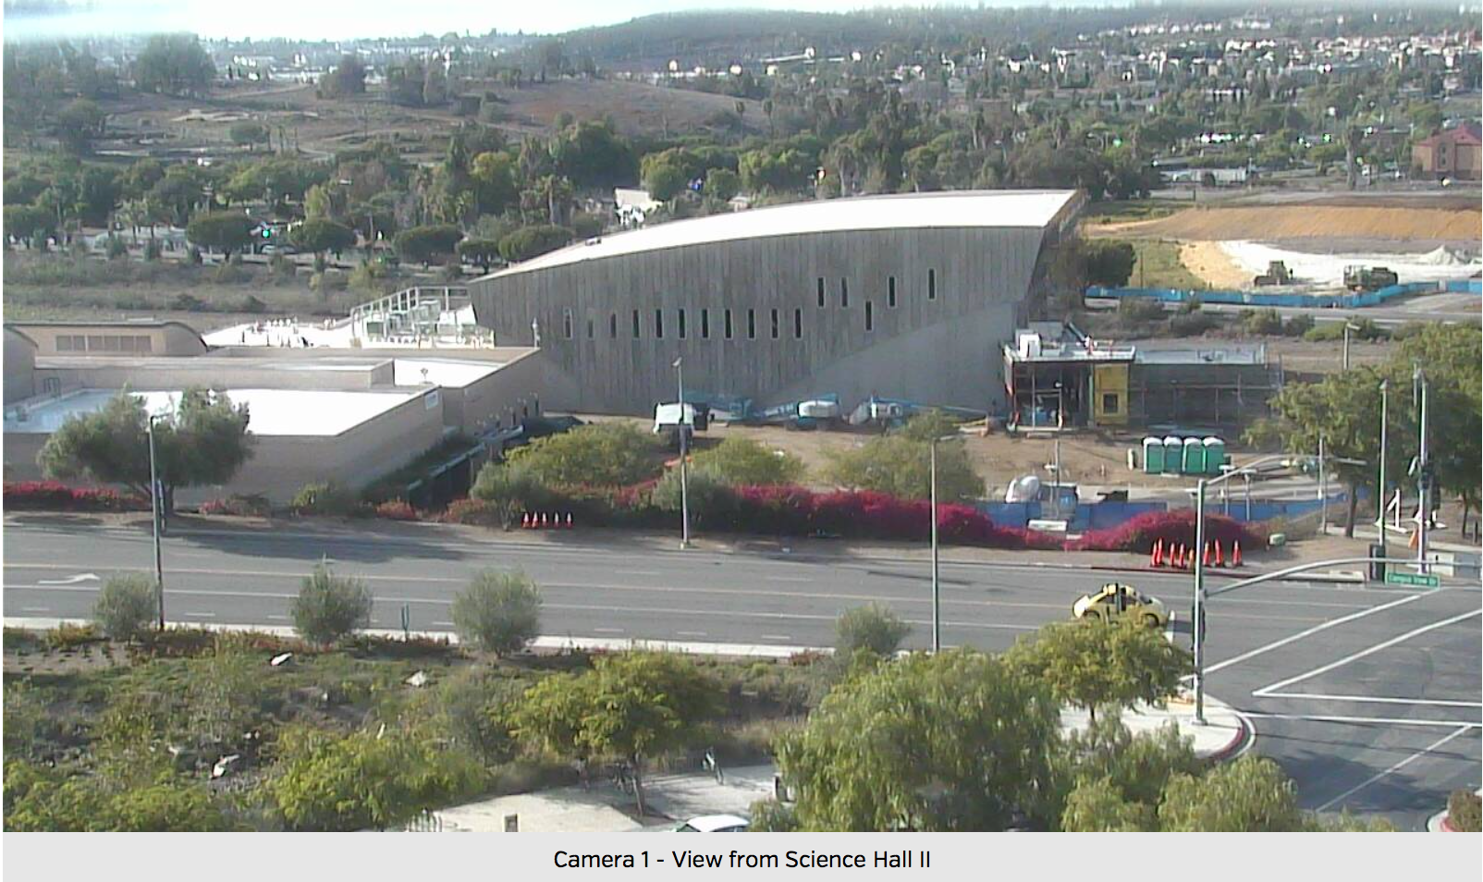
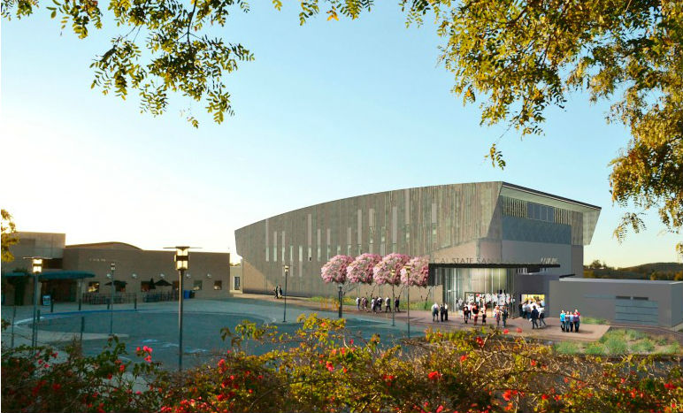
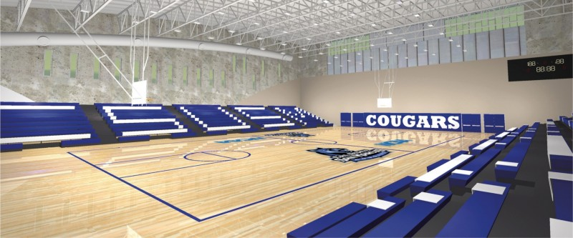
Notes:
The Sports Center, expected to open in Fall 2016

Slide 10
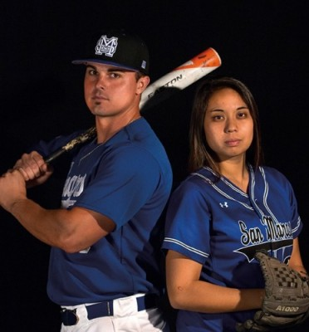
Connect with the CSUSM Cougars
Sports Center Grand Opening Fall 2016
CSUSMCougars.com
Social Media
Twitter @CSUSMCougars
Instagram @CSUSMCougars
Facebook @CSUSMAthletics
Cougar Tracks E-Newsletter

Slide 12
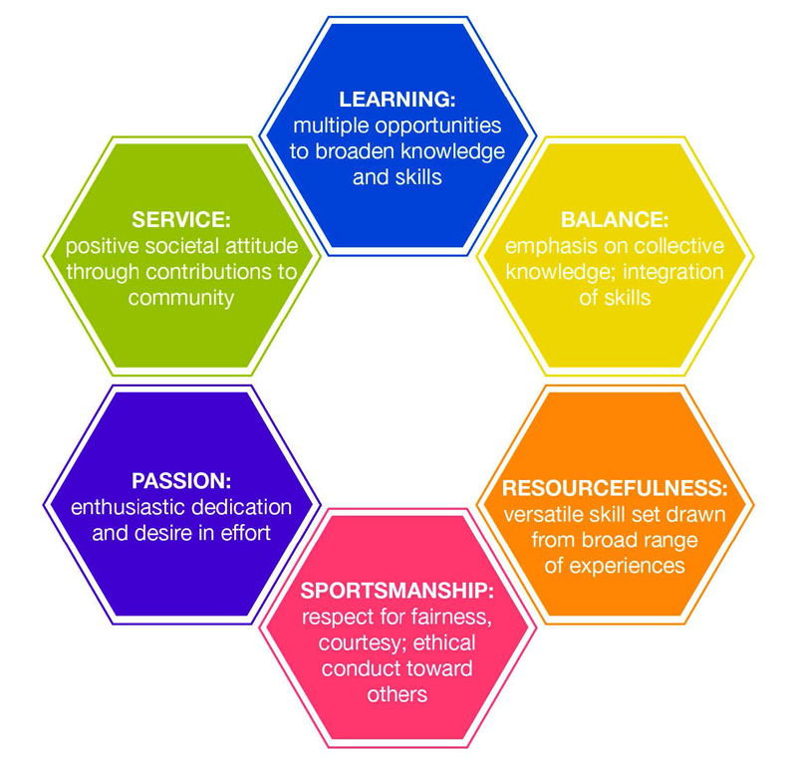
NCAA Division II
Why?
Mission & Philosophy Alignment
“Life in the Balance”
Championship Travel Reimbursement
A good fit

Slide 13
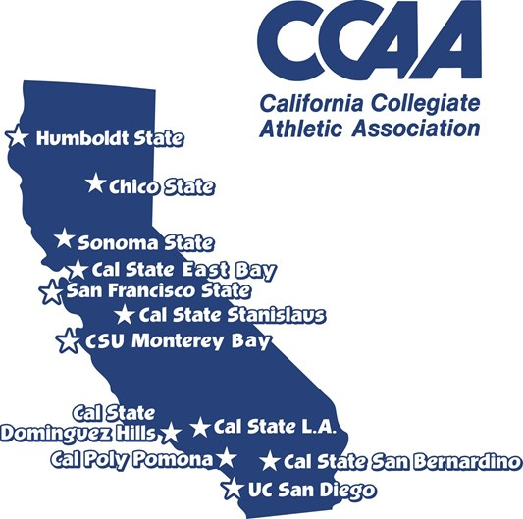
CCAA
Why?
Sister CSUs & UCSD
Regionalization of Competition
Reduction in Travel Time & Costs
Natural Rivalry
Community Engagement
A good fit

Slide 14
Student-Athlete Majors by College
Fall 2015

Slide 15
Institutional Control
President Haynes
Athletics Department Leadership
Faculty Athletics Representative (FAR)
Intercollegiate Athletics Committee (IAC)
Compliance Committee
A model Division II athletics program is:
integral to the educational mission of the institution,
fully integrated in the institution’s operations,
committed to the principle of institutional control,
an extension of the educational mission of the institution,
committed to ensuring that student-athletes learn in the classroom, on the field of play and through the overall experience of being a college student.

