Slide 1
Open Access at Cal State San Marcos
Technology Policy & Advisory Committee
Karno Ng, Chair
Carmen Mitchell, Library
Barbara Taylor, IITS Staff
Sara Bufferd, CHABSS
Fang Fang, CoBA
Kathy Hayden, CEHHS
Adam Petersen, Academic Affairs Staff
Brian Newbury, Student Representative
Rhiannon Ripley, Student Representative
Jennifer Fabbi, Dean, Library
Kevin Morningstar, Dean, IITS

Slide 2
What do you mean by Open Access?
Photo by Thomas Hawk found via Flickr: http://flic.kr/p/s3XTG

Slide 3
What is Open Access?
According to Peter Suber, the Director of the Harvard Open Access Project:
Open-access literature is digital, online, free of charge, and free of most copyright and licensing restrictions.
Open Access removes price barriers (subscriptions, licensing fees, pay-per-view fees) and permission barriers (most copyright and licensing restrictions). The Public Library of Science shorthand definition —"free availability and unrestricted use"— succinctly captures both elements.

Slide 4
What is Open Access?
There is some flexibility about which permission barriers to remove. For example, some Open Access providers permit commercial re-use and some do not. Some permit derivative works and some do not. But all of the major public definitions of Open Access agree that merely removing price barriers, or limiting permissible uses to "fair use" ("fair dealing" in the UK), is not enough.

Slide 5
What Organizations Have OA Policies?
769 organizations worldwide with OA policies:
Countries (UN Geoscheme) (769)
Africa (19)
Americas (197)
Asia (45)
Europe (468)
Oceania (40)
US Organizations include:
University of California System
Harvard University
Duke University
MIT
More at the Registry of Open Access Repository Mandates and Policies: http://roarmap.eprints.org/view/country/840.html

Slide 6
Why would CSUSM want an OA Policy?

Slide 7
Why have an OA Policy?
An OA policy helps faculty to negotiate with publishers.
Don’t give away all of your scholarship to for-profit publishers. Keep some rights to reuse your work!
Increases the visibility of and access to your scholarship and research.
Make research and scholarly output available to anyone with access to a computer and the internet.
Research shows that openly available papers are cited more often: http://sparceurope.org/oaca_table/
One central location for content from the campus.

Slide 8
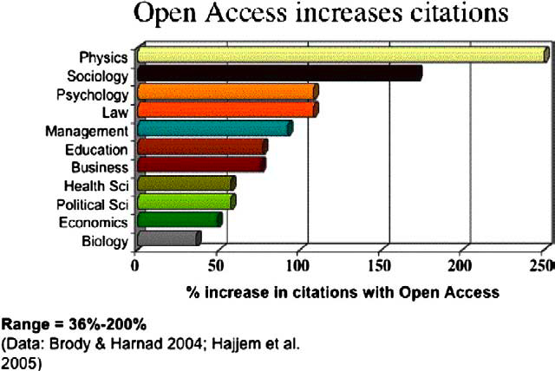
C. Hajjem, S. Harnad and Y. Gingras, “Ten-Year Cross-Disciplinary Comparison of the Growth of Open Access and How It Increases Research Citation Impact,” IEEE Data Engineering Bulletin 28 (4) (2005): 39-47.

Slide 9
Opt out vs Opt in
Opt out: The default for faculty articles is that they will be made available via ScholarWorks. (Also called a “mandate.”)
Faculty may elect to opt-out of the policy on an article-by-article basis with no restrictions.
Opt-out policies may increase rights retention for faculty.
Orgs with opt-out policies have higher rates of article deposits.

Slide 10
Opt out vs Opt in
Opt in: Faculty would have to specify that they want their work to be included in ScholarWorks.
Not the accepted best practice for an OA policy.
http://cyber.law.harvard.edu/hoap/Good_practices_for_university_open-access_policies
Gives publishers more leeway to say “no” when faculty ask to retain some rights to their work.
System is currently in place for faculty members to opt in via the CSUSM Resolution in Support of Open Access.

Slide 11
Opt- in Option
PROS
CONS
Resolution was already approved.
No change in current article submission process to publisher.
Faculty can deposit the article to the library any time.
Library will assist with rights negotiation/contract amendments.
Need to fill out an opt-in form for each article to be deposited.
Minimize faculty participation and reduce citation of faculty work.
Campus communities might have less access to the articles.

Slide 12
Opt- out Option
PROS
CONS
More leverage with publishers for retaining rights.
More articles will be made available with little faculty work required.
Best practice for OA Policies.
Library will assist with rights negotiation/contract amendments.
No restrictions on opting-out.
Need to fill out an opt-out form for each article you don’t want included.

Slide 13
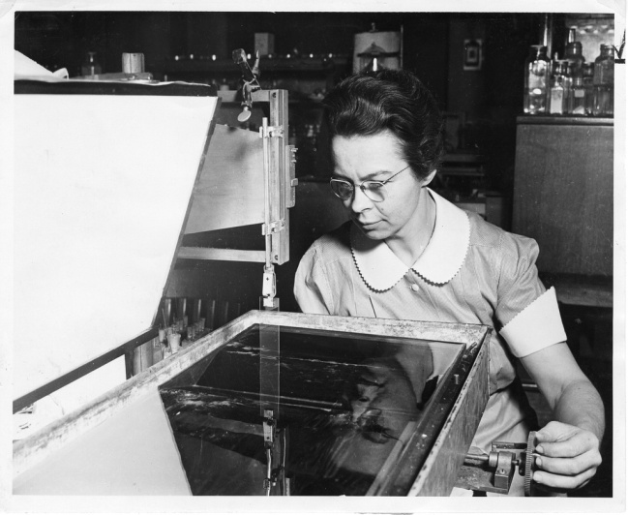
What else to consider?
Promote dissemination of knowledge, which can lead to faster innovations in the sciences and math.
Many funding agencies (like the National Science Foundation) have implemented Open Access Policies that require data and significant findings from grant funded research to be made available over the length of the project and beyond.
Requirements vary by discipline, and funder.
Many organizations utilize their IR to archive and make data sets available.
Photo of Katharine Burr Blodgett from the Smithsonian Institution Archives, found via Flickr: http://flic.kr/p/64C89A

Slide 14
Questions?

