Slide 1
The First Amendment
Free Exercise of Religion
A Case in Point
Notes:
In this unit of study you will become attorneys - and take a true case to court. We will be learning about the First Amendment - Free Exercise of Religion in detail…

Slide 2
Let’s Argue!!!
Notes:
We are going to argue today…but we are not going to grab each other and scream…we are going to review the elements of an argument, and practice civil arguments with one another!

Slide 3
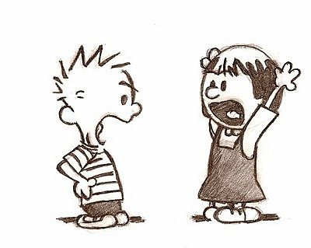
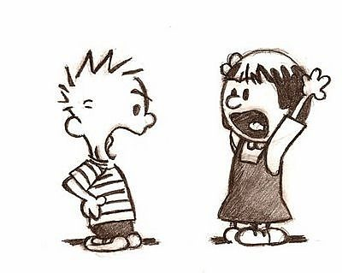
Elements of Argument
Main Argument - introduce at least three claim(s) or arguments and supply evidence and reasons in separate paragraphs for this argument. Use good sources (in this case, the law).
Counter Claims - recognize the other point of view and give reasons against this opposing argument
Conclusion - Summarize the main argument, and give it an extra “punch” that you haven’t already used!
Transitions - Use linking words to give your reasons: for instance, in order to, in addition, specifically
Notes:
These are the steps of an argument you have learned in English Language Arts, and are powerful when applied to a situation such as this court case ! You can pass out Argument Organizer handout.
(Teacher Note: Obviously 12th grade standard asks for more detail, please check: http://www.cde.ca.gov/be/st/ss/documents/finalelaccssstandards.pdf
to revise this slide.)
(Teacher may choose to give this verbal example or practice of an argument with all of the elements)
1. Parent will not allow their teenager to take the car to go out with friends on a Friday night:
• Parent main argument with evidence (reasons): “You may not take the car out tonight, as it is wet, and therefore, the roads are very slick and it would be dangerous. For instance, cars often hydroplane in puddles, and it is more difficult to see due to the glare. In addition and most important, you are not an experienced driver.”
• Parent recognizes a counter claim: “You may say that you will be very careful, so there will not be any problems.” Teacher gives supporting argument against the counterclaim: “To be specific, even if you are more careful, you cannot control other cars on the road, who may run into to you, or cause an accident.”
• Parent gives conclusion for the claim: To take the car out tonight would be unsafe. In order to stay safe, and avoid problems, we will watch Netflix tonight.
2. Ask students to argue this issue above in answer to the parent, follow above slide:
Main Argument- I should be able to take the car out tonight. Specifically……(three reasons which would actually be paragraphs in writing…with evidence)
Counter Claims- I know you say that I am inexperienced, however……
Conclusion- Summarize and use the extra “punch”

Slide 4
Simulation of Case…
An elementary school at recess time…boys are hustling out to get a basketball court for recess time…
Notes:
Setting up the case…Drama vignette. Choose five students in advance and ask them to play out the “drama vignette’ for lesson one. Have them do a short practice before class and see if they can re-enact the setting and incidence that took place, without their notes. Note: The dialogue does not need to be exact, just have them re-enact the main conflict and issue.
Students read about the case: Inform students that this was a true court case that took place…even though it has already been settled, it continues to be controversial today, and members of the law community say that they have no doubt that a case such as this will surface again. What will the outcome be?
Read the facts of the case, because in this unit we will review the First Amendment and you will write your own arguments at attorneys representing either the Cheema’s or the school district. Pass out the Cheema v Thompson Background handout.
Ask students to summarize what they have read.

Slide 5
Case Summary: Cheema v. Thompson
Cheema’s: Three Sikh children who followed their faith by wearing the five symbols: kish, kangha, kachera, kara, and a kirpan.
Livingston school district has a total ban of all weapons from school grounds and refused to allow the children to wear kirpans to school.
Notes:
Teacher’s Note: Cheema v. Thompson, Background, is a secondary source, partly from the actual court and from a newspaper article.
Recap what students just read with this slide
Background: One of the Cheema students was playing basketball when someone noticed that he was wearing a “kirpan”. He was suspended from school, along with his two brothers because the school district has a rule that bans all knives on its campuses. The students were not allowed to come back to school with their kirpans.
The Cheema’s took the school district to court, claiming that this school policy burdened their free exercise of religion.
The court believed that the school district had an important interest in assuring the safety of its students, even though this school rule burdened, or limited the Cheema’s free exercise of religion. Therefore the Cheema’s lost the case.
The Cheema’s took the case to the next level…

Slide 6
So where do we go from here?
Notes:
Where do the Cheema’s go from here?

Slide 7
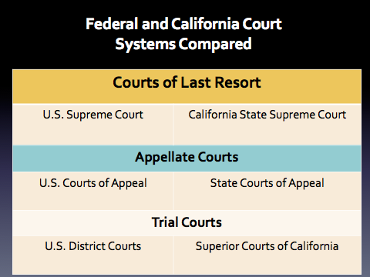
Notes:
Which court? Which level?
The judicial branch has two different systems, federal, and state. (On this slide, note that Federal is on the left and State is on the right) Sometimes, depending upon the conflict, cases go to the state court system, and other times a case may be handled by the federal system. (Explain the structure of the two systems using the above slide).
Which court system would hear this case, federal or state? The Cheema’s lost this case in which court? Check for understanding and hear student answers before going to the next slide.

Slide 8
Federal court cases include:
Cases about a federal law
Cases about the U.S. Constitution
Disagreements between citizens of different states
State court cases include:
Cases about a state law or rule
Cases about the state constitution
Disagreements between citizens of the state
Cases about family issues
Notes:
So which is correct? Federal or state? (This case was heard in a federal court because it was about the U.S. Constitution, the First Amendment.
Review this slide for students, and have them play the iCivics game, Court Quest (designed for middle school; check it out in case you think it may be beneficial for your students at other grade levels). Simply type in icivics.com, (if you don’t want to register, you do not need to), and click on “play”, and then Court Quest.
This “game” can be played as a whole group (depending upon your technical options in class), or each student can play in a computer lab or with ipads. It helps to reinforce which court handles which cases and helps to lead up to the fact that this case on which they will be working will go to federal court because it deals with the U.S. Constitution, the first amendment.
Teacher Note: This is an important understanding (along with the Structure of the Courts), as students must identify which court system they will be engaged with in their trial.

Slide 9
Legislative | Executive | Judicial
Makes Law | Initiates and Administers Law | Interprets and Applies Law
Notes:
As a review, there are three branches of government, all designed to be equal. When we go to court, the rule of law is interpreted and applied, and opinions are heard on both sides of an argument. Which branch wrote the First Amendment? Now that it is going to court, what must the Judicial Branch do? (Make a decision, based on the law, and analyze the first amendment).
Ask what it means to be “impartial”. When a judge and jury are impartial, they analyze all the facts and evidence in the case. They apply laws that relate to the case fairly, without bias, prejudice, or personal opinion.

Slide 10
The Golden Rule of Civic Life: Respect
“Conflict and debate are inevitable in a democracy. If respect and First Amendment principles are to be maintained, then how we debate is as important as what we debate.”
Notes:
Closure: Our Constitution supports debate (argument), and in order to maintain respect for one another, how we debate is as important as what we debate. It is important that we learn to create respectful, civil arguments! We will do so in the next lesson!!

Slide 11
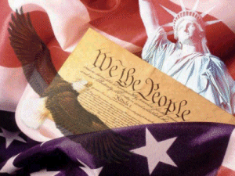
What do we mean by
“Interpretation of the Law”?
Hint:
Notes:
Lesson 3:
Ask students what is meant by “interpretation of the law”. This slide is meant to further reinforce the role of the judicial branch: The Constitution sets the “rule of law”, and arguments in court must be heard on both sides. Decisions are made based on the rules set out by the Constitution. “Interpreting the law” in an impartial way, is the job of the courts.
This is a good time to ask about the role of the other branches of government - slide #9:
Legislative Branch - Makes the laws
Executive Branch - Initiates and Administers Law

Slide 12
Is it Constitutional? ….
Which means….
Is there a law written in our Constitution that guides us when conflicts happen?
“Constitutional”
“Unconstitutional”
Notes:
Clarify what is meant by “constitutional” or “unconstitutional”: The judicial branch, or the courts, try to find out if a rule or law from the Constitution has been broken. Ask students to discuss in a Pair Share what “Constitutional” would mean, and what “Unconstitutional” would mean…discussion.

Slide 13
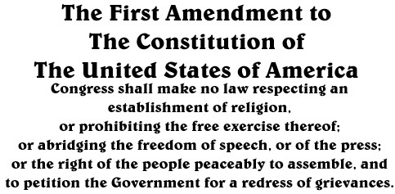
Notes:
Have students read the First Amendment and the freedoms they represent.
Freedom of speech, freedom of the press, freedom of the right to peaceably assemble, and freedom to petition. They also give the right to freedom of religion. (Discuss)

Slide 14
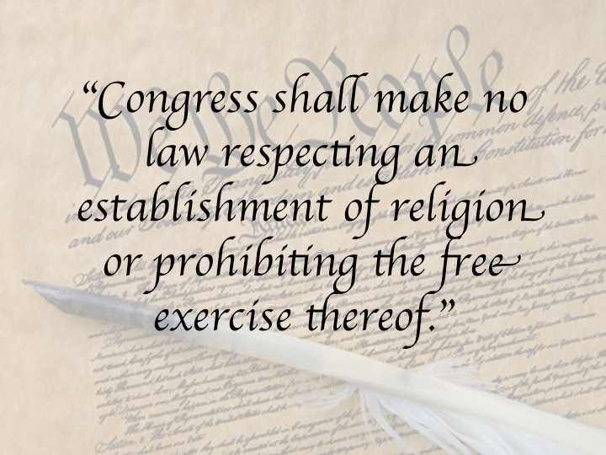
What happens when religious liberty
is at stake?
Free Exercise Clause
Make no law prohibiting free exercise of religion
Notes:
Teacher note: This slide coincides with the lesson activity and handout, “In Your Own Words”.
In schools, this means that the school may not make rules or take action that keeps people from practicing their religion. This is called the Free Exercise Clause: people are free to exercise their religion.
Pass out the handout, “In Your Own Words”, and have students pair/share as they determine the words and phrases of this clause, and then write down what they believe the meaning to be. The text is very difficult and requires thought and discussion on the part of all students as they analyze the meaning.

Slide 15
What happens when religious liberty is at stake?
Establishment Clause
absolute, no law
not even laws respecting or about an establishment of religion
Notes:
Teacher note: This slide coincides with the handout “In your own words”.
It gets even more involved! In schools, this means that the schools may not make rules that establish a religion or are about a religion. What do you think is meant by “establish” a religion, or “respecting an establishment of religion”….continue discussing and completing the handout with your partner.

Slide 16
Establishment and Free Exercise Clauses
Provide the legal basis (laws) for religious freedom in the United States,
Together, the two clauses are intended to ensure fairness and neutrality in the schools with respect to religion,
Bottom Line: Schools cannot advance nor inhibit (prevent) religious faith.
Notes:
Ask students to use their own handout and turn to a different partner, sharing their interpretation from In Your Own Words…do we agree? Discussion with new partner
The entire group can discuss and provide summaries for these two clauses of the First Amendment, bringing closure to the third lesson.

Slide 17
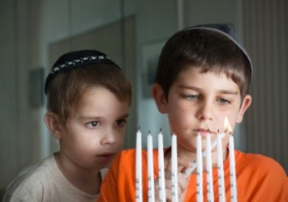
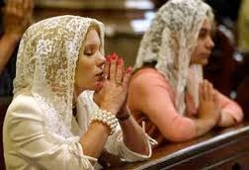
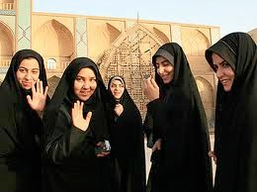
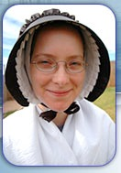
First, let’s take a look at different religions, and some of their traditions and dress.
Notes:
Lesson 4: Let’s look at some background to be considered here in understanding this case….some religious practices and traditions of faith that may be familiar to us, relating to freedom of religion are pictured on this slide.
Catholic women wear a veil as a act of humility to God.
Jewish wear the Yalmukah, signifying that God is always above them.
Many Islamic women dress modestly.
Amish women wear plain dress, including bonnets.
Many Christians wear a cross.

Slide 18
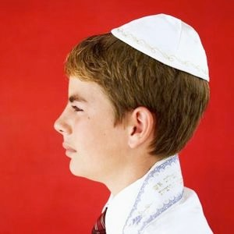
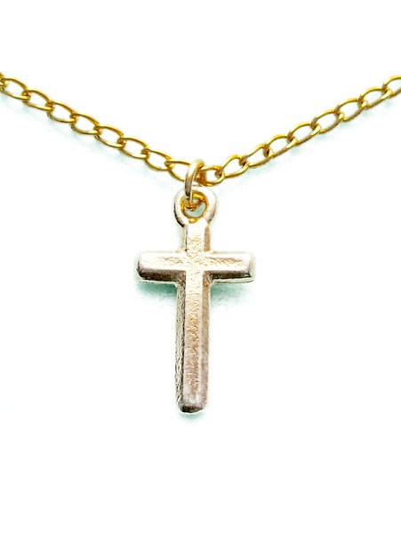
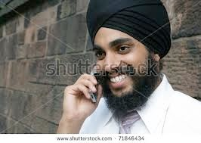
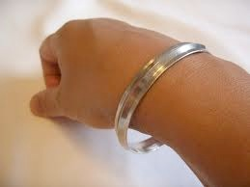
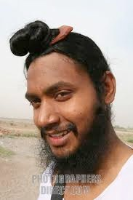
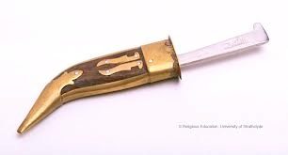
Sikhs: Five Articles of Faith
Kesh: hair
Kanga: comb
Kara: bracelet
Kirpan: sword
Kachera: undershorts
Notes:
The Sikh (Seek) religion may not be as familiar to you. It is from India…Sikhism, which came into existence about 350 years ago, is a religion that emphasizes doing good deeds. Some of their beliefs involve the five articles of faith. The men must follow and wear these articles of faith everyday:
Kesh - Living in harmony with God’s will, hair is kept in a turban to protect it.
Kanga- The Sikh keep their hair groomed and clean, the way God made them.
Kara - They wear the bracelet to symbolize restraint from evil deeds.
Kirpan = This small steel blade, kept in a sheath is an emblem of courage and self-defense, it symbolizes their readiness to defend the weak and innocent.
Kachera - This is an undergarment or under-shorts, to serve as a reminder of self restraint.
Ask students…Does it help for us to understand the differences of all of these religions? Why or why not? What does the first amendment to the Constitution say about religion?
Reinforce: We may all have our own religion, we have that freedom, given to us by the first amendment of the Constitution. Even though we do not believe the same as another person, we must respect the right of everyone to believe their way and they must respect your right as well..

Slide 19
Which Court?
Federal Court
A case about the First Amendment of the Constitution
Notes:
Students may read Cheema v.Thompson, Background Handout again, and ask them if they remember in which court this case must be heard, now that the decision is being appealed by the Cheema’s. (Slide 7, Structure of the Courts might be reviewed).
As you read in the background of the case, the district court believed, after considering the questions that must be asked regarding Freedom of Religion, that the school district had an important or compelling interest in assuring the safety of its students even though this school rule burdened, or limited the Cheema’s free exercise of religion. Therefore the Cheema’s lost the case in the U.S. District Court.
The Cheema’s took the case to the next level, the U.S. Court of Appeal. Why is this a federal court case? (Deals with the U.S. Constitution)

Slide 20
First Amendment
Does this case deal with the “establishment” of a religion?
Does this case relate to “free exercise”?
Notes:
Now that we know which court system handles this case, we need to know as attorneys, what we are dealing with? Which part of the First Amendment, Freedom of Religion does this case relate to?
If necessary, have students use the handouts they completed In Your Own Words – review the meaning of establishment and free exercise…

Slide 21
Free Exercise
Notes:
Yes, free exercise.
Closure: Ask students why? Ask students to share why this case deals with Free Exercise, rather than Establishment – Summarize with a partner, and then share out as a closure to this lesson.
(The Cheema’s have claimed that their right to practice (or free exercise) the Sikh religion (by wearing the articles of faith), has been taken away (denied). So they took the school district to court, with the claim that it is unconstitutional to have a rule at school or law that keeps them from their right of free exercise of religion.)
As attorneys you will be assigned to represent the plaintiffs in the case (Cheema’s), or the defendants (Thompson, school district), you will need to understand exactly how to interpret the Free Exercise Clause and argue for your clients.

Slide 22
Free Exercise Clause
Three questions must be asked when a law is made regarding practicing freedom of religion:
1. Has the religious freedom been burdened or taken away by government action or law? If the answer is yes, ask:
Notes:
As attorney’s we must know more about the Free Exercise Clause, as there is more than one question to be considered
This part can get tricky…we will review it, and then apply it to the case so that it makes more sense! When a law is made (or a rule from a school) about freedom of religion, and there is a question whether the law prevents the free exercise of religion, three questions must be considered by the appellate justices.
If the answer is no to all questions, then the law or rule at the school is constitutional. The answers to all three questions must be considered, before a decision is made about the free exercise clause.
You must take notes and know the three questions as they are presented to you.
Number 1 Question:
Has the religious freedom been burdened or taken away by government action or law? It is unconstitutional to take away the freedom, so if the answer is yes, another question must be asked:

Slide 23
Free Exercise Clause
2. Is there a “compelling state interest” that justifies the action (is there something so important to the state or the government (school district) that makes the action okay)?
Notes:
The second question: Is there a compelling state/government interest that would make taking away the kirpan okay? (ie: Safety of the students). If the answer is no, then what the school district did would be considered constitutional. If the answer is yes, it would be considered unconstitutional and more questions must be asked.
In this case, did the school district argue in court that there was a compelling state interest that made it okay to take away the Cheema’s religious rights? What was that interest? (Safety of the students)

Slide 24
Free Exercise Clause
3. Is there any way the government (school) can be satisfied about this important issue without restricting the religious liberty? If answer is “No”, then what the school did was constitutional.
If the answer is “Yes”, there is a way the government (school) could be satisfied about it’s concerns and in a less restrictive way, (in another way other than taking away the kirpan), then the action would be considered unconstitutional.
Notes:
The last question must be considered. Please read question number three. What do you think is meant by “satisfy without restricting the religious liberty?”
Explain “less restrictive”, or restricting religious liberty: Is there any way the government can be satisfied, could they have done something else to solve the problem, without taking away the religious liberty? If the answer is “no”, then what the school district did was unconstitutional, (they should have tried to provide a way to work it out).
If answer is “yes”, what they did in this case, (suspending children and not allowing them to wear the kirpans to school) was constitutional.
In other words, the government must try to find a way to satisfy it’s concerns (least restrictive), to make something work, so that the religious exercise can still take place.

Slide 25
What three questions must be asked when the free exercise of religion is challenged in court?
Notes:
Turn to your partner, and discuss the three questions that must be asked when the free exercise of religion is challenged in court. Share out with entire group, assessing understanding by observation of participation and comments of the students.

Slide 26
Attorneys at Work
Notes:
Hook: Tell students that they are now going to become attorneys, or teams of attorneys, and they will be assigned to represent either the plaintiff in this case. Which is? (Cheema’s), or the school district (principal’s name: Thompson). If the Cheema’s are the plaintiff’s, (complaining about an issue), what is the school district considered to be in this case? (defendants – defending their actions)
Writing Arguments (40 minutes, 2 sessions)
Students write their own briefs independently, and have them checked by the teacher. They make revisions, using the rubric and teacher comments. (Use Handout: Three Questions from lesson one, and Graphic Organizer from lesson one.) Students should be told that as attorneys, their role is to argue for their clients, and they must make the strongest most detailed arguments, backed up by the law (in this case, the three questions in the First Amendment).
Depending on writing skills, this lesson will take a couple class sessions and homework time. When strong written arguments are completed, it is time to put attorneys in teams.
Final copies of arguments are submitted to the teacher, using the Handout: Brief Form.

Slide 27
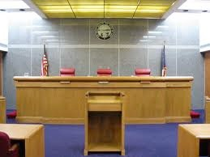
Notes:
This is what a Court of Appeal looks like at the federal level…three Justices listen to the oral arguments, and ask questions of the attorneys about the case as it applies to the law. The appellate court process does not have witnesses, as this has already been addressed at the district level. The justices have reviewed the case and all documents thoroughly already, exactly WHAT the Appellate Justices are trying to determine is whether or not the decision by the trial court was correct, in favor of the school district, stating that the school’s compelling reason (safety of the students) was a stronger need or burden than the Cheema’s loss of religious freedom.
What does it mean to stay in character? What type of behavior is called for in a classroom? Do you think that most judges act like Judge Judy? Discuss the strength of a good argument and civility.

Slide 28
Goal | To represent your clients successfully in the case, Cheema v. Thompson
Role | Attorneys representing the Cheema’s or Attorney representing Thompson (Livingston School District)
Audience | Justices of the United States Court of Appeal
Situation | This case has been taken to appeal after a decision favoring the school district.
Performance | You will submit a written brief to the court and present oral arguments for the case in the appellate court United States Court of Appeals.
Standards for Success | Your arguments will include claims, evidence, counter evidence and cite the law.
Notes:
This is when the lesson becomes authentic. Assign attorney teams of two students. Half of the teams in the class are attorneys for the plaintiff, and half for the defendant.
Each team meets and creates their oral argument in preparation for court (Oral argument handout). They should use their own briefs to refine their oral argument and decide upon at least three arguments they will present from their collective briefs. They will all share a part of their attorney team’s verbal presentation in the U.S. Court of Appeal.
In addition, each team must create at least three questions they anticipate might be asked by the Justices when they are presenting their side of the case.

Slide 29
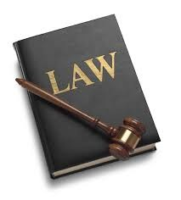
May it please the court….
Follow the introduction on your Oral Argument Handout
“Mirror” the written brief you created:
“First, (your claim)…which introduces three arguments or points”
“To our first point…”
“Which leads us to our second point…”
“Which leads us to our third and most important point…”
“Your honors, we realize that the opposing counsel may claim ______.”
“For these reasons, they are wrong…”
“Thank you, Your Honors
Notes:
Explain to the students that their oral arguments, is not anything new. They are to follow this format Oral Argument format as they address the justices and use the content:
1. Developed on their graphic organizers
2. Written as their individual opinion “brief”
3. Written as a final oral argument as a team of lawyers
Pass out the oral outline format handout which elaborates on the above. Students should practice their oral arguments and decide which part of the team will present each part, showing they are attorneys working together.
What does it mean to stay in character? What type of behavior is called for in a classroom? Do you think that most judges act like Judge Judy? Discuss the strength of a good argument and civility.
Remind students that they must create at least three questions they think the Judges might ask them during their oral arguments. Examples to help students consider in case they are called to serve as the justices are provided on Guiding Questions form.

Slide 30
What was the final decision of the U.S. Court of Appeal ?
Notes:
Lesson 6
Present the slide and ask students to indicate to a partner what they believe the was the final decision of the Court of Appeals?

Slide 31
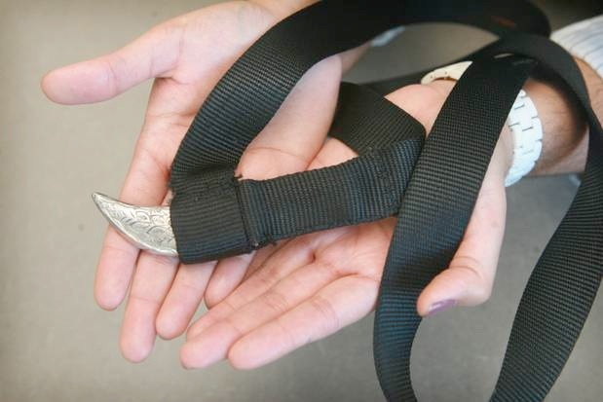
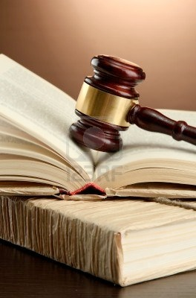
Cheema v. Thompson
Finding by the U.S. 9th Circuit Court of Appeals
Students allowed to wear the kirpans subject to strict limitations such as:
No longer than 3.5 inches
Dulled and sewn securely into a sheath and also a cloth pouch
Limited inspection rights by District
Which question(s) made the Justices decide to say
that it was unconstitutional to deny the Cheema’s their freedom of religion?
Notes:
Ask students to look at their handout on the three questions involving free exercise. Which question did the Justices apply to this case as they reversed the decision of the trial court?
(Question #3: Is there any way the government can be satisfied about this important issue without restricting the religious liberty? If answer is “No”, the law is constitutional.
Ask students what they believe was the thinking on the part of the justices.
The court decided that the district had not tried to make changes so that the students religious rights did not have to be taken away (least restrictive). They made the following rules about the kirpans, and allowed the Cheema’s to return to school.
Students allowed to wear the kirpans subject to strict limitations such as:
• No longer than 3.5 inches
• Dulled and sewn securely into a sheath and also a cloth pouch
• Limited inspection rights by the school district
These cases are not uncommon across the nation - just last year the Jurupa Unified School District created a policy similar to the above - without going to court.
Students may read (with your assistance) the Finding by the U.S. 9th Circuit Court of Appeals. It is more detailed than this slide and may be discussed.
Note: There has not been one case reported where a student of the Sikh religion has used a kirpan in an aggressive manner toward another child!

Slide 32
The Power of Argument
Do you agree or disagree with the appellate court’s findings? Why?
Does the first amendment give us responsibilities as well as rights?
What challenges do juries, judges and attorneys have when conflicts come to court?
Notes:
Small group: Discuss the questions on this slide and take the opportunity to talk about the importance of a civil argument and the right to do so .
Whole group: Small groups share their discussion points.
This is a great opportunity for a discussion on respect, equity and fairness, and the importance of following the Constitution, and the Rule of Law it presents. Ask for follow-up to these questions: why, why not, and examples.
It is challenging for everyone involved to be impartial, and not to “rush” to judgment, especially when something or someone is not familiar to them. All people are equal under the law, and we must work to understand one another, and develop understanding for all points of view! Reminder: Legislature writes the laws, Executive enforces or implements, and the Judicial interprets when there is a conflict.
The law is complicated. For example, all three questions that must be considered in order to decide if the action taken was constitutional or unconstitutional may not have all have a “yes”, or all have a “no” answer. All must be considered before a final decision is decided.

Slide 33
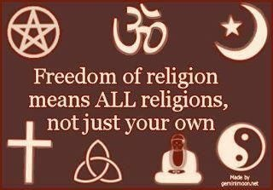
The First Amendment
Notes:
We must remember that our Constitution determines rights and responsibilities of citizens. We all have the right to free exercise - or to practice our religion. We also have a responsibility to respect the rights of all. When conflicts arise, we must turn to our judicial branch to help interpret and apply the laws fairly.

