Slide 1
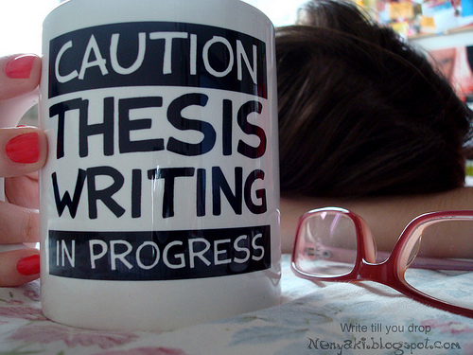
THESES
Notes:
http://3.bp.blogspot.com/-6zcoifnMceQ/T0wlqrdZqlI/AAAAAAAAFQw/z9Y__70XOJo/s1600/thesis-writing.jpg

Slide 2
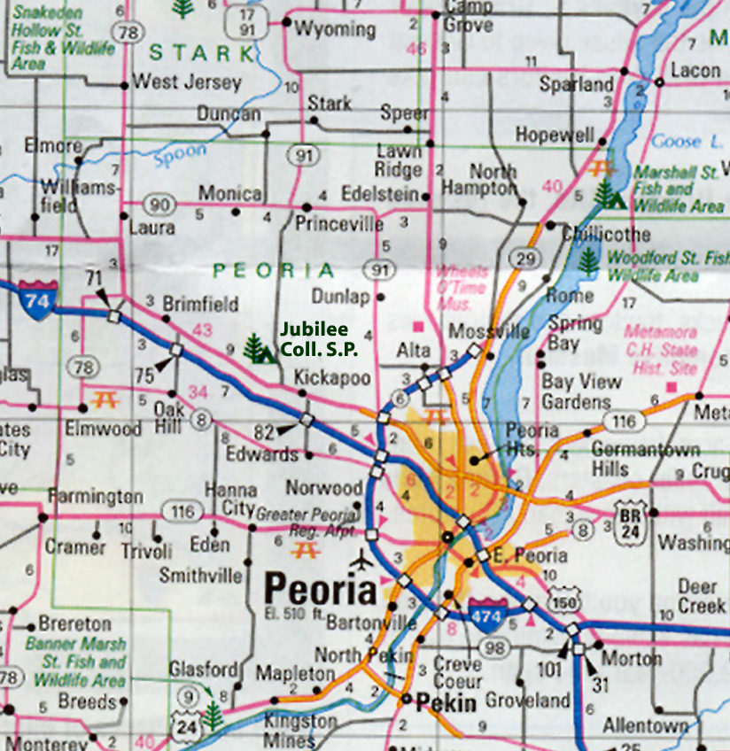
What is a thesis statement?
-A roadmap for your readers
-The central focus of your paper (all your points
should connect back to your thesis)
-A promise you are making to
your reader
Notes:
http://faculty.icc.edu/easc111lab/labs/labe/graphics/roadmap_jubilee.jpg map
http://www.clker.com/cliparts/y/f/Q/v/N/w/wagon-wheel-hi.png wheel

Slide 3
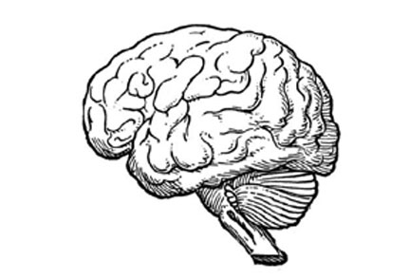
Basic Formula for a Thesis +
Notes:
http://upload.wikimedia.org/wikipedia/en/e/ea/Paper-%266-pencil-iconicWER6T.jpg pencil
http://www.mentalfloss.com/wp-content/uploads/2008/04/brain-sketch.jpg brain

Slide 4
Now let’s look at some common errors...
Notes:
http://fabiusmaximus.files.wordpress.com/2012/12/20121230-no-error.png white background

Slide 5
No Perceptive Point
Original: Schizophrenia patients present as having limited emotional responses.
Revised: Patients with schizophrenia present as having limited typical emotional responses, often helping to identify accompanying symptoms of the illness such as paranoia and delusions.

Slide 6
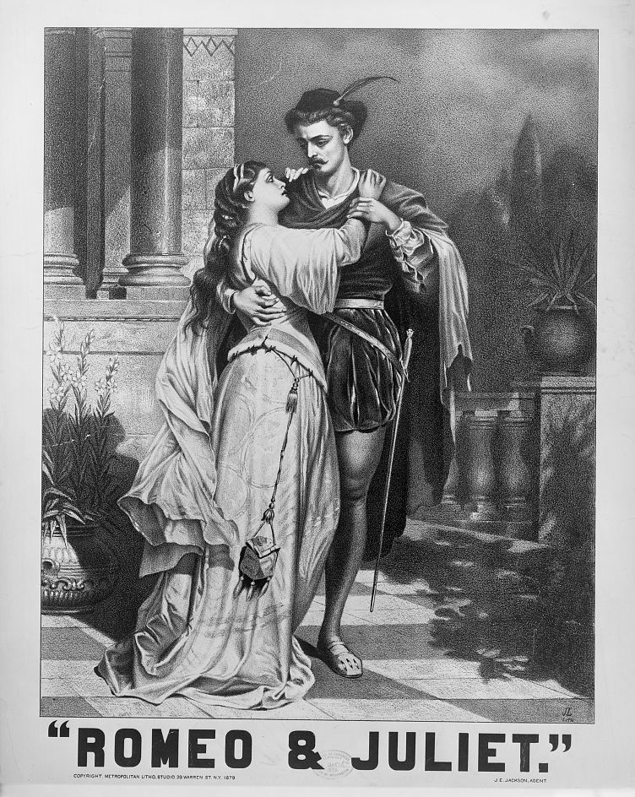
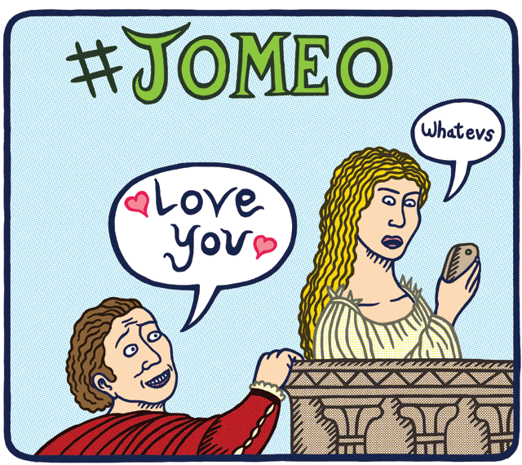
Self-Evident Statement
Original: Shakespeare’s play Romeo and Juliet is a tragic love story.
Revised: Shakespeare’s play Romeo and Juliet presents the view that love redefines the social order.
Notes:
http://upload.wikimedia.org/wikipedia/commons/6/6f/Romeo_Juliet.jpg black and white
http://willainley.files.wordpress.com/2014/03/jomeo.gif #jomeo
https://hammond2011.wikispaces.com/file/view/romeowiki.jpg/291624071/300x183/romeowiki.jpg words

Slide 7
Statement of Fact
Original: Computers have changed the world.
Revised: Most people believe that computers are a welcomed change to modern life, but ironically they have increased rather than decreased the amount of time we spend at work.

Slide 8
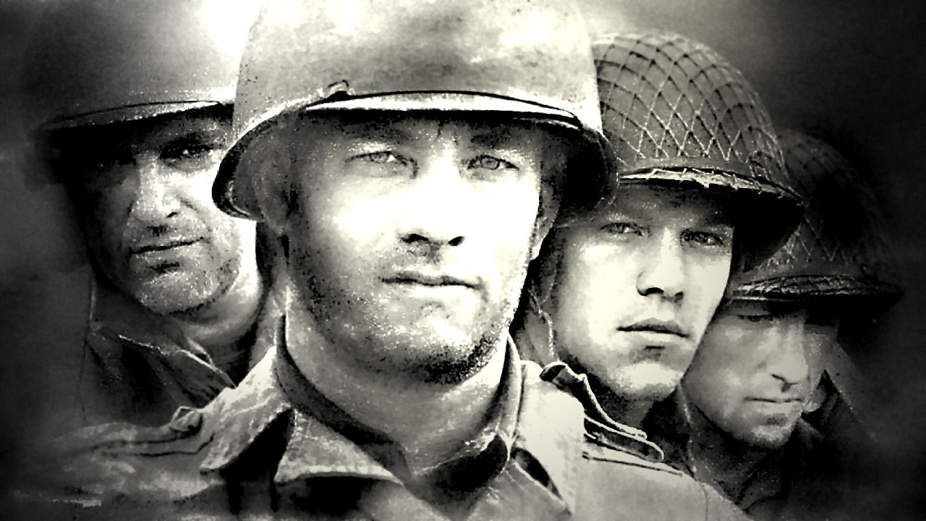
Statement of Summary
Original: Steven Spielberg’s Saving Private Ryan presents the horrors of war.
Revised: Steven Spielberg’s Saving Private Ryan argues that the horrors of war bring out the goodness of humans.
Notes:
http://1.bp.blogspot.com/-EDY_Q2Xnmvk/UX0F9AM1w1I/AAAAAAABEGo/-Pr6X5pzFu4/s1600/Saving+Private+Ryan.jpg

Slide 9
Too Broad
Original: Newspapers cater to the taste of the American public.
Revised: The success of USA Today indicates that people want newspapers that are easy to read and entertaining.

Slide 10
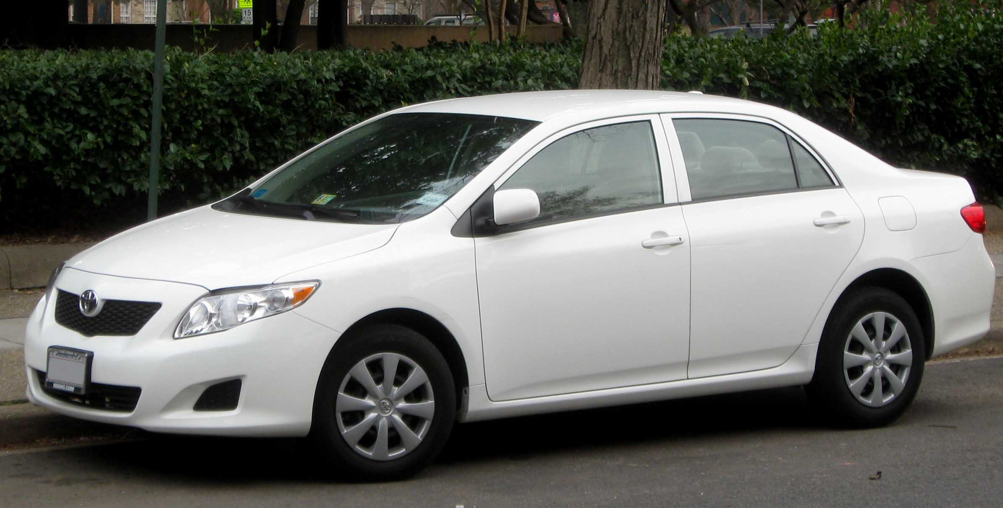
Too Narrow
Original: The colors in the Toyota advertisement represent the connection that Toyota wants its consumers to make between their cars and the preservation of the environment.
Revised: Toyota markets their product by appealing to an eco-conscious consuming audience.
Notes:
http://upload.wikimedia.org/wikipedia/commons/1/17/09_Toyota_Corolla.jpg

Slide 11
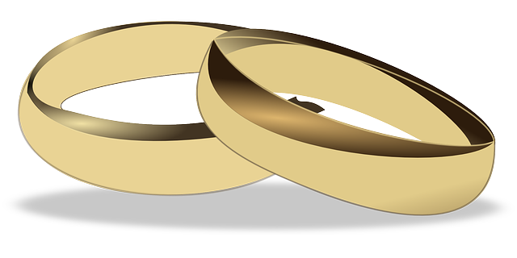
Let’s Practice:
Teenagers should not get married.
Notes:
http://www.csun.edu/~bashforth/098_PDF/ME3_Argument/Thesis/05Sep04Bad%26BetterThesisStatements.pdf
https://pixabay.com/static/uploads/photo/2013/07/12/15/40/wedding-rings-150300_640.png

Slide 12
Revision:
Teenagers should not get married because they are not emotionally or financially mature enough to handle the stresses of marriage.

Slide 13
The government has the right to limit free speech.
Notes:
http://www.csun.edu/~bashforth/098_PDF/ME3_Argument/Thesis/05Sep04Bad%26BetterThesisStatements.pdf
http://1.bp.blogspot.com/-yBBeMlXpUXM/TsQH9GHOjFI/AAAAAAAAEUM/iTUR3YsRN70/s1600/NoFreeSpeech.gif

Slide 14
Revision:
The government has the right to limit free speech in cases of overtly racist or sexist language because the failure to address such abuses would effectively suggest that society condones such ignorant and hateful views.
Notes:
http://www.csun.edu/~bashforth/098_PDF/ME3_Argument/Thesis/05Sep04Bad%26BetterThesisStatements.pdf

Slide 15
This paper will consider the advantages and disadvantages of certain restrictions on free speech.
Notes:
http://www.csun.edu/~bashforth/098_PDF/ME3_Argument/Thesis/05Sep04Bad%26BetterThesisStatements.pdf

Slide 16
Revision:
Even though there may be considerable advantages to restricting hate speech, the possibility of chilling open dialogue on crucial racial issues is too great and too high a price to pay.
Notes:
http://www.csun.edu/~bashforth/098_PDF/ME3_Argument/Thesis/05Sep04Bad%26BetterThesisStatements.pdf

Slide 17
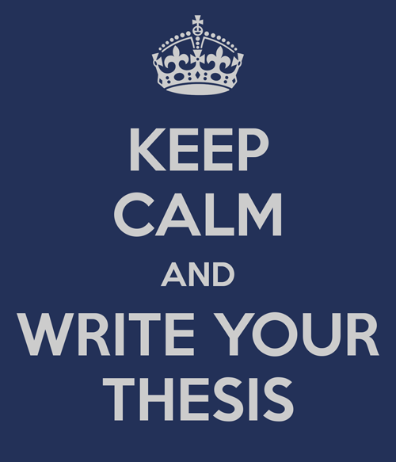
Happy Writing!
Notes:
http://www.egosumdaniel.se/blog/img-post/121117_keep-calm-and-write-your-thesis.png

