Slide 1
Academic Writing
Tips on How to Write in a College Setting

Slide 2
Things to Consider When Identifying Academic Writing...
Tone
Word Choice
Point of View
Audience
Readers
Intention
Authorship
Writer
Credibility
Bias

Slide 3
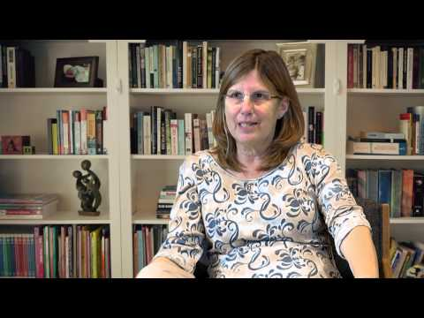
Dr. Vivienne Bennett talks about Reasoned Judgement

Slide 4
Things to Consider in Your Own Academic Writing...
Type of Assignment
Research Paper
Book Analysis
Personal Reflection
Exploratory Paper
Audience
Reader
Familiarity with Topic
Scope of Thesis/Claim
Broad or Specific?

Slide 5
What Makes College Writing Different?
Content
Focus on research
Supporting thesis
Fewer opinions
Deep Analysis
Critical Thinking
Delve past the obvious
Beyond High-School thinking
Format
Length
Various page lengths
Paragraphs
Citation Styles
APA
MLA
APSA
CSE
And more!

Slide 6
Tips from Success in College
“When you first get a writing assignment, pay attention to keywords for how to approach the writing. These will also suggest how you may structure and develop your paper.”
Useful Key Terms
Summarize
Define
Classify
Compare/contrast
Analyze
Argue

Slide 7
It’s the little things...

Slide 8
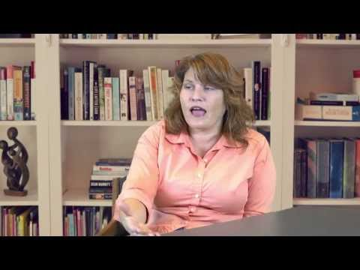
Professor Heidi Breuer talks about Grammar

Slide 9
Second-person Perspective
Second-person is writing sentences from a “you” perspective.
“When eating chicken, you should consider where the meat comes from.”
Avoid using “you” in academic essays!
It sounds as though the essay is directed towards the reader (often times your professor)
Instead of using “you”, write: “When eating chicken, the consumer should consider where the meat comes from.”
It looks awkward at first, but it will give your essay a much more academic tone

Slide 10
First-person Perspective
Some professors don’t like the use of First-person, but as a general rule, use it sparingly even if it’s allowed.
Using phrases like “I think” can sound really informal or conversational and it makes your statement seem weaker than if you omitted it.
“I think that Shelley wrote Frankenstein about the consequences of Mankind’s pride.” sounds weaker than “Shelley wrote Frankenstein about the consequences of Mankind’s pride.”
When you include “I think” or “I believe” statements in an essay that is not an opinion essay, it is almost like apologizing for the sentence or showing that you’re unsure about the idea.
You can use “I think” or “I believe” in Opinion essays.

Slide 11
Contractions
Don’t.
Contractions are when a word or words come together to make a shorter form of the word(s); examples of contractions are:
Don’t
Can’t
Shouldn’t
It’s
Instead of using contractions, spell out the whole word(s):
Do not
Cannot
Should not
It is

Slide 12
Contractions
You might be tempted to write: “Gregor couldn’t get along with his family after turning into a giant vermin.” BUT it’s not as academic-sounding as writing the words in their entirety!
“Gregor could not get along with his family after turning into a giant vermin.” That sounds better!
Sometimes it’s hard to catch yourself using contractions, especially since we’re so used to using them in everyday life!

Slide 13
Colloquialisms
“A word or phrase that is not formal or literary, typically one used in ordinary or familiar conversation”
So that’s things like slang, conversational language, and turns-of-phrase:
“It cost an arm and a leg.”
“It made my ears bleed.”
“The shirt was on fleek.”
Instead, use the literal meaning of those phrases:
“It cost $1000.” OR “It was expensive.”
“It was loud and dissonant.”
“The shirt was congruent with modern fashion.”

Slide 14
Colloquialisms
Another common colloquialism is the use of “should of”, “would of”, and “could of”. These are incorrect!
When we talk, we often say “could of”
When you write, you should write “could have”
Instead of: “Gatsby should of forgotten about Daisy.”
Write: “Gatsby should have forgotten about Daisy.”

Slide 15
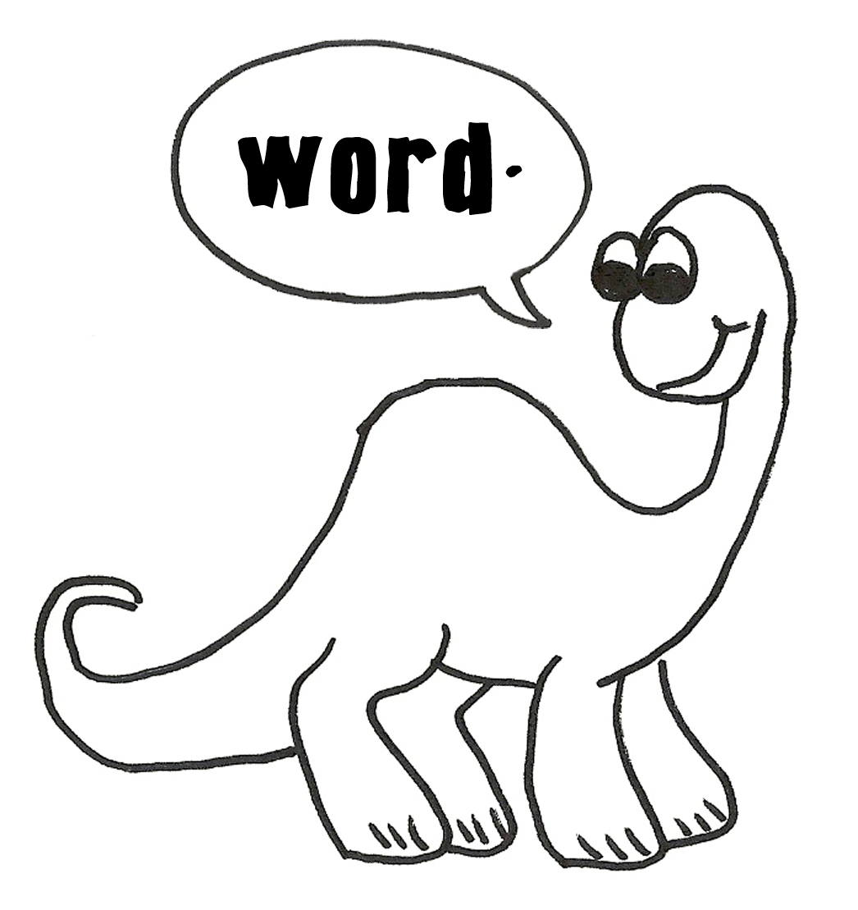
Do not expect to have perfect Academic Writing right away! Like forming a good habit, it takes time and patience. Luckily, the tutors here at the Writing Center are here to help! Please come by or make an appointment! We would love to see you!

