Slide 1
Pre-Writing
The Writing Before the Writing

Slide 2
The Writing Environment
What helps you get in the mindset for writing?
Notes:
Rebecca
Ask question to those at the workshop, include own experiences

Slide 3
The Writing Environment
Music?
Quiet Space?
Certain Foods?
No Distractions?
A Productive Environment?
Notes:
Rebecca
Give some ideas to help them expand their pool of options

Slide 4
Brainstorming
F r e e
W r i t i n g
Notes:
http://elmeuordinador.blogspot.com/2012/01/competencia-comunicativa-per.html
http://neilmossey.blogspot.com/2012_07_01_archive.html

Slide 5
Brainstorming
Bullet Points
They’re very useful
They let you organize your ideas
Even if it’s just a list
It’s still good
And makes writing your essay much easier
Bullet Points
Notes:
http://evilcrayon.com/2012/03/19/bullet-point/

Slide 6
Brainstorming
Concept/Mind Mapping
What is Brainstorming, exactly? It’s a term we’ve heard since we were in Grade School, but it’s difficult to clearly define.
Brainstorming is best done in groups or pairs. It helps to have somebody to talk to and translate your ideas to.

Slide 7
Organizing
Categorize
Notes:
http://lafuencislainenglish.blogspot.com/2012/01/animal-groups.html

Slide 8
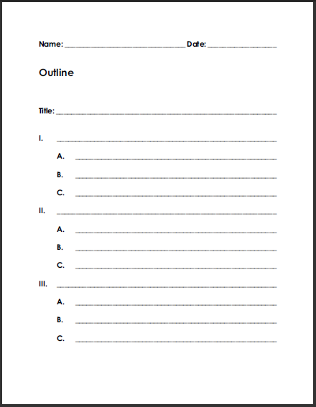
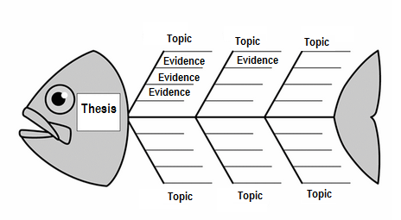
Organizing
Outline
Notes:
http://www.storiestotellbooks.com/blog/2012/6/17/revising-your-draft-use-a-reverse-outline.html
http://www.fun-with-pictures.com/emperor-penguin-outline-coloring-page.html

Slide 9
Organizing
Index Cards
Notes:
http://viewfromfairview.blogspot.com/2011/11/revision-day-2-index-cards.html
http://elementalblogging.com/the-index-card-system/

