Slide 1


FINANCIAL
AID AND SCHOLARSHIPS

Slide 2
CSU by the Numbers
  Over 60% of CSU students pay $0 tuition
  80% of CSU students receive some form of financial aid to help with tuition and other costs
  On average, first-time CSU freshmen finish in fewer years than CCC transfer students
  Starting at a CSU as a first-time freshman can help keep the total four-year cost of attendance lower
    Excess units at CCC and major-prep misalignment significantly delay transfer timelines
Notes:
Here are a few systemwide CSU points to keep in your back pocket. First: over 60% of CSU students pay $0 tuition—that surprises a lot of families. Second: timelines matter. When students accumulate excess units or their major prep doesn’t align, transfer can be delayed—and delays cost money. The big message here is: planning early saves time, protects aid eligibility, and can keep the total cost lower

Slide 3
Is College Worth It?
What California Parents say...
  71% of parents want their child to graduate with at least a bachelor’s degree
  69% worry about being able to afford college
  Parents & students have reluctance to take on debt
  Some wonder if college will yield higher earnings
Source: Public Policy Institute of California, Is College Worth It? April 2025
6

Slide 4
  Higher Earnings: In 2023, workers with a BA earned on average 61% more than HS grads
  Job Stability: Lower unemployment during economic downturns
    During COVID-19 recession- unemployment rate for no college was 18% compared to 10% with a bachelor’s degree
  Return on Investment (ROI): Wage benefits and pace of ROI differ by major
The Financial Case
Notes:
On the financial side, college is still strongly linked to higher earnings and job stability. The return can vary by major, but the general pattern is clear: more education tends to increase lifetime earnings and reduce unemployment risk. When students are unsure, it helps to connect CSU affordability to the longer-term payoff—while still being honest that planning and finishing on time matter.

Slide 5
CSU Commitment to Affordability
At the CSU, our mission is to make a CSU education affordable and accessible, with financial aid that puts a degree within reach for students from all income levels.
Notes:
At the CSU, affordability is part of the mission. CSU is designed to be accessible, and financial aid is a major tool to keep a degree within reach for students from all income levels. This is the bridge from ‘college is worth it’ to ‘CSU is doable

Slide 6
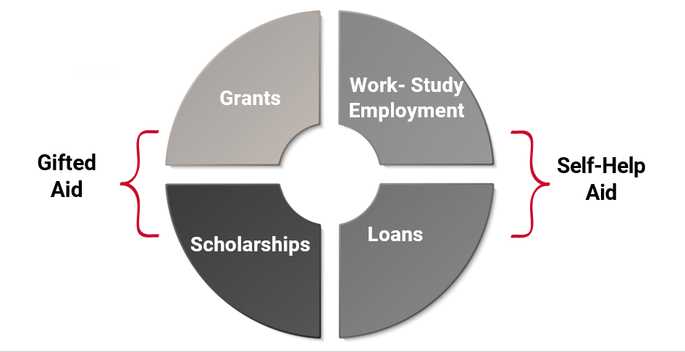
CSU Financial Aid
Notes:
This is the big picture: CSU aid generally falls into four buckets. Grants and scholarships are ‘gift aid’—typically not repaid. Work-study is earned money through employment. Loans are optional borrowing—students can accept, reduce, or decline.

Slide 7
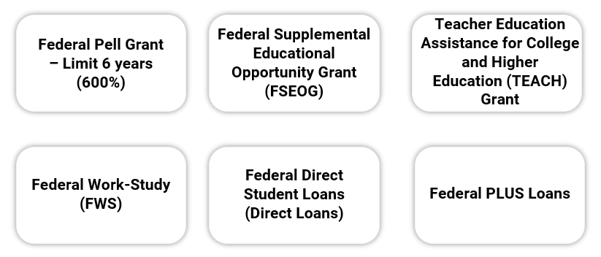
Federal Financial Aid
Notes:
On the federal side, the biggest grant is the Pell Grant, and it has a lifetime limit—students can receive Pell for the equivalent of about six years. Federal aid can also include work-study, grants like FSEOG at some campuses, and federal student loans. if a student is close to a lifetime limit, finishing on time becomes even more important

Slide 8
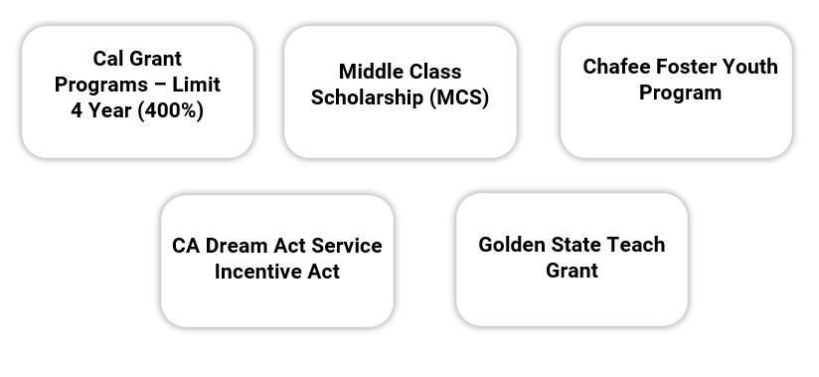
State of California
Notes:
At the state level, students may qualify for programs like Cal Grant and Middle Class Scholarship, plus supports for specific student groups like foster youth. Cal Grant has a lifetime usage limit—often explained as about four years of eligibility. This is where AB 540 exceptions show up.

Slide 9
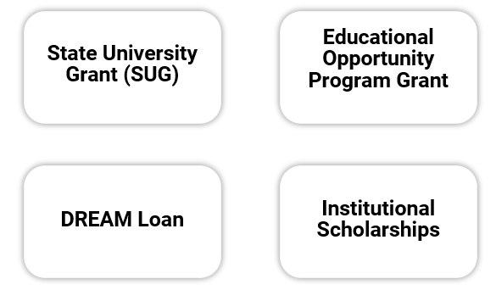
California State University
Notes:
At CSU, there are also CSU/campus-based resources like the State University Grant, EOP grant for eligible students, institutional scholarships, and options for Dream Act students. SUG is our Promise Grant

Slide 10
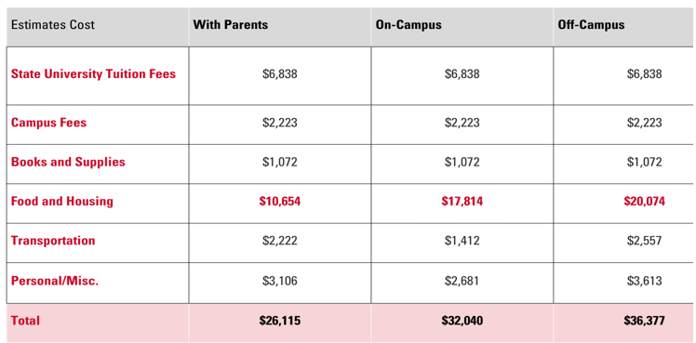
CSU Estimated COA, 2026-27
Notes:
Call out- using systemwide estimates and students should check campus websites for exact numbers

Slide 11

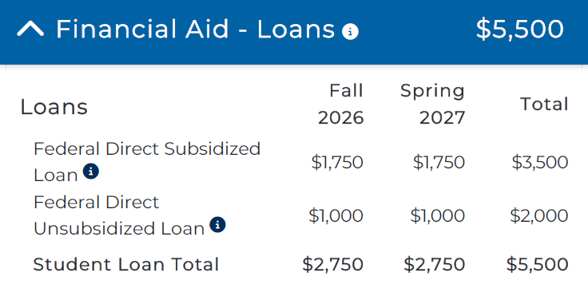
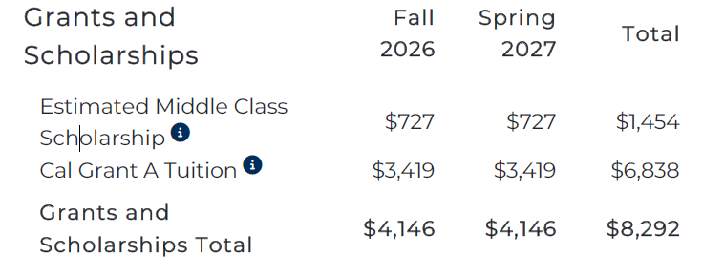
CSU Financial Aid Offer Letters
Notes:
-Start with total cost of attendance
-Subtract grants and scholarships → net cost
-Highlight where loans appear and that they’re optional
-Clarify what’s actually billed by CSU vs living costs
STUDENT LIVING WITH PARENTS

