Slide 1

WELCOME
FROM THE OFFICE OF ACADEMIC ADVISING!
We’re glad to connect with you today!
While we couldn’t be here in person at this event (our team is currently supporting student course enrollment), we want to share
a few important details…

Slide 2

ENROLLMENT AT CSUSM
IS A PROCESS
Course Enrollment is one of the first processes that occurs
Course enrollment takes place outside of orientation
This approach allows for a better, more supported student experience

Slide 3
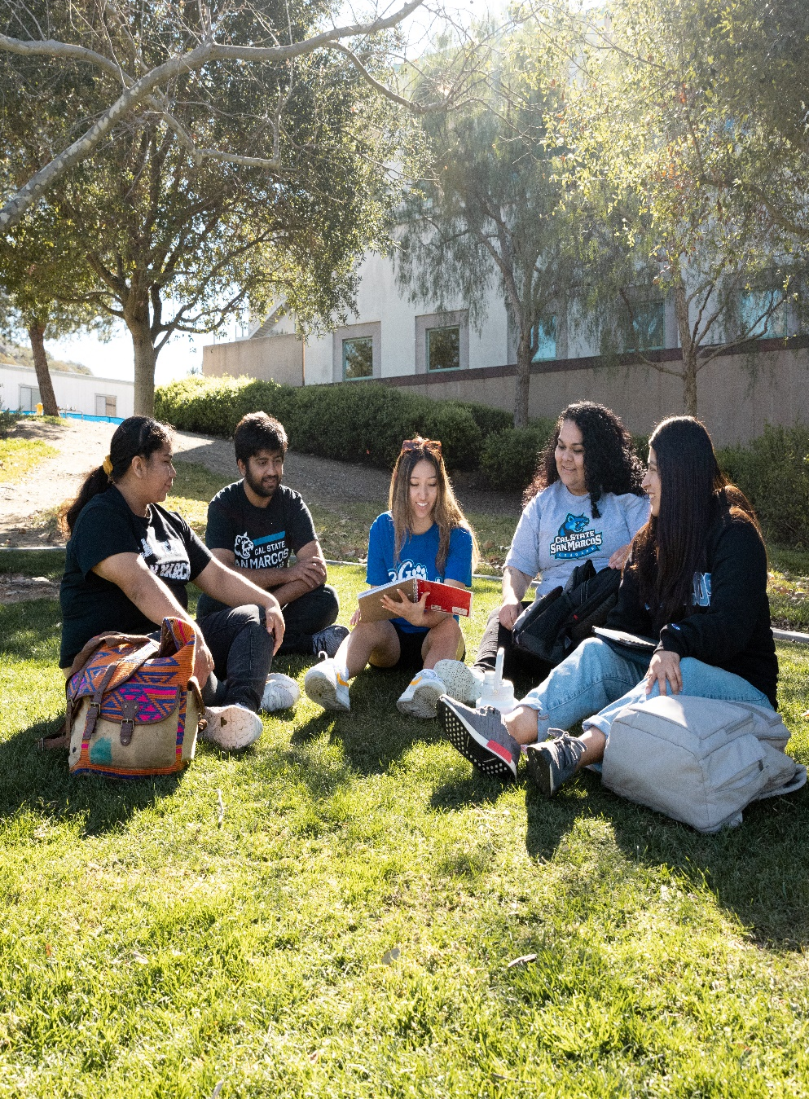
STUDENTS ARE
NOT ON THEIR OWN
Partnership with the Office of Success Coaching
Multiple workshops and support options are available
Support is offered throughout the summer—not just on enrollment day

Slide 4

CLEAR & TIMELY
COMMUNICATION
Students will receive regular updates
Guidance on when and how to get support is clearly provided

Slide 5

ACADEMIC ADVISING
& ENROLLMENT
Complete the Enrollment Tutorial
1
Covers Graduation Requirements, what classes to take, how to enroll, and how to connect with Advising
Academic Advising Support
2
Begins late May, early June*
*Course Enrollment Begins
3
Student enrollment date will be posted in their Student Center in myCSUSM. Transfers begin June 9.
First Years begin June 23.

Slide 6


Finally, well beyond the initial new student course enrollment process, students will have year-round access to both the Office of Success Coaching and the Office of Academic Advising for ongoing support throughout their time at CSUSM.
THANK YOU!
www.csusm.edu/academicadvising

