Slide 1
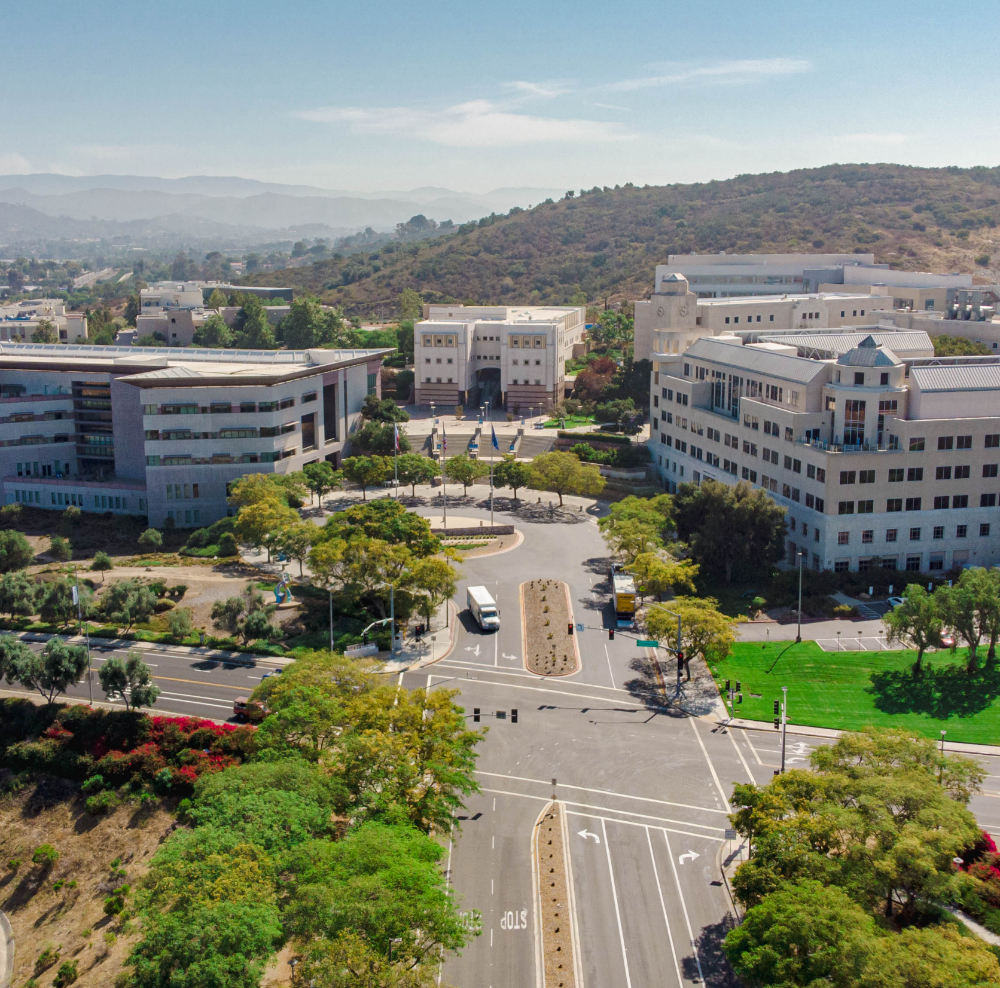

2026 Counselor
Forum
College of Humanities, Arts, Behavioral & Social Sciences

Slide 2


Slide 3


Slide 4
CHABSS IN NUMBERS
6461+
6461+
Students in CHABSS Majors
1,000+
379+
GE Courses Offered by CHABSS
379+
1000+
Classes taught by a diverse array of tenure track and lecturer faculty

Slide 5
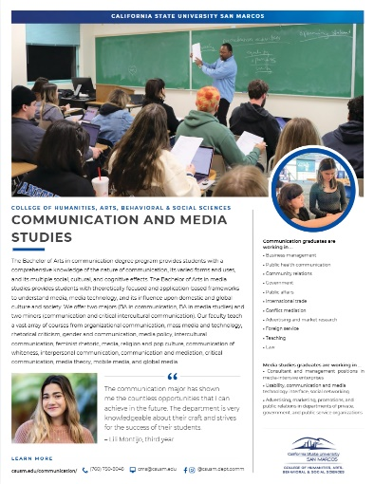
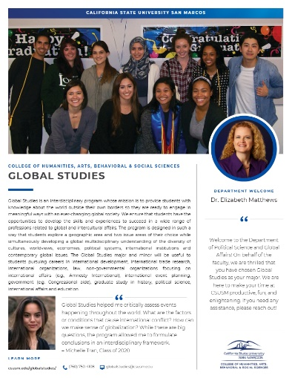
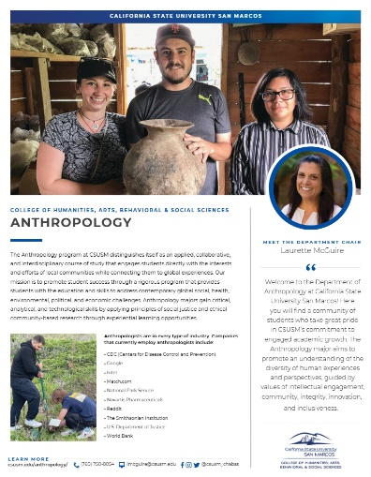
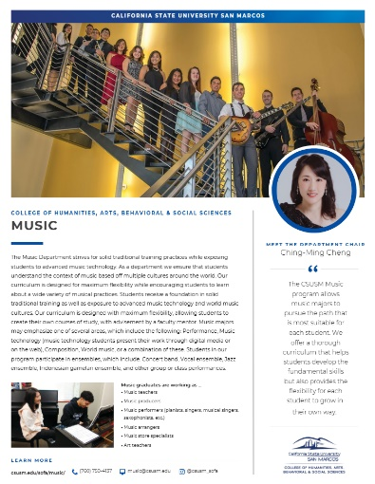
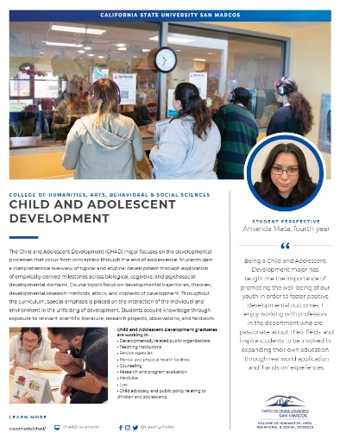
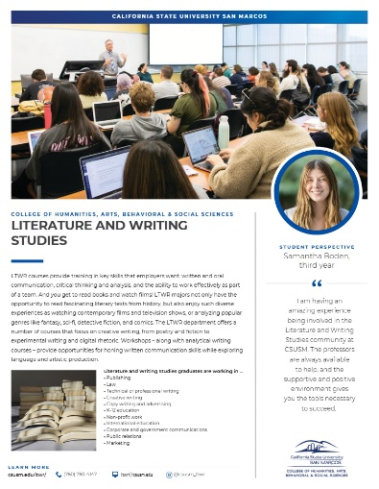

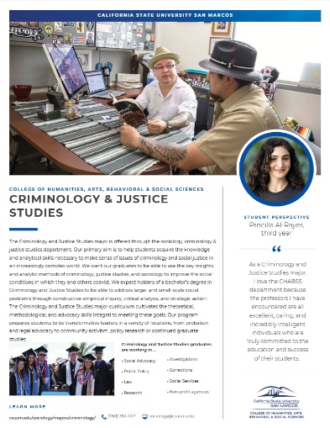
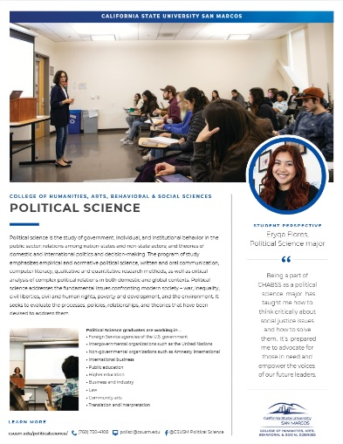
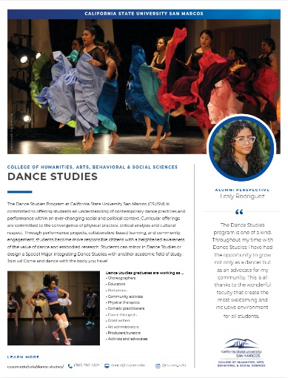
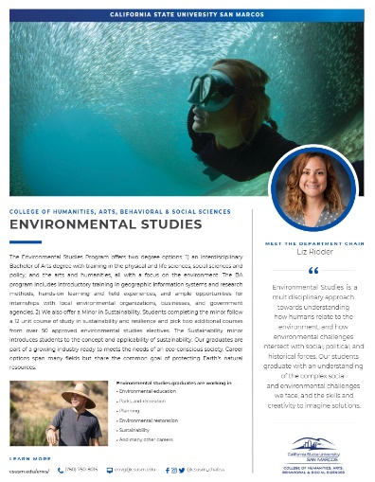
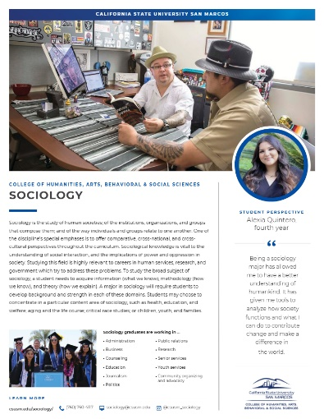
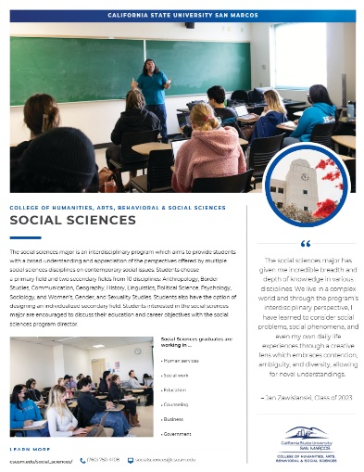
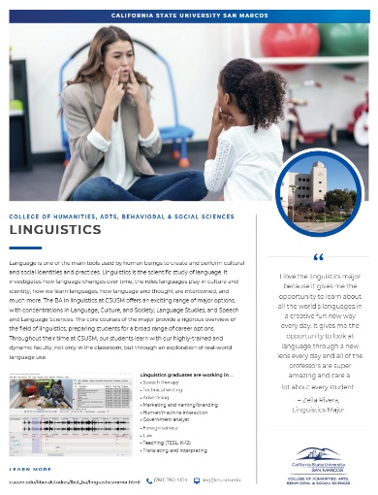

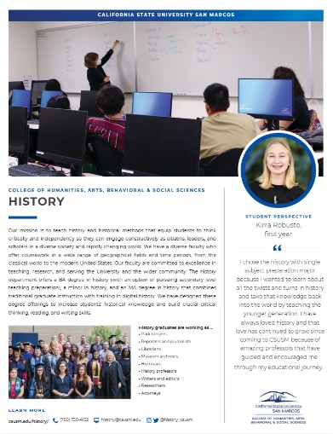
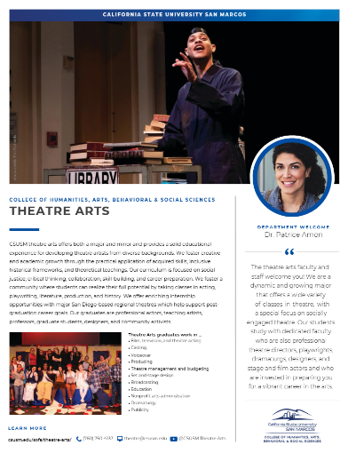
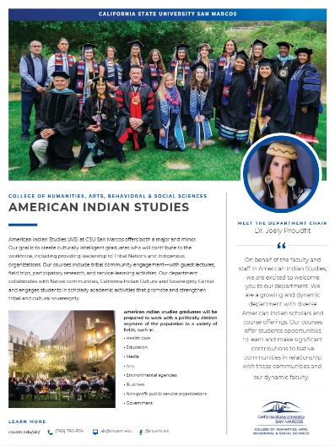
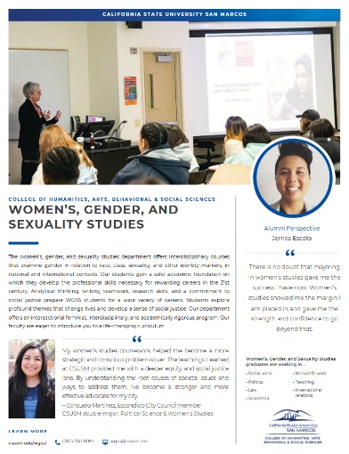
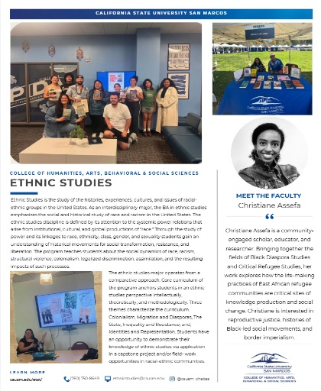
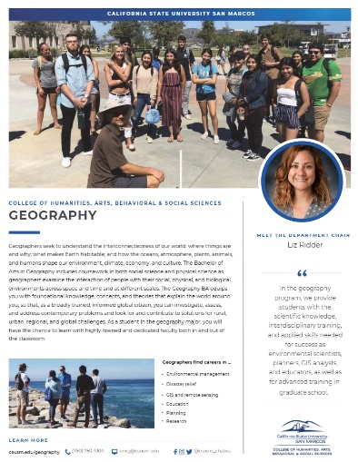
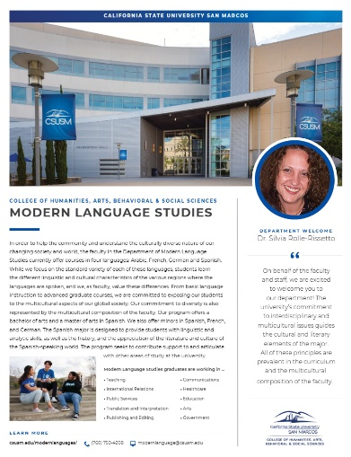
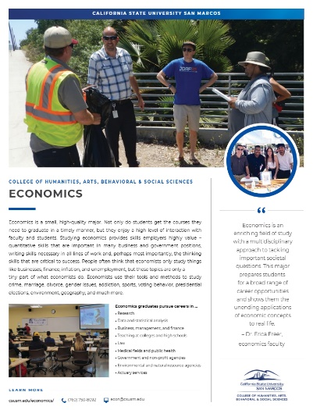
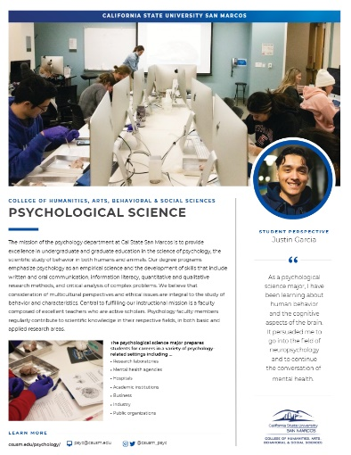
CHABSS Social Mobility

Slide 6
CHABSS Social Mobility
From Curriculum to Career
Career Readiness Across the Student Lifecycle
Curriculum to Career
Launch
Find
Take on
Explore
Residential Learning Community
2 Floors for First Year CHABSS Students
Student Clubs and Organizations
Belonging and Retention
HIPs
Student Success Fund
Pathways to Purpose
Academic Paid Internship Program
CHABSS Social Mobility: Supporting our students throughout the student lifecycle

Slide 7
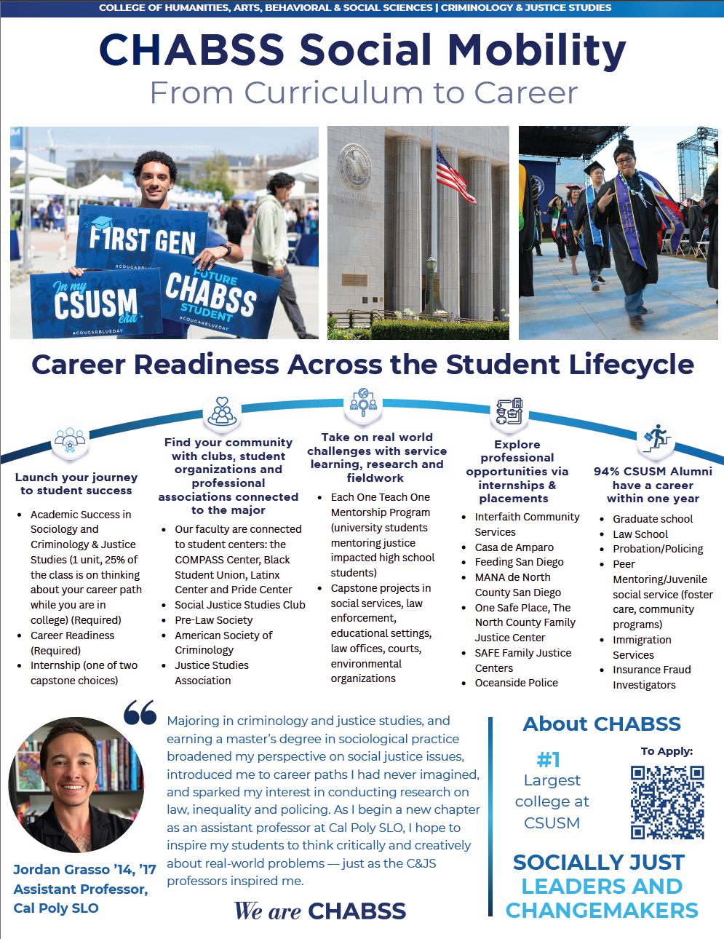
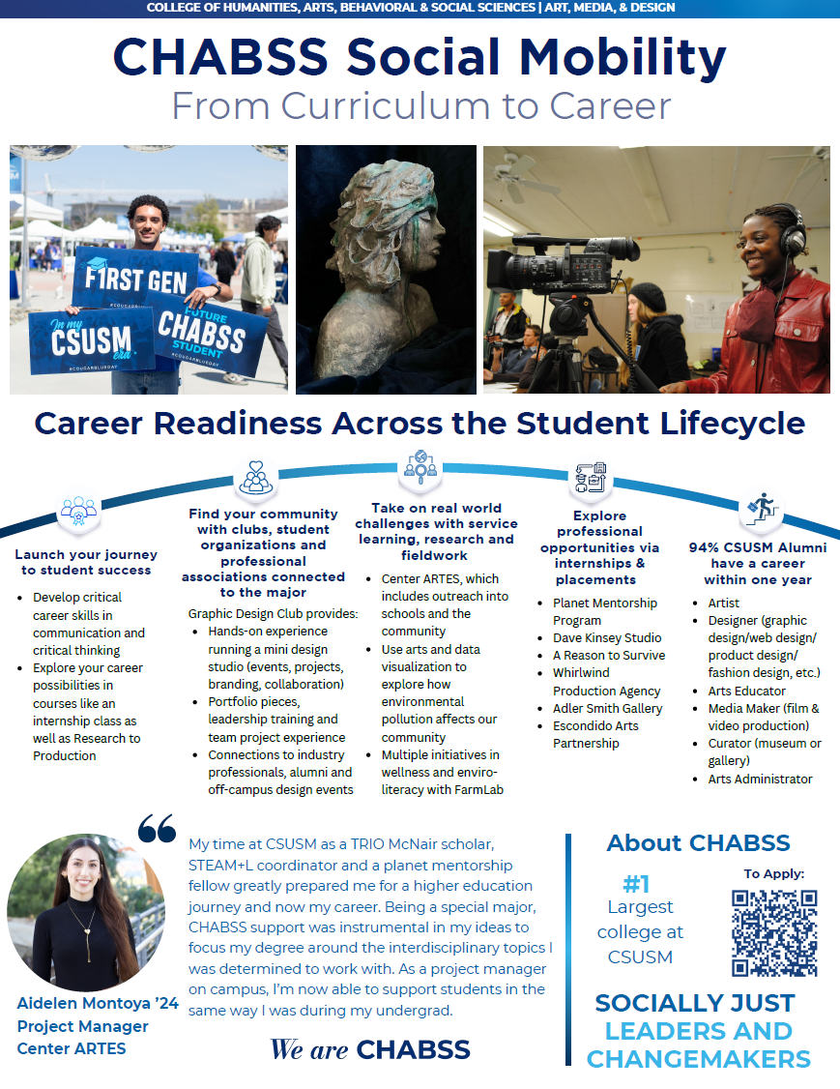

Slide 8


Thank You
Connect With Us
Email: chabss@csusm.edu
Website: www.csusm.edu/chabss

