Slide 1
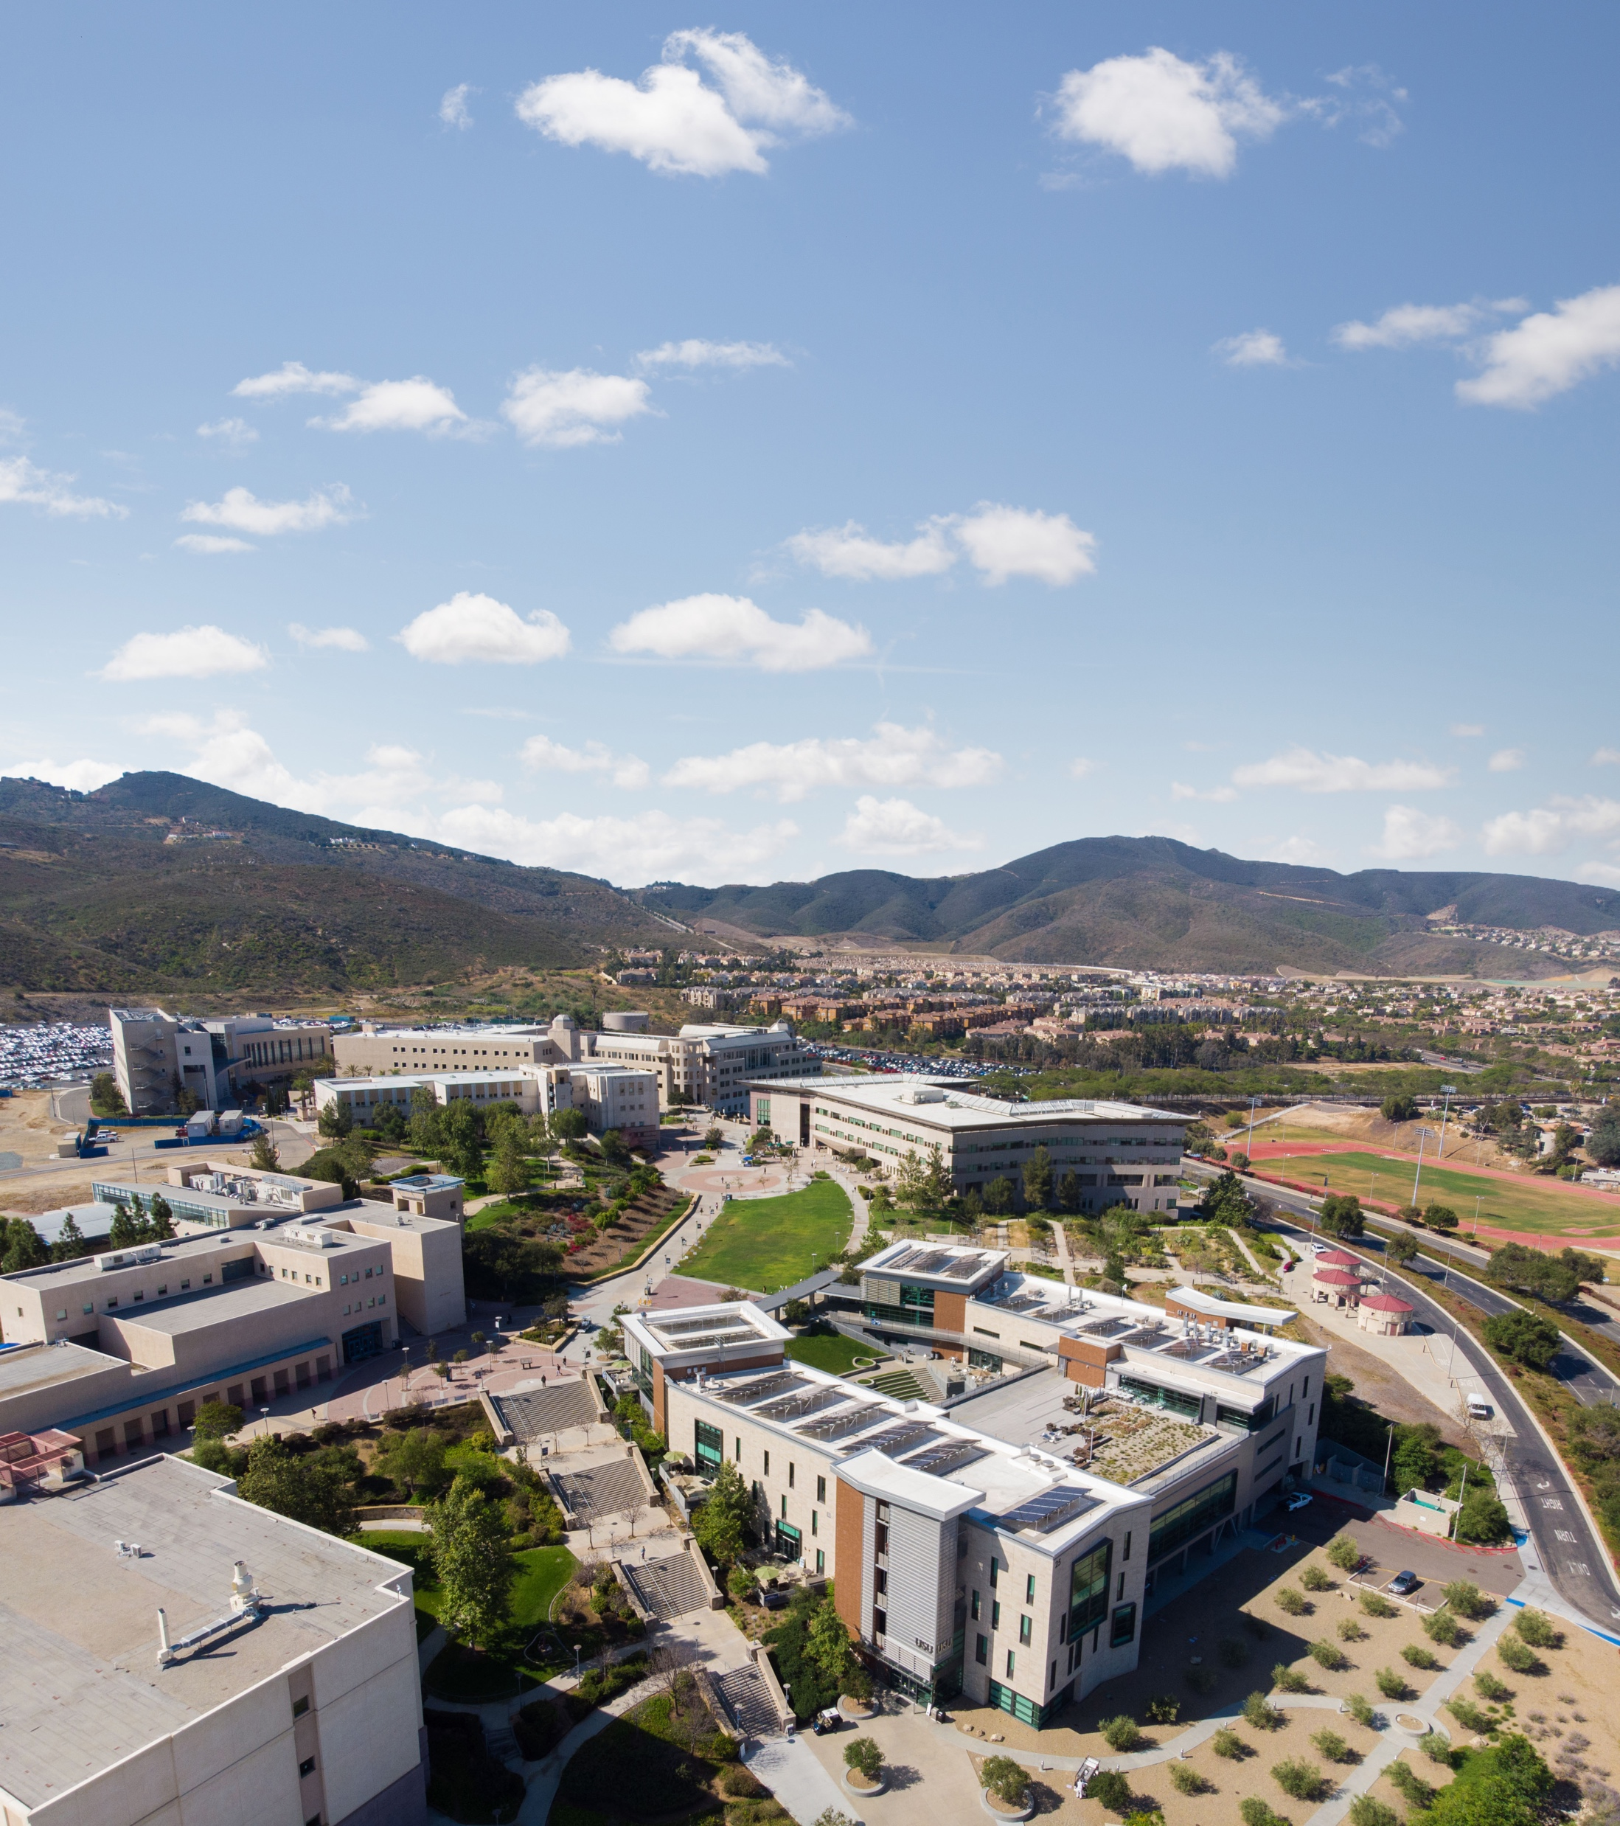
Office of Sponsored Projects
Pre/Post-Award Open Forum
Concur Hot Topics
9/10/26

Slide 2
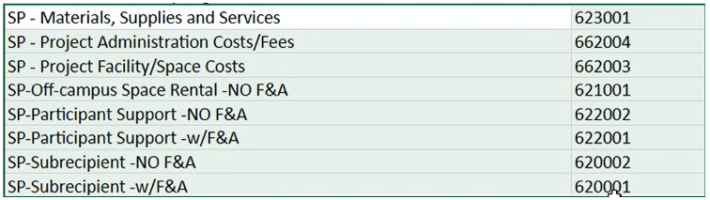
#1
  Have these accounts been validated as correctly posting in CFS/DW now? Sounded like there may have been a mapping issue preventing all from mapping correctly. (No F&A expenses not consistently posting to the correct accounts, creating compliance and financial-reporting risks.)
#2
  Are there situations where Concur’s automatic routing will bypass the required PI approval when the PI does not act within the designated timeframe?
  Appears to have happened, compliance issue.
  (Kimberly Askew was told by Elle that it happened on T. Brown’s project)
#3
  Expense-type descriptions do not clearly identify the corresponding GL account numbers; a crosswalk between old codes, new descriptions, and posting accounts is needed, can this be provided?
  (Melissa Teetzel; Leslie Brotcke)
#4
  Approvers cannot correct expense categories or GL account codes, forcing incorrectly coded reports to be approved and manually corrected downstream.
  What is the best way to handle this?
  (Leslie Brotcke)

Slide 3
#5
  What is the timing of the GL posting?
  And whether it is driven by individual purchases, completed reconciliations, or scheduled processing dates.
  (Leslie Brotcke)
#6
  What is the process for when someone submits an expense on behalf of a PI, so that the PI’s approval is subsequently bypassed?
  (Maria Chiem)
#7
  Staff have difficulty finding submitted requests, distinguishing pending from completed items, and identifying where transactions are in the approval process.
  Is there a way to run a report of all pending and completed expenses in Concur?
  Who can we contact to research individual transaction inquiries?
  (Maria Chiem)
#8
  What are the current hospitality form process within Concur for sponsored projects (85xxx projects)?
  Can certain projects bypass it when the form isn’t required?
  (OSP Analysts)

