Slide 1


2014 Great Colleges Survey
Richard K. Boyer

Slide 2
Survey Overview
Survey Instrument
60 core belief statements
12 additional statements
17 item benefits satisfaction component
12 demographic questions
3 open-ended questions
Methodology
Online survey administered March 31, 2014 – April 15, 2014
Response Rates
Overall response rate: 35% - 468/1344
Benchmark
2014 Honor Roll >10,000 Enrollment - Great Colleges to Work For Program

Slide 3
15 Core Survey Dimensions
Job Satisfaction/Support | Policies, Resources & Efficiency | Faculty, Administration & Staff Relations
Teaching Environment | Shared Governance | Communication
Professional Development | Pride | Collaboration
Compensation, Benefits & Work/Life Balance | Supervisors/Department Chairs | Fairness
Facilities | Senior Leadership | Respect & Appreciation

Slide 4
Survey Definitions
Institution refers to the entire University or college.
Department refers to your most immediate workgroup or team.
Senior Leadership refers to the most senior members of the institution (e.g. Chancellor or President and those who report directly to them).
Supervisor/Department Chair refers to the individual to whom you directly report.

Slide 5
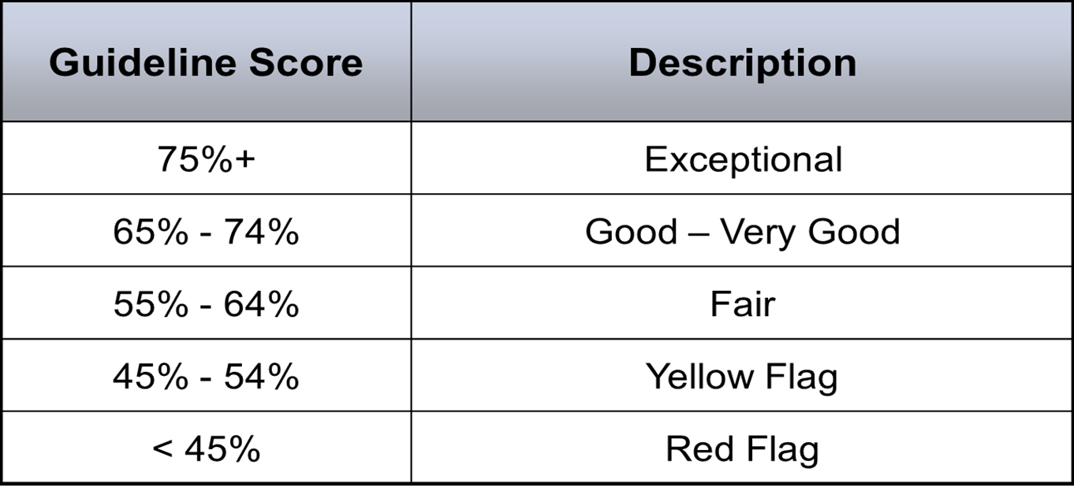
Guidelines for Positive Responses
Response Scale:
Strongly Agree; Agree; Sometimes Agree/Sometimes Disagree; Disagree; Strongly Disagree; Not Applicable
Positive Response - Strongly Agree & Agree

Slide 6
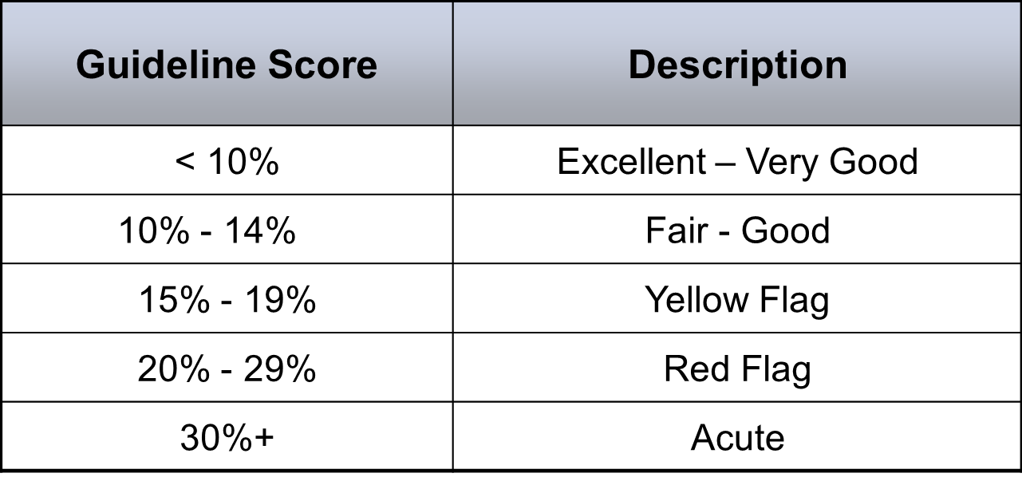
Guidelines for Negative Responses
Response Scale:
Strongly Agree; Agree; Sometimes Agree/Sometimes Disagree; Disagree; Strongly Disagree; Not Applicable
Negative Response - Strongly Disagree & Disagree

Slide 7
Overarching Themes
Faculty and staff report a strong sense of connection to and pride in the mission of the University. There is also a heightened sense of enthusiasm given the youth and growth of the institution.
Faculty and staff very much appreciate the ability to make a difference in the lives of students and in the community/region. Similarly, they appreciate the commitment to being a diverse and inclusive community.
Faculty and staff report high degrees of job fit and appreciate the flexibility and autonomy they have as well as the benefits and the support for work/life balance.
Faculty and Staff report having good relationships with and high regard for their supervisors and senior leaders. They also report a need for greater consistency and enhanced managerial/leadership skills, specifically those regarding communication, performance management and accountability.
While there is a strong sense of community within many departments, the strength of that camaraderie does not consistently translate to strong cross-functional collaboration or a sense of alignment across the University.

Slide 8
Overarching Themes
Resource constraints particularly those regarding staffing and compensation are pain points for many faculty and staff.
Faculty and staff would like to see greater communication from and with senior leadership, as well as a greater sense of alignment across senior leadership.
Both faculty and staff express a need for improved communications. There is a desire for more transparency regarding the rationale with which decisions are made and an interest in greater participation in those decisions which directly impact their work.
Staff express a desire for additional training, professional development and career opportunities.
For many, there are concerns regarding accountability, especially as related to the consistency of policies/processes and the inability to deal with low performers and/or conflict.

Slide 9
Barometer Statements by Job Category
Survey Statement |  | California State Uni. San Marcos Overall results (% Positive) (% Positive) | Admin. (% Positive) | Faculty (% Positive) | Adjunct Faculty (% Positive) | Exempt Prof’l Staff (% Positive) | Non-exempt Staff (% Positive)
25 | Overall, my department is a good place to work. | 82 | 89 | 81 | 73 | 77 | 82
60 | All things considered, this is a great place to work. | 81 | 90 | 69 | 69 | 83 | 85
59 | This institution's culture is special - something you don't find just anywhere. | 68 | 82 | 58 | 53 | 72 | 67
36 | I am proud to be part of this institution. | 87 | 96 | 75 | 80 | 89 | 88

Slide 10
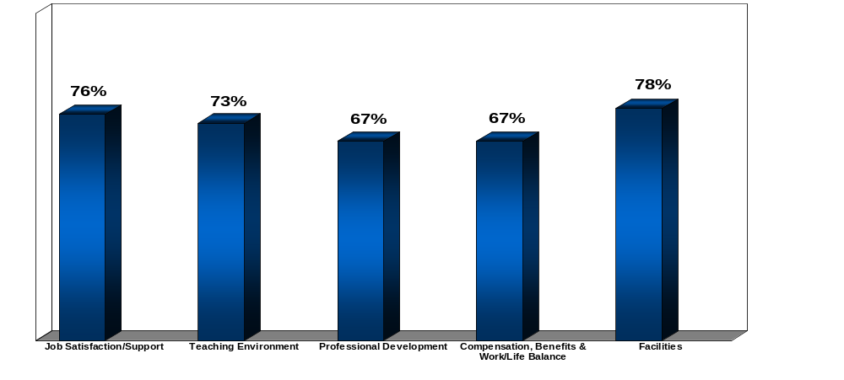
Dimensions (Overall % Positive)

Slide 11
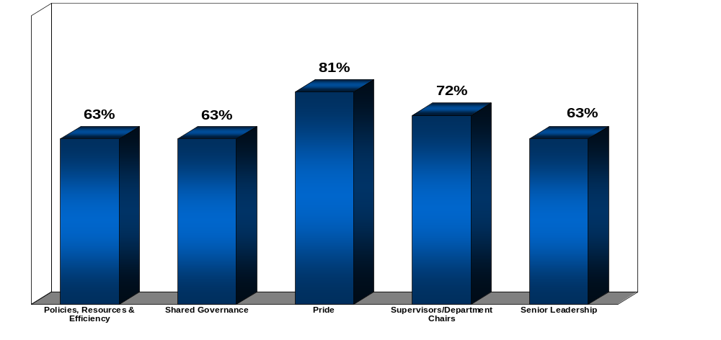
Dimensions cont’d (Overall % Positive)

Slide 12
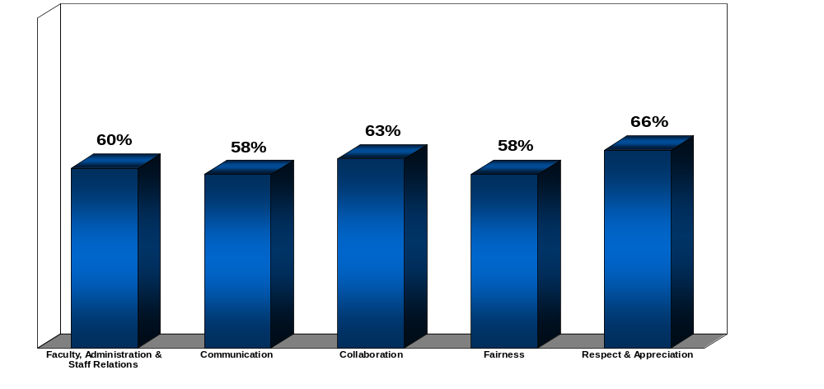
Dimensions cont’d (Overall % Positive)

Slide 13
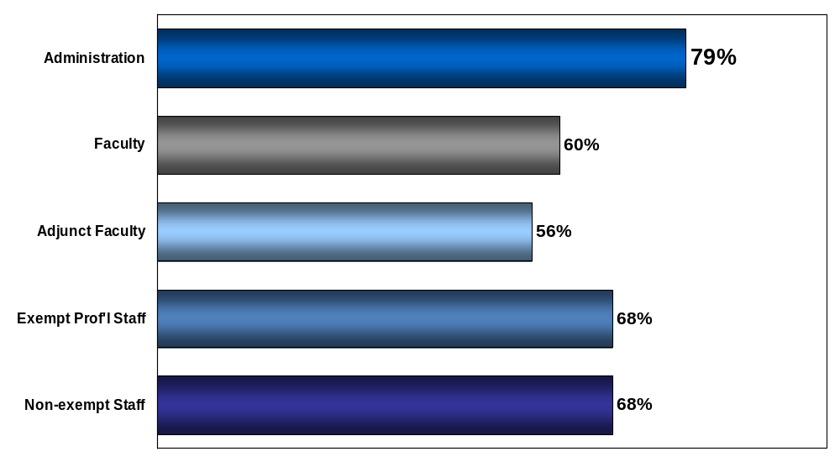
Job Category (Overall % Positive)

Slide 14
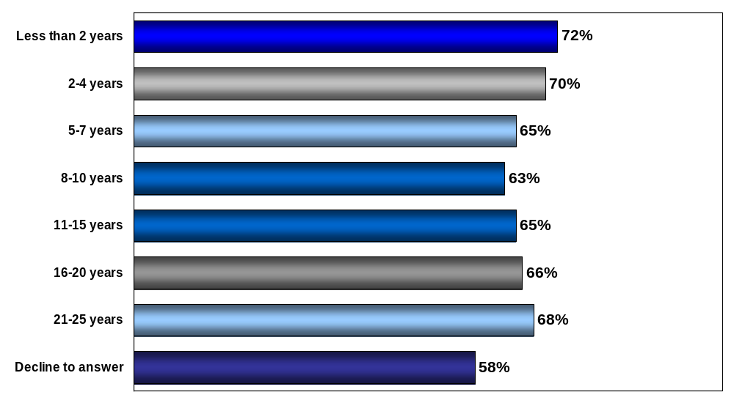
Years at Institution (Overall % Positive)

Slide 15
Top Ten Statements
Survey Statement |  | California State Uni. San Marcos Overall results (% Positive) | California State Uni. San Marcos Overall results (% Negative) | 2014 Honor Roll Benchmark >10,000 (% Positive)
5 | I understand how my job contributes to this institution's mission. | 90 | 3 | 92
49 | This institution actively contributes to the community. | 89 | 1 | 90
36 | I am proud to be part of this institution. | 87 | 3 | 87
68 | We are good citizens/stewards in our local community. | 87 | 1 | *
29 | The institution takes reasonable steps to provide a safe and secure environment for the campus. | 85 | 3 | 91

Slide 16
Top Ten Statements
Survey Statement |  | California State Uni. San Marcos Overall results (% Positive) | California State Uni. San Marcos Overall results (% Negative) | 2014 Honor Roll Benchmark >10,000 (% Positive)
2 | I am given the responsibility and freedom to do my job. | 84 | 4 | 85
24 | I have a good relationship with my supervisor/department chair. | 84 | 5 | 86
61 | People at CSUSM understand and value the benefits of a diverse workforce. | 83 | 4 | -
34 | This institution's benefits meet my needs. | 82 | 3 | 87
47 | My supervisor/department chair supports my efforts to balance my work and personal life. | 82 | 8 | 86

Slide 17
Strengths
Job Satisfaction & Connection to Mission
Benefits & Work/Life Balance
Supervisor/Department Chair
Teaching Environment
Diversity & Inclusion
Facilities

Slide 18
Job Satisfaction & Connection to Mission
Survey Statement |  | California State Uni. San Marcos Overall results (% Positive) | California State Uni. San Marcos Overall results (% Negative) | 2014 Honor Roll Benchmark >10,000 (% Positive)
1 | My job makes good use of my skills and abilities. | 80 | 6 | 85
2 | I am given the responsibility and freedom to do my job. | 84 | 4 | 85
5 | I understand how my job contributes to this institution's mission. | 90 | 3 | 92
72 | I find personal meaning and fulfillment in my work. | 81 | 4 | -
49 | This institution actively contributes to the community. | 89 | 1 | 90

Slide 19
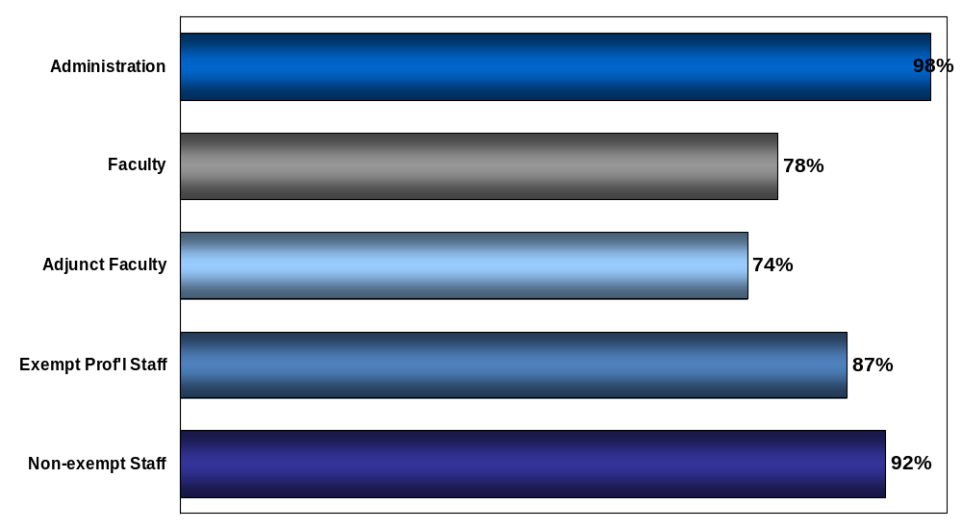
68. We are good citizens/stewards in our local community.

Slide 20
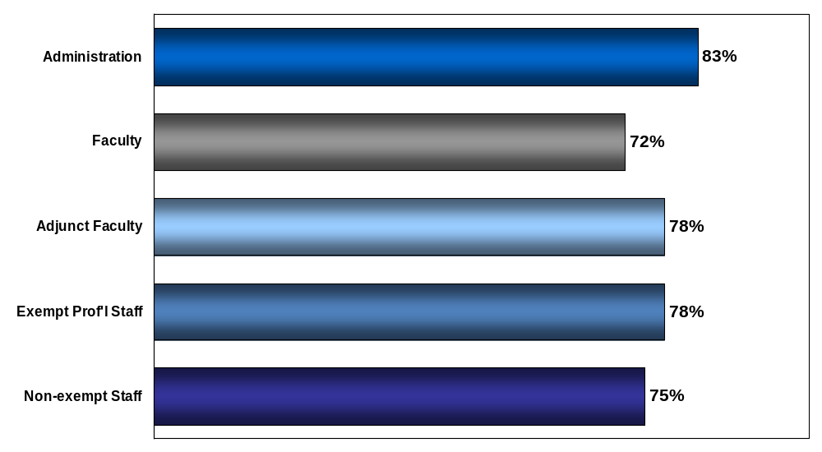
69. Faculty and staff are encouraged to participate in community service activities.

Slide 21
Benefits & Work/Life Balance
Survey Statement |  | California State Uni. San Marcos Overall results (% Positive) | California State Uni. San Marcos Overall results (% Negative) | 2014 Honor Roll Benchmark >10,000 (% Positive)
34 | This institution's benefits meet my needs. | 82 | 3 | 87
47 | My supervisor/department chair supports my efforts to balance my work and personal life. | 82 | 8 | 86
53 | This institution's policies and practices give me the flexibility to manage my work and personal life. | 77 | 8 | 83
67 | This institution provides me with enough flexibility and support to meet the demands of my personal and family life. | 78 | 7 | -

Slide 22
Supervisor/Department Chair
Survey Statement |  | California State Uni. San Marcos Overall results (% Positive) | California State Uni. San Marcos Overall results (% Negative) | 2014 Honor Roll Benchmark >10,000 (% Positive)
3 | My supervisor/department chair makes his/her expectations clear. | 72 | 9 | 77
7 | I receive feedback from my supervisor/department chair that helps me. | 66 | 13 | 73
12 | I believe what I am told by my supervisor/department chair. | 71 | 7 | 79
15 | My supervisor/department chair regularly models this institution's values. | 74 | 9 | 81

Slide 23
Supervisor/Department Chair cont’d…
Survey Statement |  | California State Uni. San Marcos Overall results (% Positive) | California State Uni. San Marcos Overall results (% Negative) | 2014 Honor Roll Benchmark >10,000 (% Positive)
19 | My supervisor/department chair is consistent and fair. | 71 | 11 | 76
20 | My supervisor/department chair actively solicits my suggestions and ideas. | 69 | 11 | 76
47 | My supervisor/department chair supports my efforts to balance my work and personal life. | 82 | 8 | 86
24 | I have a good relationship with my supervisor/department chair. | 84 | 5 | 86

Slide 24
Teaching Environment
Survey Statement |  | California State Uni. San Marcos Overall results (% Positive) | California State Uni. San Marcos Overall results (% Negative) | 2014 Honor Roll Benchmark >10,000 (% Positive)
33 | There is a good balance of teaching, service and research at this institution. | 73 | 10 | 81
40 | Teaching is appropriately recognized in the evaluation and promotion process. | 73 | 9 | 80
51 | There is appropriate recognition of innovative and high quality teaching. | 75 | 8 | 80
39 | Faculty are appropriately involved in decisions related to the education program (e.g., curriculum development, evaluation). | 70 | 9 | 80

Slide 25
Teaching Environment by Tenure Status
Survey Statement |  | California State Uni. San Marcos Overall results (% Positive) | Tenured (% Positive) | Tenure Track/ Untenured (% Positive) | Not Tenure Track (% Positive)
33 | There is a good balance of teaching, service and research at this institution. | 73 | 50 | 33 | 71
40 | Teaching is appropriately recognized in the evaluation and promotion process. | 73 | 70 | 85 | 100
51 | There is appropriate recognition of innovative and high quality teaching. | 75 | 70 | 78 | 42

Slide 26
Diversity & Inclusion
Survey Statement |  | California State Uni. San Marcos Overall results (% Positive) | California State Uni. San Marcos Overall results (% Negative) | 2014 Honor Roll Benchmark >10,000 (% Positive)
45 | At this institution, people are supportive of their colleagues regardless of their heritage or background. | 78 | 8 | 89
50 | This institution places sufficient emphasis on having diverse faculty, administration and staff. | 82 | 6 | 81
54 | This institution has clear and effective procedures for dealing with discrimination. | 76 | 11 | 85
61 | People at CSUSM understand and value the benefits of a diverse workforce. | 83 | 4 | -
63 | Senior Leadership is committed to achieving a diverse workforce. | 82 | 5 | -

Slide 27
Diversity & Inclusion
Survey Statement |  | California State Uni. San Marcos Overall results (% Positive) | California State Uni. San Marcos Overall results (% Negative) | 2014 Honor Roll Benchmark >10,000 (% Positive)
62 | CSUSM presently employs a diverse workforce. | 79 | 7 | -
64 | The environment at this institution is supportive of the expression of different opinions, styles, and perceptions. | 71 | 8 | -
65 | We are making good progress towards valuing differences. | 76 | 7 | -
66 | This institution makes a genuine effort to involve a diverse group of faculty/staff on college initiatives. | 79 | 7 | -

Slide 28
Facilities
Survey Statement |  | California State Uni. San Marcos Overall results (% Positive) | California State Uni. San Marcos Overall results (% Negative) | 2014 Honor Roll Benchmark >10,000 (% Positive)
31 | The facilities (e.g., classrooms, offices, laboratories) adequately meet my needs. | 72 | 9 | 75
29 | The institution takes reasonable steps to provide a safe and secure environment for the campus. | 85 | 3 | 91

Slide 29
Bottom Ten Statements
Survey Statement |  | California State Uni. San Marcos Overall results (% Positive) | California State Uni. San Marcos Overall results (% Negative) | 2014 Honor Roll Benchmark >10,000 (% Positive)
11 | I am paid fairly for my work. | 30 | 49 | 62
28 | My department has adequate faculty/staff to achieve our goals. | 31 | 37 | 55
18 | Issues of low performance are addressed in my department. | 45 | 28 | 59
16 | Promotions in my department are based on a person's ability. | 46 | 28 | 67
22 | Changes that affect me are discussed prior to being implemented. | 50 | 20 | 58

Slide 30
Bottom Ten Statements
Survey Statement |  | California State Uni. San Marcos Overall results (% Positive) | California State Uni. San Marcos Overall results (% Negative) | 2014 Honor Roll Benchmark >10,000 (% Positive)
35 | Our recognition and awards programs are meaningful to me. | 50 | 23 | 61
55 | There is regular and open communication among faculty, administration and staff. | 53 | 14 | 71
30 | Our orientation program prepares new faculty, administration and staff to be effective. | 54 | 16 | 71
42 | Faculty, administration and staff are meaningfully involved in institutional planning. | 54 | 12 | 69
41 | Senior leadership communicates openly about important matters. | 56 | 14 | 71

Slide 31
Opportunities
Resources Constraints
Performance Management
Fairness Concerns
Senior Leadership
Communication & Collaboration
Shared Governance
Respect & Appreciation

Slide 32
Resources Constraints
Survey Statement |  | California State Uni. San Marcos Overall results (% Positive) | California State Uni. San Marcos Overall results (% Negative) | 2014 Honor Roll Benchmark >10,000 (% Positive)
4 | I am provided the resources I need to be effective in my job. | 65 | 11 | 74
28 | My department has adequate faculty/staff to achieve our goals. | 31 | 37 | 55

Slide 33
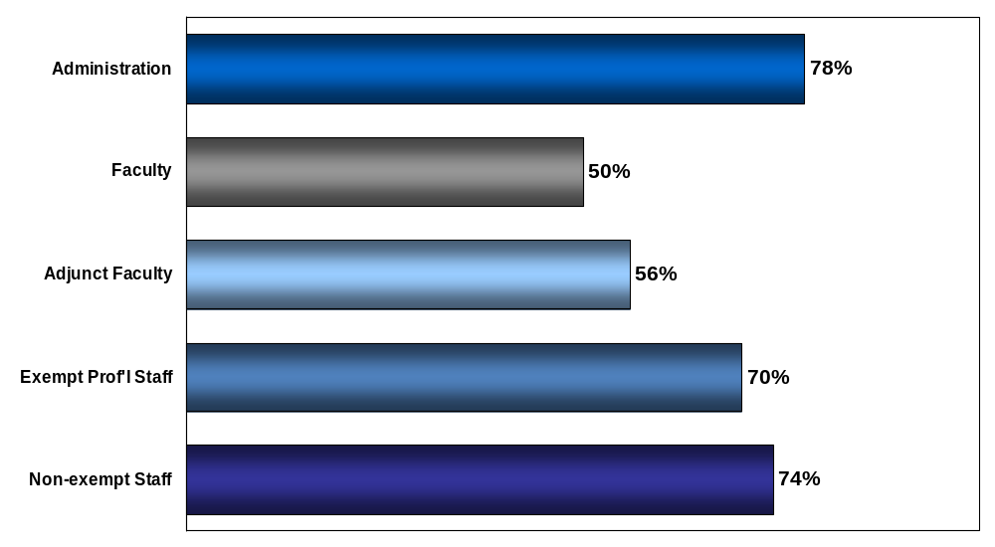
4. I am provided the resources I need to be effective in my job.

Slide 34
Performance Management
Survey Statement |  | California State Uni. San Marcos Overall results (% Positive) | California State Uni. San Marcos Overall results (% Negative) | 2014 Honor Roll Benchmark >10,000 (% Positive)
17 | Our review process accurately measures my job performance. | 57 | 19 | 66
16 | Promotions in my department are based on a person's ability. | 46 | 28 | 67
18 | Issues of low performance are addressed in my department. | 45 | 28 | 59
7 | I receive feedback from my supervisor/department chair that helps me. | 66 | 13 | 73
30 | Our orientation program prepares new faculty, administration and staff to be effective. | 54 | 16 | 71

Slide 35
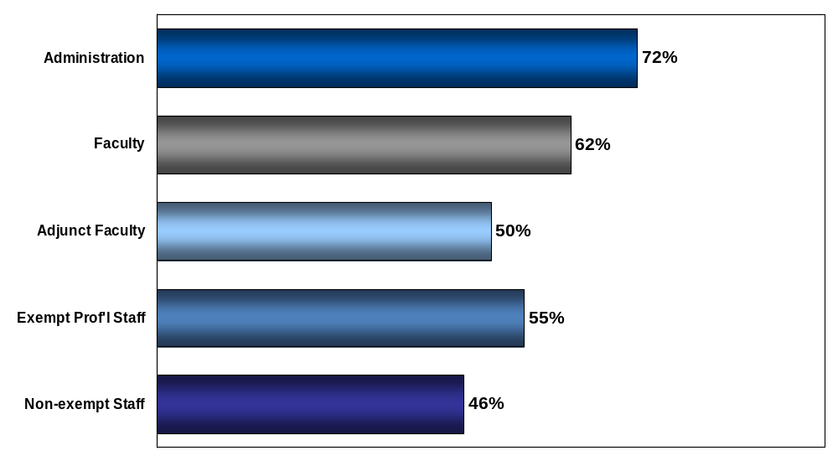
17. Our review process accurately measures my job performance.

Slide 36
Fairness Concerns
Survey Statement |  | California State Uni. San Marcos Overall results (% Positive) | California State Uni. San Marcos Overall results (% Negative) | 2014 Honor Roll Benchmark >10,000 (% Positive)
11 | I am paid fairly for my work. | 30 | 49 | 62
14 | I can speak up or challenge a traditional way of doing something without fear of harming my career. | 62 | 16 | 72
28 | My department has adequate faculty/staff to achieve our goals. | 31 | 37 | 55
44 | This institution's policies and practices ensure fair treatment for faculty, administration and staff. | 61 | 12 | 75
70 | People in my department are focused on solutions rather than blame. | 65 | 11 | -

Slide 37
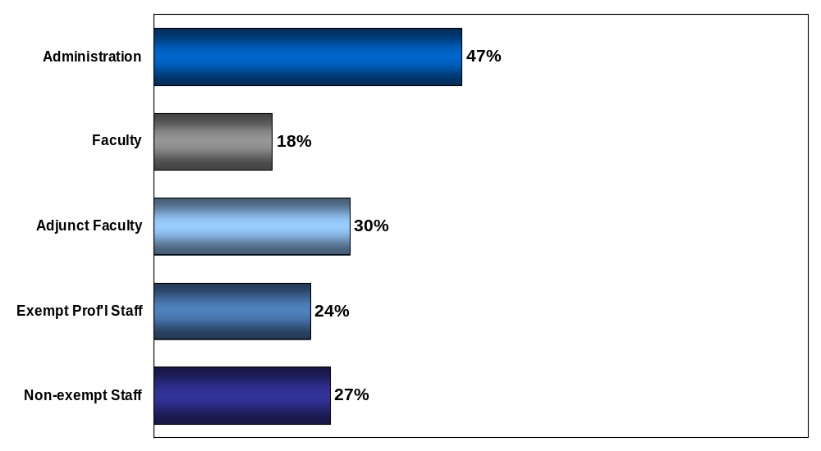
11. I am paid fairly for my work.

Slide 38
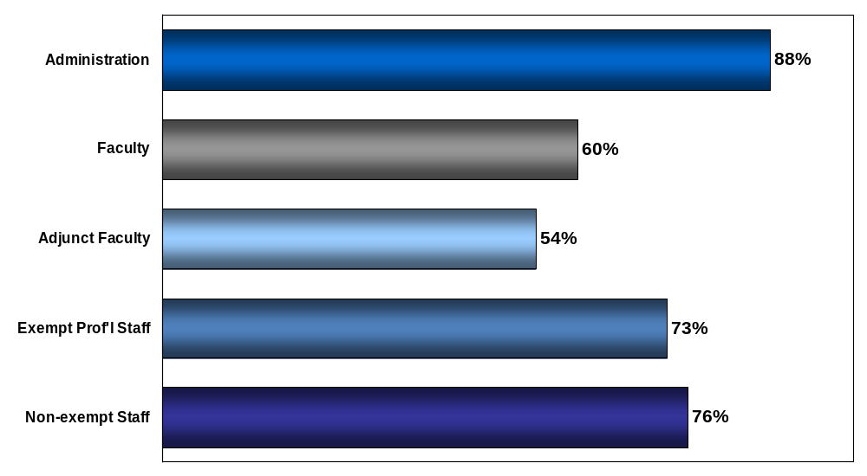
32. Our senior leadership has the knowledge, skills and experience necessary for institutional success.

Slide 39
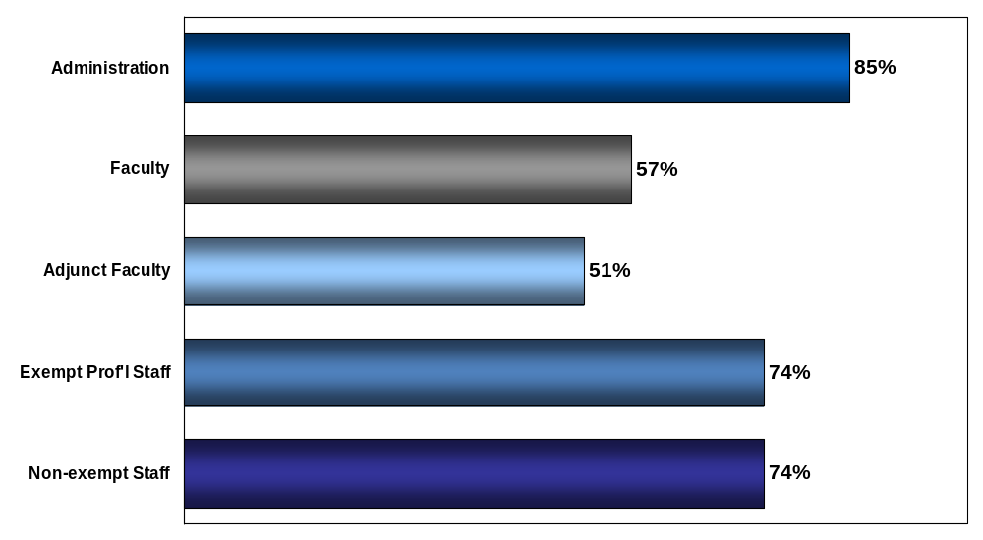
48. Senior leadership regularly models this institution's values.

Slide 40
Senior Leadership
Survey Statement |  | California State Uni. San Marcos Overall results (% Positive) | California State Uni. San Marcos Overall results (% Negative) | 2014 Honor Roll Benchmark >10,000 (% Positive)
27 | Senior leadership provides a clear direction for this institution's future. | 63 | 13 | 73
41 | Senior leadership communicates openly about important matters. | 56 | 14 | 71
37 | Senior leadership shows a genuine interest in the well-being of faculty, administration and staff. | 61 | 14 | 74
56 | I believe what I am told by senior leadership. | 58 | 12 | 75

Slide 41
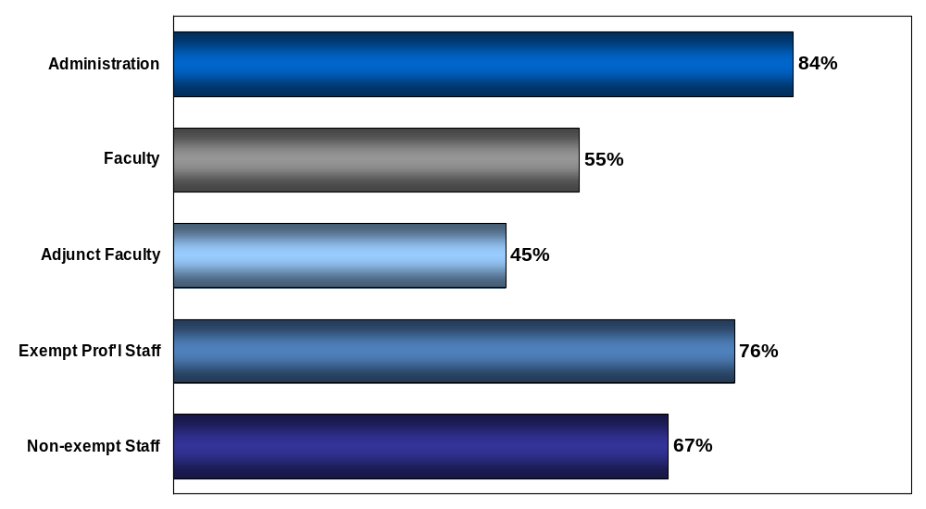
57. This institution is well run.

Slide 42
Communication
Survey Statement |  | California State Uni. San Marcos Overall results (% Positive) | California State Uni. San Marcos Overall results (% Negative) | 2014 Honor Roll Benchmark >10,000 (% Positive)
8 | When I offer a new idea, I believe it will be fully considered. | 67 | 13 | 73
21 | In my department, we communicate openly about issues that impact each other's work. | 62 | 14 | 72
22 | Changes that affect me are discussed prior to being implemented. | 50 | 20 | 58
43 | At this institution, we discuss and debate issues respectfully to get better results. | 56 | 12 | 72

Slide 43
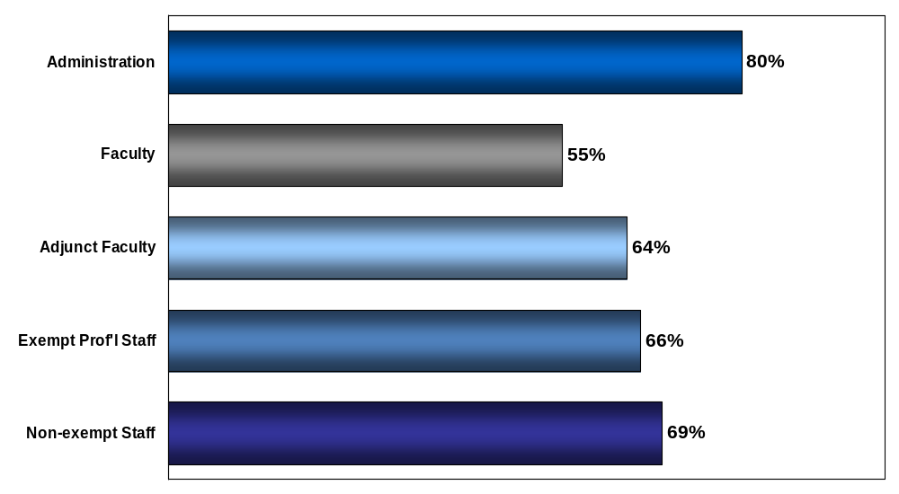
8. When I offer a new idea, I believe it will be fully considered.

Slide 44
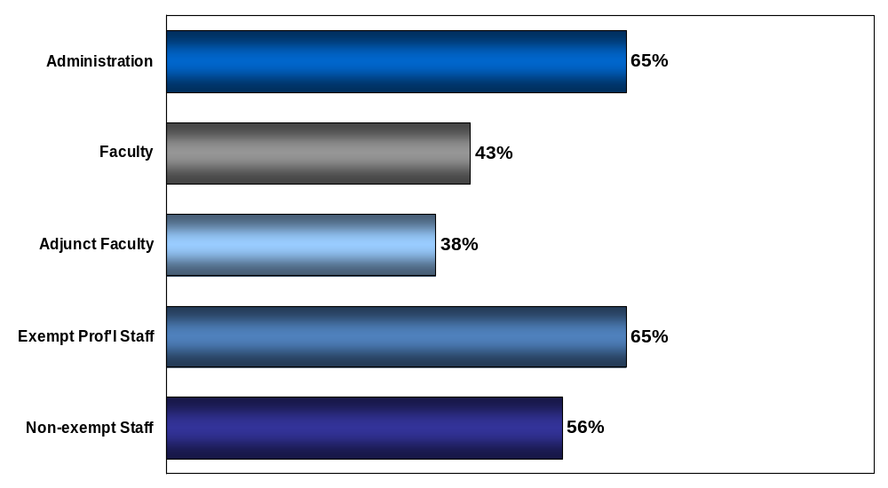
43. At this institution, we discuss and debate issues respectfully to get better results.

Slide 45
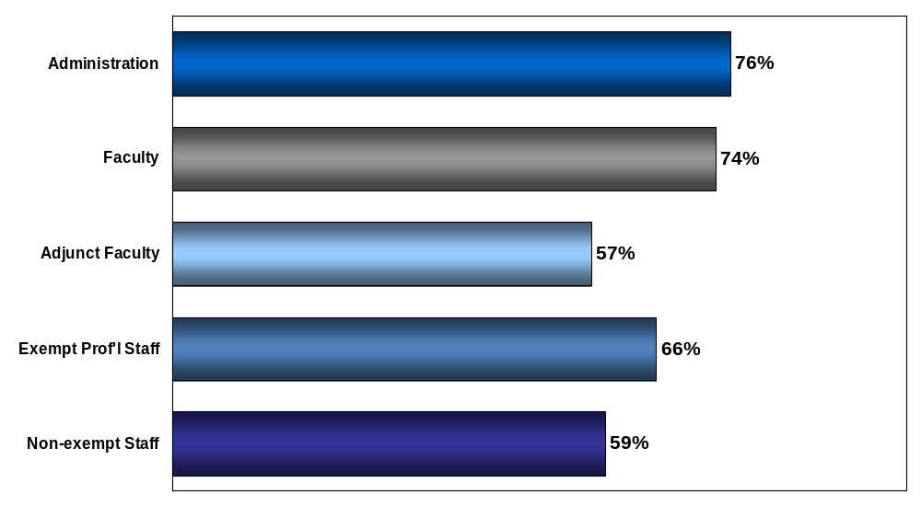
13. We have opportunities to contribute to important decisions in my department.

Slide 46
Collaboration
Survey Statement |  | California State Uni. San Marcos Overall results (% Positive) | California State Uni. San Marcos Overall results (% Negative) | 2014 Honor Roll Benchmark >10,000 (% Positive)
13 | We have opportunities to contribute to important decisions in my department. | 66 | 11 | 75
23 | People in my department work well together. | 67 | 8 | 75
26 | I can count on people to cooperate across departments. | 61 | 10 | 69
58 | There's a sense that we're all on the same team at this institution. | 58 | 17 | 71

Slide 47
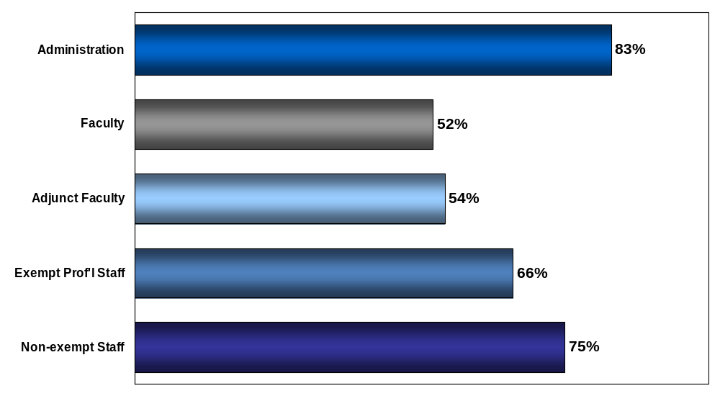
46. Faculty, administration and staff work together to ensure the success of institution programs and initiatives.

Slide 48
Shared Governance
Survey Statement |  | California State Uni. San Marcos Overall results (% Positive) | California State Uni. San Marcos Overall results (% Negative) | 2014 Honor Roll Benchmark >10,000 (% Positive)
38 | The role of faculty in shared governance is clearly stated and publicized. | 66 | 9 | 75
39 | Faculty are appropriately involved in decisions related to the education program (e.g., curriculum development, evaluation). | 70 | 9 | 80
42 | Faculty, administration and staff are meaningfully involved in institutional planning. | 54 | 12 | 69
55 | There is regular and open communication among faculty, administration and staff. | 53 | 14 | 71

Slide 49
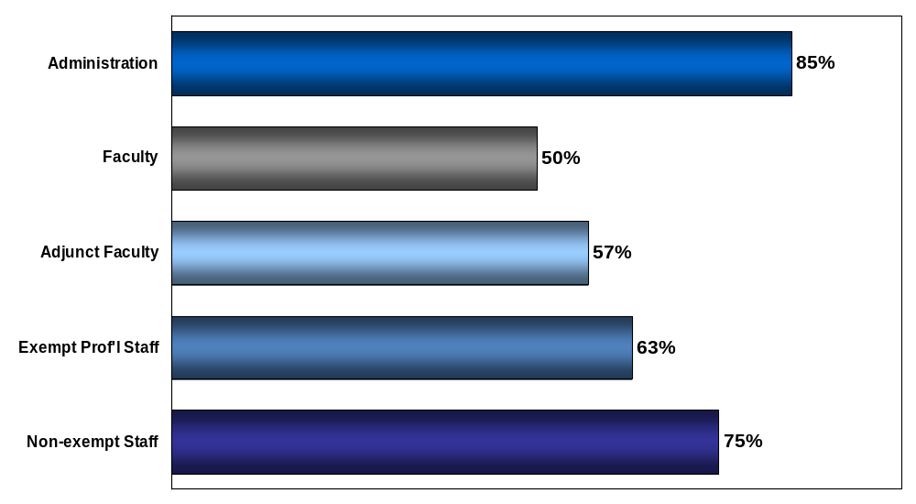
71. Our institution’s values guide decision-making throughout the institution not just in theory but also in our day-to-day actions.

Slide 50
Respect & Appreciation
Survey Statement |  | California State Uni. San Marcos Overall results (% Positive) | California State Uni. San Marcos Overall results (% Negative) | 2014 Honor Roll Benchmark >10,000 (% Positive)
9 | I am regularly recognized for my contributions. | 59 | 19 | 67
35 | Our recognition and awards programs are meaningful to me. | 50 | 23 | 61
52 | We celebrate significant milestones and important accomplishments at this institution. | 80 | 4 | 84

Slide 51
ModernThink Recommendations
Communicate a high level summary of the survey results to faculty, staff and appropriate leadership groups.
Ensure those in supervisory/leadership roles have the necessary training to provide day-to-day leadership…especially as related to fair treatment, coaching behaviors, and effective communication.
Review existing communication structures, processes and norms to better determine what is currently working well and how best to strengthen the quality of communication and dialogue.
Review and address fairness concerns regarding performance management processes and accountability. Ensure systems and processes related to ensuring fair treatment are up-to-date and consistently communicated.
Consider introducing formal mechanisms/processes to enhance senior leadership visibility, interaction and relationship with the goals of fostering a greater sense of confidence in the credibility/alignment of leadership and the experience of shared governance.
Consider an intentional focus on specifically defining and articulating the unique nature of the employment experience at California State University San Marcos so that faculty and staff have a greater sense of alignment and shared culture.

Slide 52
Additional Resources
Richard K. Boyer
rboyer@modernthink.com
302.764.4477

