Slide 1
Welcome to
Budget Orientation
Joseline Dyas
Budget Manager, Budget Office
Maria Rasimas
Director, Operations & Resource, Academic Affairs

Slide 2
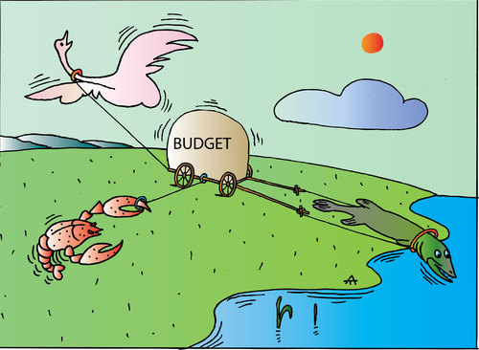
Welcome to
Budget Orientation
Who is this for? ALL EMPLOYEES THAT MANAGE A BUDGET
New hires
Current employees
New supervisors of budget

Slide 3
Budget Basics
What is a budget?
Budget is not another word for cash.
A budget is an estimated plan of income for a set period of time.
A budget provides a vehicle for managing financial resource plans.
The budget runs on a fiscal year calendar from July 1 through June 30.

Slide 4
State Budget Allocation Process
State of California
Governor’s January Budget → May Revise → Final June Budget
Higher Education
California State University
CSU, San Marcos

Slide 5
Campus Budget Allocation Process
The Budget Office notifies the Divisions of allocation funds available.
The Divisions determine the budget allocations for their areas.
Divisions collect and send all budget submissions from each area to the Budget office.
The Budget Office uploads/posts budget allocations to Data Warehouse.

Slide 6
Two Parts to Every Budget
Revenue
Expenditures (aka Actuals)
State Appropriation
Student tuition and fees
Self-generated revenue in auxiliary units or self-supported designated funds such as Extended Learning
Lottery, Trust & Grants
Salaries
Operating expenses
Travel
Hospitality
Special Consultants

Slide 7
Terminology:
Budget “Scenarios”
  BASE funds
  New permanent base allocation
  Continuing permanent base allocation to cover expenses that recur annually
  Most common scenarios for budget uploads and transfers:
  BBB Base Budget (allocation)
  BBT Base Budget Transfer
  BBS Base AE&SS Fees
  ONE-TIME funds
  One-time allocations for special projects or expenses beyond the scope of base funding
  Expenses that are not recurring
  Most common scenarios for budget uploads and transfers:
  OTB One-time Budget (allocation)
  OBT One-time Budget Transfer
  Less common scenarios:
  OSS One-time Salary Savings
  OBR One-time Budget Restoration
  OTR One-time Reimbursement

Slide 8
Terminology:
Transaction Types
Budget
  Spending Authority
  Allowance/ Income
Actual (aka Expenditure)
  Actual expense (Check has been cut and vendor has been paid)
Encumbrance
  Open purchase orders
Balance (BBA = Budget Balance Available)
  Budget less actuals and encumbrances.

Slide 9
Terminology: STATE Fund Sources
EACH FUND HAS ITS OWN GUIDELINES AND REGULATIONS
General or Operating Funds 485xxx: the predominant fund for financing state operations.
  Must spend to zero or funds will be swept June 30 (48500 only). Must request carry forward approval from Academic Affairs for 48500 funds, this should be rare with the exception of mandatory carry forwards.
  STUDENT FEES: Academic Excellence & Student Success Fee (AE&SS), Non-Discretionary or Course Fees, student fees reserved for specific purposes (generated on campus from fees paid by students)
  Must be spent in compliance with Executive Orders (EO), may only be used as they were approved or request formal revision. Must be reviewed for compliance periodically. Submit annual forms with budget request. Annual training available.
  Trust/Special Projects 496xx, 463xx, 47xxx, 44xxx (Extended Learning): state self support funds, revenue generating activities such as campus newspaper, athletics, cultural programs, Extended Learning, etc.
    Carried forward to the next fiscal year automatically if not spent, request is not necessary. Submit annual forms with budget request. Annual training available.
  Lottery Funds 481xx: restricted by law to projects and programs directly related to the educational process.
    Lottery funds should be spent out in year allocated or risk loss of funding.
    Must formally request ‘restoration’ if not spent (no more than 80% of allocation) from the Budget Office (form on their website) and notify your Resource Analyst.

Slide 10
Terminology: AUXILIARY Fund Sources
EACH FUND HAS ITS OWN GUIDELINES AND REGULATIONS
CSUSM Corporation
  Campus Programs - Internal Grants: Indirect Costs (IDC), Campus & Community Relations Funds (CCR), Grant Proposal Seed Money (GPSM)
  Sponsored Projects - External Grants: NIH, NSF
  Foundation
    Donations, Endowments

Slide 11
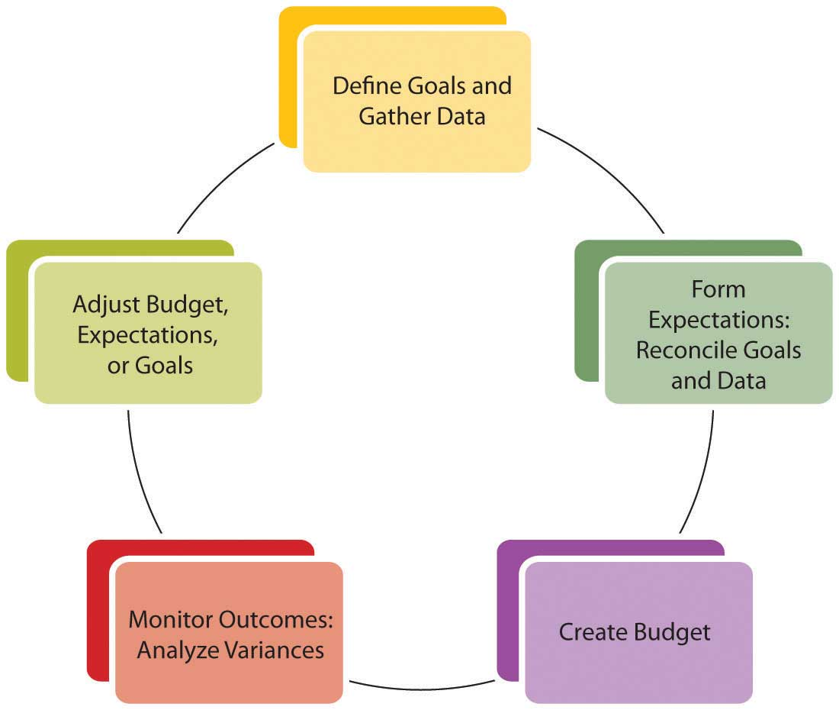
Budget Cycle
Training, support, and resources are available through your unit Budget Analyst
  DEFINE GOALS Administrators
  Three Year Rolling Plan (TYRP)
5. ADJUST Staff & Supervisor (Unit or Dept Level)
Mid-Year Report
Cash Trust Submission
Carry Forward Request
Fiscal Year Close
Non-Discretionary Student/Course Fees Submission
2. FORM EXPECTATIONS Administrator with support from Unit Analyst as needed
TYRP Fiscal Year budget request and FY Salary Savings report
4. MONITOR & ANALYZE BUDGET
Budget Staff & Supervisor (Unit or Dept Level)
Create new FY Shadow Budget
3. CREATE BUDGET Administrator & Unit Analyst
Base Budget Review (BBR)

Slide 12
Fiscal Year Budget Timeline
Templates and Guidelines will be provided
Base Budget Review (BBR): All Units - Submit budget and confirm you received what you expected July
Non-Discretionary Student/Course Fees: Units with Student Course Fees only - Submit new forms each FY July
Mid-year Report: All Units - After December close, project through June 30 and complete report January
Three Year Rolling Plan (TYRP) & Salary Savings Report: All Units - Including narrative & FY Budget Request February
Cash Trust: Units with Cash Trusts only Submit new forms each FY May
Carry Forward Request: If needed - Lottery through Budget Office, 48500 through Lead Analyst/VP MANDATORY ONLY May
Fiscal Year Close: All Units - Follow Year-End Closing Calendar to monitor deadlines June
Create new FY Shadow budget: Enter new budget/projections. Forecast, reconcile and review June
  Adjust budget & projections as needed to meet goals. Expense funds as much as possible by March 31 to avoid last minute issues (there are exceptions but they should be rare). ENSURE STRATEGIC SPENDING RATHER THAN LAST MINUTE SPENDING!

Slide 13
Uses of Funds: PROCARD and Purchasing
Prefer university purchasing processes (e.g. ProCard; Purchase Order) over personal reimbursements
Best practices:
  Code expenses to the correct account code
  Confirm invoice is attached
  Accurate description of purpose (e.g. recipient name for Professional Development)
  Hospitality expense must have ​signed hospitality ​form attached

Slide 14
Uses of Funds: Professional Development
Faculty should be expected to explain the following (however briefly) for spending requests:
How will this purchase further your professional development?
How does this purchase align with the College’s mission and/or strategic goals?
Guidelines:
Any items purchased with University funds are intended for University business
Any items purchased with professional development funds are the property of CSUSM
Professional development funds must cover the entire cost of the item(s). Co-mingling of funds is not allowed
University Procurement processes must be followed, personal reimbursements must comply with the Direct Pay guidelines
Technology purchases and COVID-related purchases require approval from the Dean/Supervisor BEFORE purchasing and/or requesting from IITS
PLEASE REVIEW PROFESSIONAL DEVELOPMENT WEBSITE FOR FULL GUIDELINES

Slide 15
Monthly Budget Reconciliation
Budget reconciliation is the process of reviewing transactions, supporting documentation, and resolving any discrepancies that are discovered after the Data Warehouse general ledger closes each month.
Reconcile and Forecast monthly – this is the foundation for internal control and ensures protection of the University’s resources, and helps determine whether or not your funds will end the fiscal year “on target”.
Professional Development/Faculty Funds should also be reconciled monthly by name and reviewed for accuracy
Division of ACADEMIC AFFAIRS: Monthly reconciliation required by all budget staff and reviewed and signed by budget manager, process includes:
  Run CFS/Data Warehouse (DW) report by Department, Fund, Account (also known as DFA Report)
  Compare data from DW report to your Shadow Budget workbook including submitted transactions, budget transfers, and encumbrances. Resolve any variances.

Slide 16
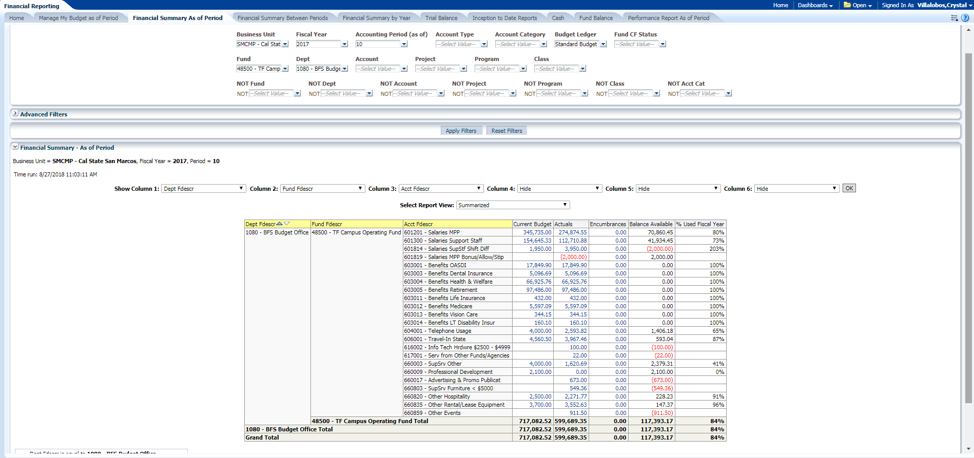
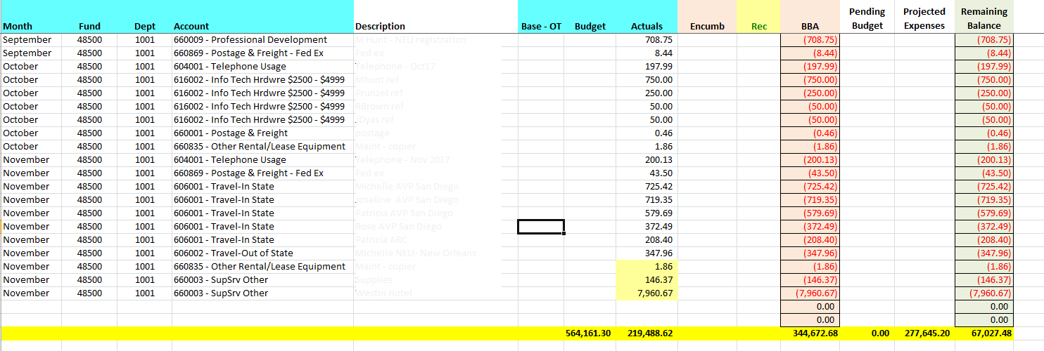
Managing Your Department Budget: Reconciliation
Utilize Data Warehouse (DW) to gather your data for the specific time period.
Download the data from DW to Excel to reconcile.
Work with your Division Analyst to determine your divisions reconciliation process.

Slide 17
Sample of monthly budget reconciliation reports

Slide 18
Reconciling – Why is it Important?
Maintain Internal Control
Protects the resources of the University by being good stewards
Confirms financial statements are accurate and reliable
Helps determine whether or not your funds will end the fiscal year “on target” and in good financial health
Find and correct any financial discrepancies/variances
Division of ACADEMIC AFFAIRS: Monthly reconciliation required

Slide 19
Reconciling – What Do I Look For?
Confirm transactions are posted for the correct amount and match your submitted transactions
Confirm transactions are recorded in the correct department, fund and account.
All transactions that should be recorded are recorded.
The balance in the shadow budget matches the balance on the budget report in three columns: Budget, Actuals and BBA (balance) as well as each account.

Slide 20

What Should I Do if I Find an Error?
RESEARCH and get it corrected preferably by the next reconciliation, do not wait. You risk losing funds if errors are not caught and corrected WITHIN the quarter.
For questions regarding the payment of an invoice, contact Accounts Payable
For payroll questions, contact Payroll Services
For budget help, contact your unit lead Budget Analyst
Corrections may include submitting the following:
  Budget Transfer
  Salary Adjustment
  Financial Transfer
  Billing Invoice

Slide 21
Budget and Transfers – BEST PRACTICES
MULTIPLE BUDGET TRANSFERS:
If you are transferring funds to more than one department, please post on one transaction, eliminate multiple transactions as much as possible.
BUDGET TRANSFERS WITHIN A DEPT ID:
Please avoid transferring funds between accounts in the same department. By submitting these transfers, it creates non-value added work for the Budget Office.
Keeping budget as it was originally posted will help your unit forecast and budget for the next fiscal year.
EXPENSING FUNDS OUT OF A DIFFERENT ACCOUNT THAN BUDGETED TO:
Accounts are considered ‘green’, it’s ok to be negative in one account if budget was posted to another in the same DEPT ID.
For instance posting budget to Professional Development funds for faculty and expensing to travel, supplies, or events is fine. Track it with tags/categories in your shadow budget. Please request help from your lead analyst, if needed.
Regardless of the account of the budget, you MUST use the correct account to expense, please review the account list for the most appropriate account.
FULLY FUNDED SALARY LINES:
The original budget (BBR) for salary lines should fully fund the new fiscal year. If IRPs or Reclassification occur, submit a budget transfer to fully fund the salary line.
This will assure all salary lines are fully funded at year end. This is the only time you are allowed to budget transfer within a department.

Slide 22
What is a CPO? Cash Posting Order
  A Cash Posting Order is the tool used to move cash between our campus and other CSU campuses or between our campus and the Chancellor’s Office (CO).
  CPO payments are made electronically by the CO – they are not invoiced or paid with checks.
  The Budget Office collaborates with Accounting to ensure entries required by the Budget Office are accurately processed on a monthly basis.
  Often stateside grants come as CPO’s, examples COAST, CSUPerb, etc.

Slide 23
Reviewing Budget Basics
A Budget is not cash. It is an estimated plan of income for a set period of time which provides a vehicle for managing financial resource plans.
Reconcile and Forecast your records monthly – this is the foundation for internal control and ensures protection of the University’s resources, and helps determine whether or not your funds will end the fiscal year “on target”.
Review, Research and Resolve any discrepancies and variances and contact your Resource Analyst for help.

Slide 24
Academic Affairs RESOURCES
Planning and Resources (PAR)Website review:
https://www.csusm.edu/par/resource_operations/index.html
Includes AA budget training & resources, onboarding resources, and other important links.
Information on AA Business Operations (AABO) meetings including monthly Roundtable Discussions and Fall and Spring presentations.
AA Approval Requirements MATRIX and Provost Signature guidelines
PLEASE TAKE ADVANTAGE OF THESE HELPFUL RESOURCES

Slide 25
QUESTIONS?
CSUSM Academic Affairs September 16, 2021

