Slide 1
Lead from where you are
WELCOME
Administrative Retreat
October 30, 2019
Kellogg 5400, Reading Room
11:30am to 4:00pm
Includes lunch

Slide 2
Why are we here?
VISION: Through our shared experiences supporting administrators and leading staff, we come together to network, share our expertise, encourage & support through career growth and leadership activities while nurturing and growing into a shared vision of leadership
MISSION: LEAD FROM WHERE YOU ARE

Slide 3
“Lead from where you are.” CSUSM President Ellen Neufeldt
“Anytime a group of talented, hard-working, intelligent women can come together, it’s a good thing.” Margarita Robles
“I define a leader as anyone who takes responsibility for finding the potential in people and processes, and who has the courage to develop that potential.”
Brene Brown, DARE TO LEAD

Slide 4
AGENDA Lead from Where You Are
11:30 ICE BREAKER – Inspiring Women Leaders
11:45 WELCOME – Lunch with The Highwomen
12:15 ACTIVITY – Dare to Lead
1:30 BREAK – Dessert & GROUP PHOTO
2:00 ACTIVITY – Women and Mentoring
3:15 ACTIVITY – Creative project and Lending Library
3:45 CLOSING
2019 Administrative Retreat
Wednesday, October 30, 2019
11:30am to 4:00pm

Slide 5
OUR THEME SONG: The Highwaymen had "Highwayman," a song about outlaws sung by the outlaws of country music. But instead of killers and outlaws, the Highwomen are revolutionaries. The group was conceived as a radical restructuring of what a country group looks like, not least of that being its emphasis on community between women and a fundamental lack of competition or opposition between female artists. “Our goal is simply to elevate all women and completely abandon the concept of competing with one another so that we can let as many women through the door as possible and give our girls those country music heroes that we all had." Brandi Carlile
The Highwomen, left to right: Natalie Hemby, Brandi Carlile, Maren Morris and Amanda Shires.
https://www.youtube.com/watch?v=7D-6nklMMbM

Slide 6
Leadership is a lifestyle. Leadership is a choice.
An OPTIMISTIC attitude
PERSISTENCE
A strong and powerful VOICE
Living with PASSION and PURPOSE
A strong sense of self and CONFIDENCE
Embody and EMBRACE CHANGE
AUTHENTICITY
Seeking and receiving SUPPORT
Dr. Lorri Sulpizio, Director of Women’s Leadership Academy, University San Diego
https://www.huffpost.com/entry/be-a-woman-of-impact-with-these-8-qualities-of-women-leaders_b_7228944
BE A WOMAN OF IMPACT:
We can mold, and develop how we move through the world, making conscious efforts to shape not only what we do, but who we are.
Whether you do all of these some of the time, or some of them all of the time, increasing your capacity in these areas is sure to improve your impact on the world and maximize your capacity for leadership. You can be a woman of impact in your work place, with your family, for your community. HANDOUT 1

Slide 7
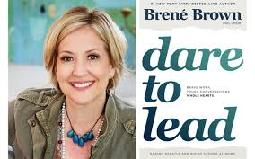
BRENE BROWN: https://www.youtube.com/watch?v=hEnqV_M_Dm4

Slide 8
LEADERSHIP CHARACTERISTICS Activity
Honesty, Integrity, Inspiring, Goals, Commitment, Vulnerability, Communicates, Divergent thinking, Decisive, Accountability, Delegation, Empowerment, Creativity, Innovation, Empathy, Optimism, Persistence, A strong and powerful voice, Passion, Purpose, Confidence, Embraces change, Authenticity, Seeking and receiving support, Clarity, Courage, Humility, Vision, Listens, Resilience, Transparency, Emotional intelligence, Open-minded, Patient, Diplomacy, Initiative, Influence, Trust, Motivation, Relationships
What characteristics would I like to NURTURE?
What characteristics are my STRENGTHS?
WHAT MAKES A GOOD LEADER GOOD?

Slide 9
What Makes a Good Leader GOOD?
Think of a good leader you know or have worked with. What makes them “good” in your opinion?
Five Characteristics of Successful Women Leaders:
1
2
3
4
5
What Helps Us and Hurts Us?
What actions, behaviors, values and characteristics do women frequently exhibit that help PROMOTE us as leaders? Why?
What actions, behaviors, values and characteristics do women frequently exhibit that can HURT us as leaders? Why?
What About YOU?
What characteristics do YOU have that may help you be a good leader? List two of your current STRENGTHS:
1
2
How can you build on/use each one to your advantage?
What characteristics do YOU have that may hinder you as a good leader? List two that you’d like to NURTURE:
1
2
How can you improve on/avoid each one listed?

Slide 10
THE GROWTH CYCLE…basically we are plants with emotions, we need nurturing too…
PLANT
NURTURE
HARVEST

Slide 11
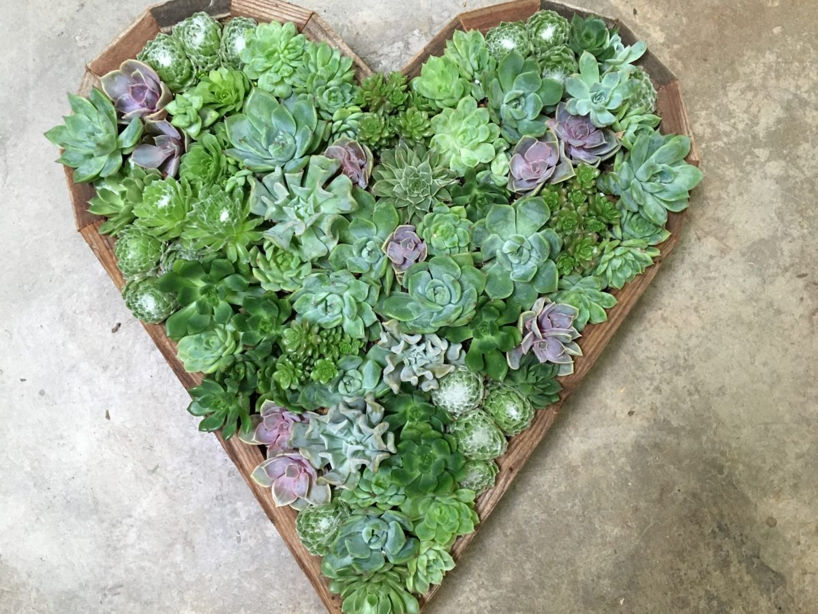
JUST FOR YOU
They help you breathe
They purify the air
They help prevent diseases
They help you focus
They aid in quicker recovery
FIVE WAYS SUCCULENTS CAN HELP YOU LIVE HEALTHIER
5 health benefits of having succulents in your home HANDOUT 2
BY KARLINA VALEIKO
20/05/2019
https://www.redonline.co.uk/interiors/homeware/a526209/five-health-benefits-of-having-succulents-in-your-home/

Slide 12
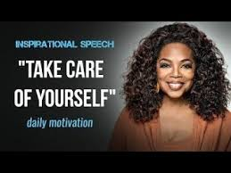
Oprah Winfrey: https://www.youtube.com/watch?v=kfLGR0KYuys

Slide 13
You can calm your mind and reduce anxiety in a matter of minutes with a handful of proven techniques to reduce stress. Here, 15 ways to de-stress at work instantly.
1. Take a Walk
2. Take a Deep Breath
3. Stretch
4. Meditate with an App
5. Make a Checklist and Action Plan
6. Talk It Out with a Friend
7. Get Inspired with a TED Talk
8. Use Essential Oils
9. Interact with an Animal
10. Work Outside
11. Listen to Music
12. Take a Reading Break
13. Take a Power Nap
14. Reach for Tea Instead of Coffee
15. Put Your Mental Health First and Listen to What You Need
How to De-Stress at Work Instantly: 15 Proven Ways to Calm Your Mind HANDOUT 3 & 4
By Larry Kim https://www.inc.com/larry-kim/how-to-de-stress-at-work-instantly-15-proven-ways-to-calm-your-mind.html

Slide 14
Inspiring TED Talks
Simon Sinek: "How Great Leaders Inspire Action"
Simon Sinek: “Why Good Leaders Make you Feel Safe”
Sheryl Sandberg: "Why We Have Too Few Women Leaders"
Derek Sivers: "How to Start a Movement"
Dan Ariely: "What Makes Us Feel Good About Our Work?"
Rosalinde Torres: "What It Takes to Be a Great Leader"
Amy Cuddy: “Your body language may shape who you are”
Jane McGonigal: “The game that can give you 10 extra years of life”
Brene Brown: “The power of vulnerability”
Elizabeth Gilbert: “Your elusive creative genius”
Shawn Achor: “The happy secret to better work”
Monica Lewinsky “The price of shame”
Chimamanda Ngozi Adichie “We should all be feminists”
Christine Porath “Why being respectful to your coworkers is good for business”

Slide 15
5 Types of Self-Care for your Mental Health
Physical: Healthy Living
Emotional: Feel your Feelings
Psychological: It’s OK to say NO
Spiritual: Inspired living
Professional: Balance HANDOUT 5

Slide 16
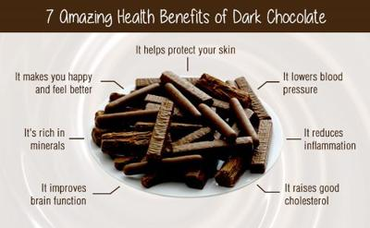
DESSERT and BREAK

Slide 17
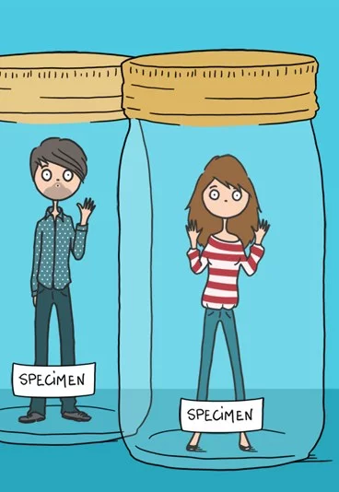
Women working with Women
The difference between men and women in one video:
https://www.reddit.com/r/ANormalDayInRussia/comments/8lzzyi/the_difference_between_men_and_women_in_one_video/

Slide 18
WOMEN working with WOMEN
While women continue to forge ahead educationally, economically, and professionally, they face a particular challenge: helping each other succeed. As female professionals continue to enter and occupy the workforce in large numbers, there are a few skills they need to develop and a few habits they must unlearn.
The number one interpersonal habit that has to go is covert competition among women. HANDOUT 6
Here’s some exciting news: women now make up 49% of the workforce and 57% of the college population—indisputable evidence that women aren’t just a part of the workforce, they’re shaping it.
Caution: Women Competing at Work
Jan 24, 2019
By Katherine Crowley and Kathi Elster
https://www.amanet.org/articles/caution-women-competing-at-work/

Slide 19
Shine Theory is a practice of mutual investment in each other.
“I don’t shine if you don’t shine.”
— AMINATOU SOW & ANN FRIEDMAN

Slide 20
What is Shine Theory?
“ShineTheory” is a term that writer Ann Friedman coined to describe the radical act of prioritizing mutual support over competition (for women). Shine Theory is the simple premise that "I don't shine if you don't shine." It's a term I coined with Aminatou Sow to describe a commitment to collaborating with rather than competing against other people—especially other women.
We practice Shine Theory because true confidence is infectious. Because powerful women make the greatest friends. Because people know you by the company you keep. Because we want the strongest, happiest, smartest women in our corner—and we want to support each other in pursuing success and happiness on our own terms.
Shine on!
Shine Theory is intentional. It is accountable. It is personal. SHINETHEORY.COM
Creators of Shine Theory, best friends, Aminatou Sow and Ann Friedman

Slide 21
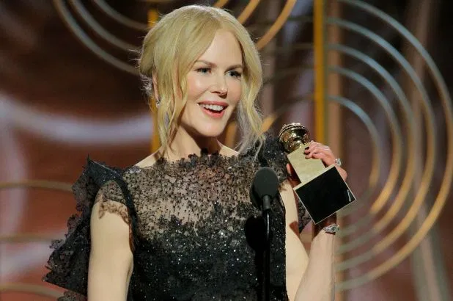
Shine Theory in Action!
https://www.youtube.com/watch?v=BsHx2dclkLE

Slide 22
Power Of The Pack: Women Who Support Women Are More Successful
A woman alone has power; collectively we have impact.
Take the word “work” out of networking. Reframe what networking is: Simply putting yourself in environments that give you the opportunity to meet with peers and get to know each other share experiences can be a game changer.
Prioritize relationship building. Does your calendar reflect your values? Schedule time to connect with relationships you value.
Know that connection building isn’t one and done. “Seek out people who you admire. Ask for advice, and follow up. Participate wherever and however you can. In short, be a doer!”
Amplify other women. SHINE THEORY! Build other women up!
Find your squad—and tap into them. Who’s on your team…your support network? Build your squad, people you can bounce ideas off of, go to for advice, give you a boost when needed.
https://www.forbes.com/sites/shelleyzalis/2019/03/06/power-of-the-pack-women-who-support-women-are-more-successful/#287f0ec61771
We’re better together. As Madeleine Albright said, “There is a special place in hell for women who don't help other women." As we say from personal experience, “There is a special place in heaven for women who support other women.” HANDOUT 7

Slide 23
MENTORING CARDS Activity
3 bullet points to mentor your younger self
3 bullet points to mentor your future self
What do you wish you had known that you would want to share with someone else?
What do you hope to have achieved in one years time? 5 years time? 10 years time?

Slide 24
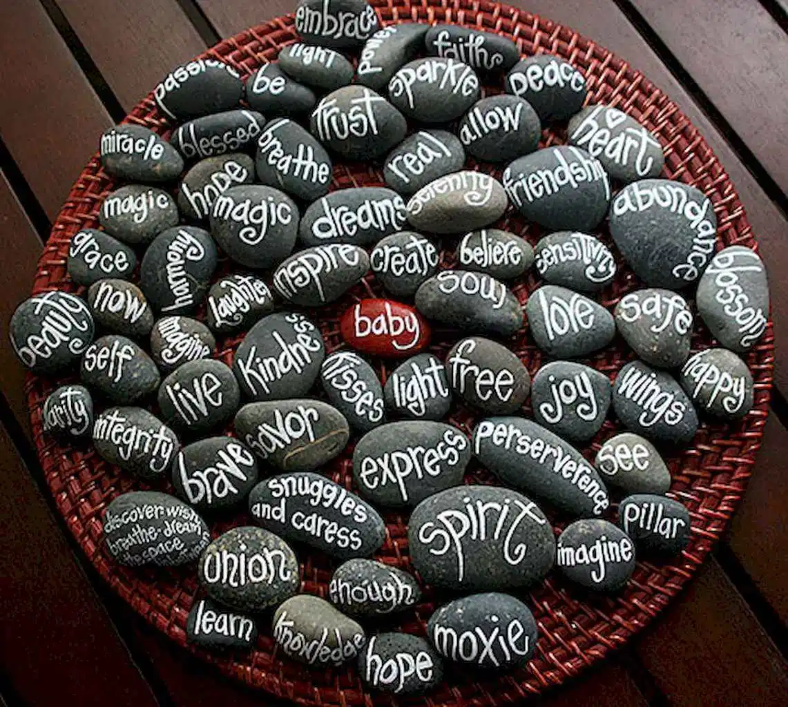
PAINTING ROCKS
GROWTH WORD FOR THE COMING YEAR

Slide 25
LEADERSHIP LENDING LIBRARY
LOCATED IN KRIS ROBERTS OFFICE

Slide 26
More Resources:
10 Best Podcasts For Women: Find Personal and Career Fulfillment in Your Everyday Life
https://www.inhersight.com/blog/insight-commentary/10-best-podcasts-women-find-personal-and-career-fu?_n=46286645 HANDOUT 8
https://www.sandiego.edu/soles/conscious-leadership-academy/womens-leadership/shexperience.php

Slide 27
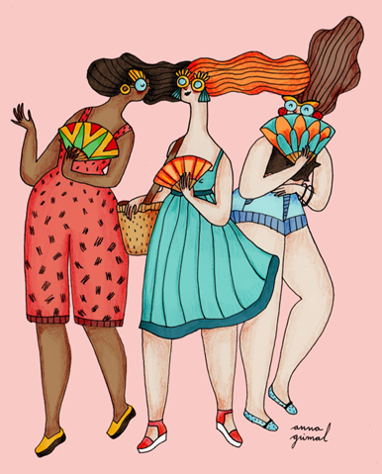
Thank you for joining us!
And THANK YOU TO THE PROVOST AND VICE PROVOST FOR SUPPORTING OUR RETREAT!
LIVE VIDEO OF THE HIGHWOMEN

