Slide 1
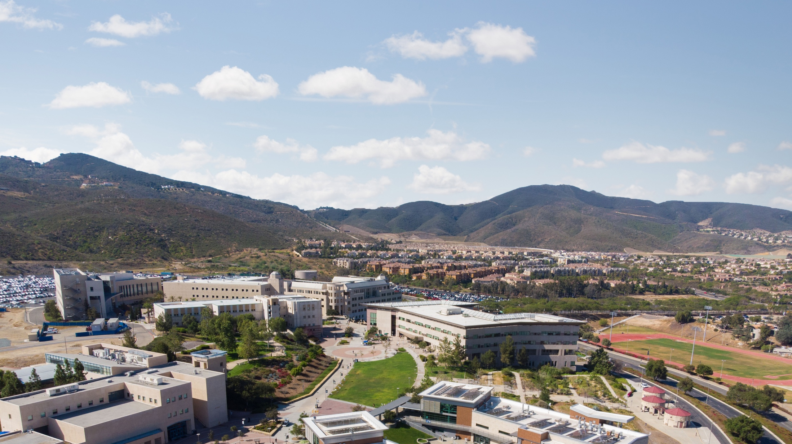
Academic Affairs
Student Fee
Training
Maria Rasimas
Director, Resources & Operations

Slide 2
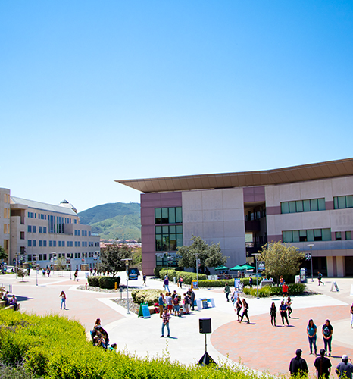
WHY DO WE NEED TRAINING ON STUDENT FEES?
INTERNAL CONTROLS

Slide 3
WHO IS RESPONSIBLE FOR INTERNAL CONTROLS?
The auditors, right? Wrong!
Everyone plays a part in the CSU's internal control system.
That responsibility is delegated to each area of operation, which must ensure that internal controls are established, properly documented, and maintained.
Every employee has some responsibility for making this internal control system function.

Slide 4
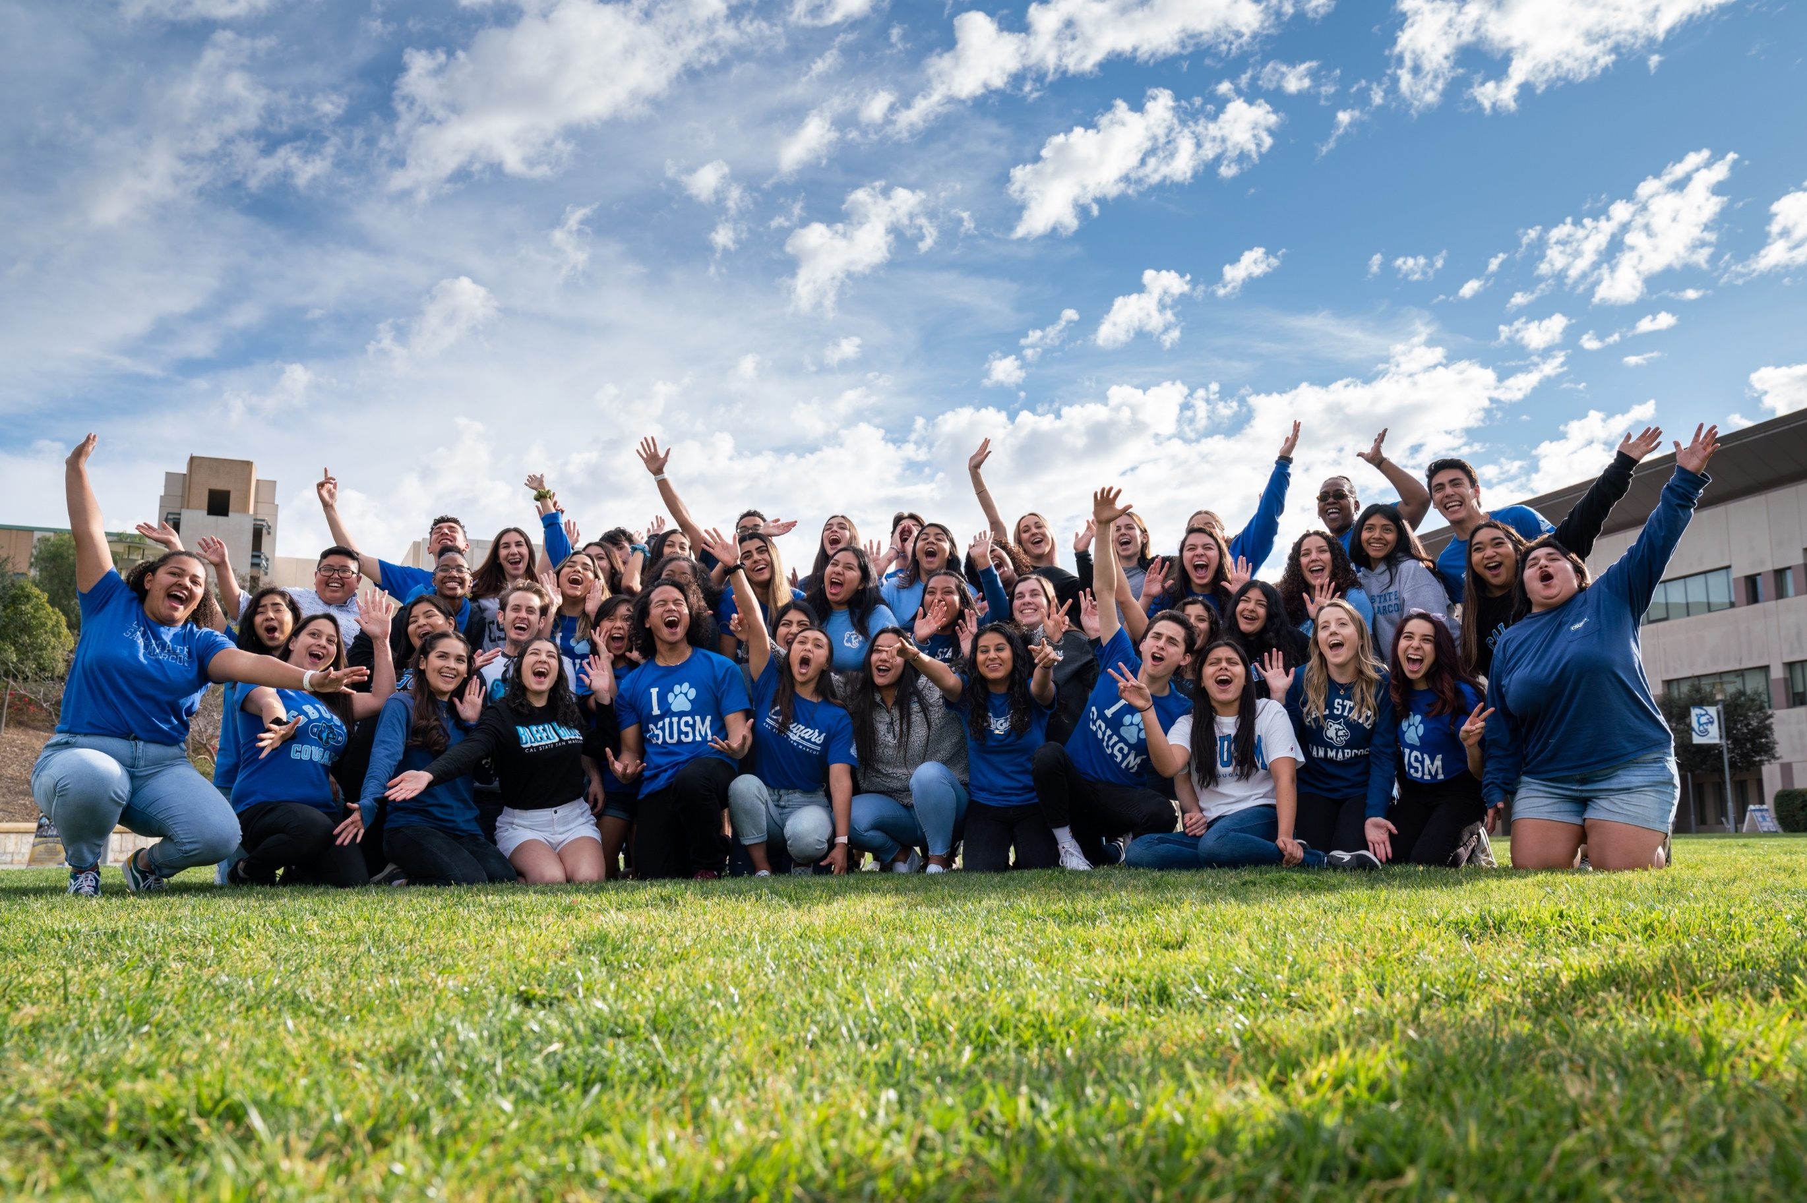
Employees responsible for monitoring the expenditure of student fees and for ensuring that fees generated are properly utilized in each area include:
Dean/Associate Dean
Department Chair
Budget Analyst/Coordinator

Slide 5
THE CALIFORNIA STATE UNIVERSITY
STUDENT FEE POLICY (Executive Order 1102)
EXAMPLES OF FEES BY CATEGORY:
Category I GRADUATE BUSINESS PROFESSIONAL FEES (EO 1102)
Category II ACADEMIC EXCELLENCE AND STUDENT SUCCESS FEES(AE&SS - EO 1086) AND CAREER/WRITING/MATH CENTER FEE (EL MOU)
Category III MISCELLANEOUS COURSE FEES (EO 1025 and 1004)
Category IV THESIS SERVICES FEE, LIBRARY FINES, CREDENTIAL PROGRAM APP FEE (EO 1102)
Category V SELF SUPPORT FEES – CONTINUING EDUCATION/EXTENDED LEARNING
Category VI SYSTEMWIDE VOLUNTARY FEES

Slide 6
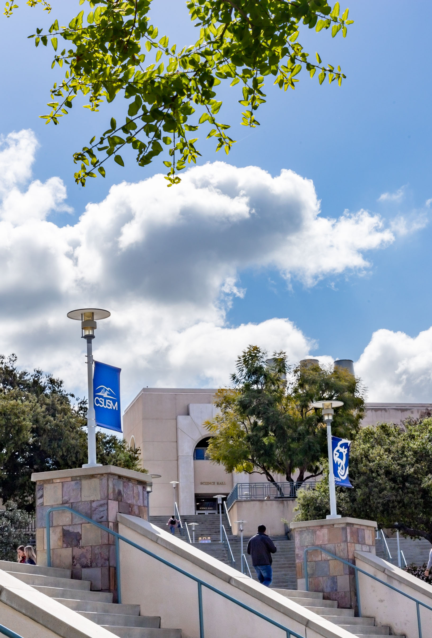
IMPORTANT STUDENT FEE LINKS:
1
Executive Order 1102 - CSU Systemwide Student Fee Policy
2
CSU Systemwide Executive Orders for CSUSM
3
CSU San Marcos current Student Mandatory and User fees
4
CSU San Marcos Student Fee Advisory Committee (SFAC)

Slide 7
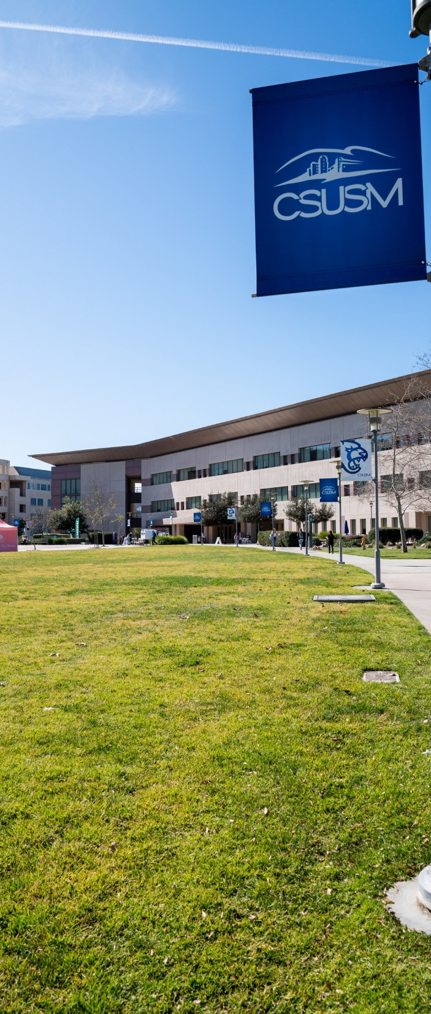
STUDENT FEE Approval and Compliance PROCESS
1. Proposer:
a. Reviews CSU Student Fee Policy (Executive Order 1102)
b. Completes Student Fee Proposal Form
c. Submits to Student Fee Advisory Committee (SFAC) – Rosa Mora, Admin Support
2. SFAC Committee:
a. SFAC meets monthly October through April
b. If declined, SFAC notifies proposer
c. If approved, proposal is forwarded to President for review
3. President:
a. Makes final decision
b. If approved, Budget Office and Student Financial Services are notified (to set up fee tables to implement fee)
c. Effective date of implementation depends on approval date and Student Financial Services implementation timeline, as well as timely notification to students

Slide 8
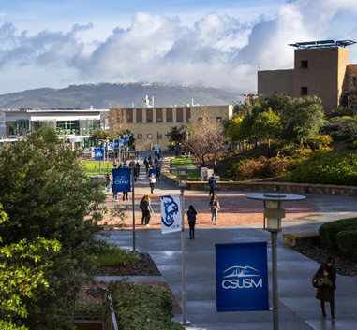
Student Fee documents should be kept on file in Dean’s Office and Department responsible for managing funds.
1
STUDENT FEE DOCUMENTATION
2
Confirm implementation of approved fee is submitted with Student Financial Services and being collected from students accurately.

Slide 9
ANNUAL PROCESSES:
UNIT RESPONSIBILITIES
Submits student course fee projection on Non-Discretionary Submission forms at beginning of fiscal year to the Budget Office when requested, using enrollment projection, BE CONSERVATIVE, true ups at census and year-end for actual enrollment will adjust revenue.
Adds Student Fees to BBR for budget upload: 1) Prior Year BASE plus, 2) New Fiscal Year BASE projection adjustment (could be more or less based on enrollment), and if needed, 3) one-time PY carry forward. RECONCILES BBR with Budget Office/Academic Affairs.
Reconciles budget/expenses monthly as well as student fee collection at SPRING CENSUS to head count to confirm received correct student fees (possibly PY adjustments may be included).
Forecast expenses and reconcile monthly to confirm budget will not end in a negative balance, carry forwards should be rare.
Confirm student fees are expensed and materials purchased and consumed during the term fees were collected for the course, provide justification if there is a negative end of year balance or carry forward.
Audit expenditures to confirm compliance with purpose and usage of fee, student fees are designated and non-discretionary, fees must be used as approved. See the Policy, Executive Order, MOU or other approved fee documents to confirm.
Analyze fee annually to confirm fee collected is accurate/appropriate. If the student fee is determined insufficient and/or too much for approved costs, submit for modification through the same Fee Proposal process through the Student Fee Advisory Committee (SFAC). The college will supplement costs as needed if fee is insufficient. Surplus of revenue if costs are reduced may not be spent without approval from the Budget Office, it is possible fees could be refunded to the student. SFAC website to pursue modification: https://www.csusm.edu/sa/sfac/index.html
Confirm if the student fee should be changed if course structure changes, canceled, increased, or reduced based on online/hybrid/change in instruction/technology, etc.
Request student fee budget balance on Academic Affairs request for carry forward, it is a mandatory one time carry forward item.

Slide 10
ANNUAL PROCESSES:
BUDGET OFFICE and ACADEMIC AFFAIRS RESPONSIBILITIES
The Budget Office reconciles (true ups) student course fees on Spring census date and at year end, this results in a ONE-TIME budget transfer in or out of the DEPT ID based on actual enrollment.
Restores budget balance as one-time funds, student fees are a mandatory carry forward to the same student fee DEPT ID, they remain designated funds and cannot be used to fund other activities.
Most academic departments have separate DEPT IDs to manage course fees, work with Academic Affairs and Accounting for new DEPT ID if needed.
Train new staff and administrators on student fee guidelines as needed.

Slide 11
Example of Annual Non-Discretionary Submission Forms – use for all EXCEPT AE&SS fees):
Forecast revenue on anticipated enrollment (use correct revenue code)
Forecast expenses reconciled to revenue (use correct expense code)

Slide 12
ACADEMIC EXCELLENCE AND STUDENT SUCCESS FEES
The Academic Excellence and Student Success (AE&SS) fee was established by Executive Order (EO) 1086 on June 18, 2013. The fee is designed to support student learning and engagement; and to ensure that students graduate in a timely manner with the tools to be successful in their chosen careers. The fee has been used for additional course sections, undergraduate advising, career support, academic support, and student life and recreational opportunities. It has preserved our student-centered mission, vision and values, and provides students increased opportunities for success.
Process
Reporting:
AE&SS is a Category II Fee.
We used 48511 fund to budget and manage these funds at the time they were established
Difficult to manage in a separate fund so currently we use 48500 fund and the Budget Office reports in 48511 fund based on the annual division plan
We are still required to manage these funds AS IF we are using a separate fund
Budget amount allocated for AE&SS on the BBR with 48500 funds based on the guidelines, confirm you are expensing as you budgeted
While benefits are in a central pool, for reporting of these funds if it was budgeted to a salary line, benefits are added centrally to reflect the true cost for reporting purposes (on the website and CO)
Use of fees is posted annually on our website and reported to the Chancellor’s Office
If fees are used for the lecturer budget, we report the courses online that are funded, please confirm they are correct annually (online) and that you really are expensing the amount budgeted to those courses or revise/update as needed.
LINKS:
  CSU San Marcos Academic Excellence & Student Success Fee (AE&SS)
  CSU Budget Office – Student Success Fees

Slide 13

22/23 AA Non-Discretionary / Student Fees
Year | Unit | Description | Revenue Account | Dept ID | EO#/Guidelines | Category
22/23 | CEHHS | Credential Program App Fee | 501826 | 1313 | EO 1102 | 4
22/23 | CEHHS | Course Fee Kinesiology | 501849 | 1317 |  | 3
22/23 | CEHHS | LVN-BSN Skills Assessment Fee | 501877 | Inactive
22/23 | CHABSS | Course Fee Music | 501841 | 1327 | EO 1025 | 3
22/23 | CHABSS | Course Fee Psychology | 501857 | 1328 |  | 3
22/23 | CHABSS | Course Fee Art, Media, Design | 501886 | 1329 | EO 1025 | 3
22/23 | CHABSS | Course Fee Theatre | 501885 | 1384 | EO 1025 | 3
22/23 | CHABSS | VPA Equipment Late Fee | 501873 | 1386 | EO 1102 | 4
22/23 | CoBA | Professional Program Fee | 501201 | 1280 | EO 1102 | 1
22/23 | CoBA | Professional Program Fee | 501201 | 1280 | EO 1102 | 1
22/23 | CoBA | Professional Program Fee | 501201 | 1280 | EO 1102 | 1
22/23 | CoBA | Professional Prog Fee Waiver | 501865 | 1280 | EO 1102 | 1
22/23 | CSTEM | Course Fee Biology (I) | 501837 | 1314 | EO 1004 | 3
22/23 | CSTEM | Course Fee Chemistry | 501838 | 1315 | EO 1025 | 3
22/23 | CSTEM | Chem Lab Breakage Fee | 501863 | 1315 | EO 1102 | 4
22/23 | CSTEM | Course Fee Physics | 501839 | 1316 | EO 1025 | 3
22/23 | CSTEM | Course Fee Biology (II) | 501837 | 1321 | EO 1004 | 3
22/23 | LIBRARY | Thesis Services Fee | 501862 | 1311 | EO 1102 | 4
22/23 | LIBRARY | Library Fines | 501881 | 1148 | EO 1102 | 4
22/23 | LIBRARY | Career/Writing/Math $20 1079 | 501866 | 1079 | EL MOU | 2
22/23 | OUGS | Career/Writing/Math $12 1358 | 501866 | 1358 | EL MOU | 2
22/23 | OUGS | Career/Writing/Math $12 1203 | 501866 | 1203 | EL MOU | 2
22/23 | CEHHS, CHABSS, CoBA, CSTEM, LIBRARY, OUGS, OGSR, ACADEMIC PROGRAMS & ADVISING | Academic Excellence and Student Success Fees (AE&SS) |  | Misc | EO 1086 | 2

Slide 14

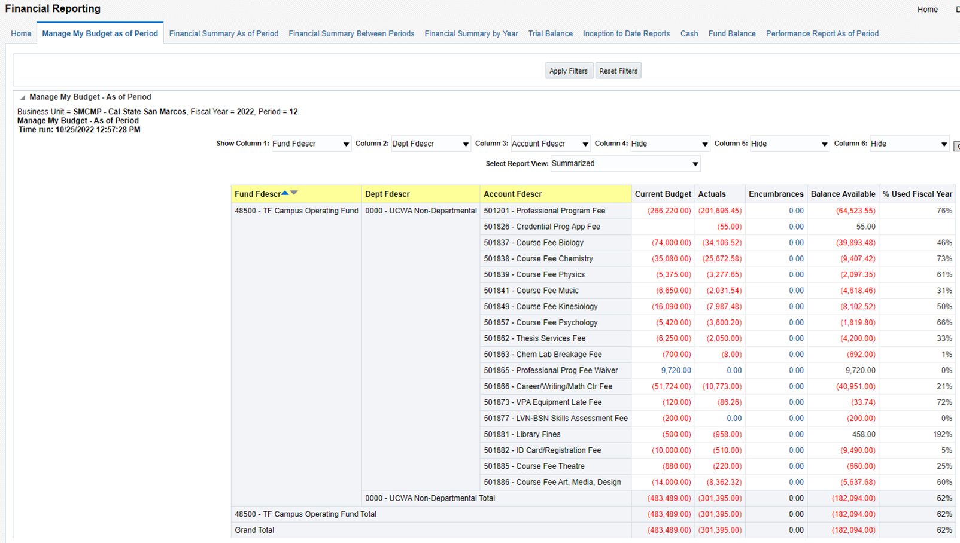
Data Warehouse report for Budget Office true ups

Slide 15
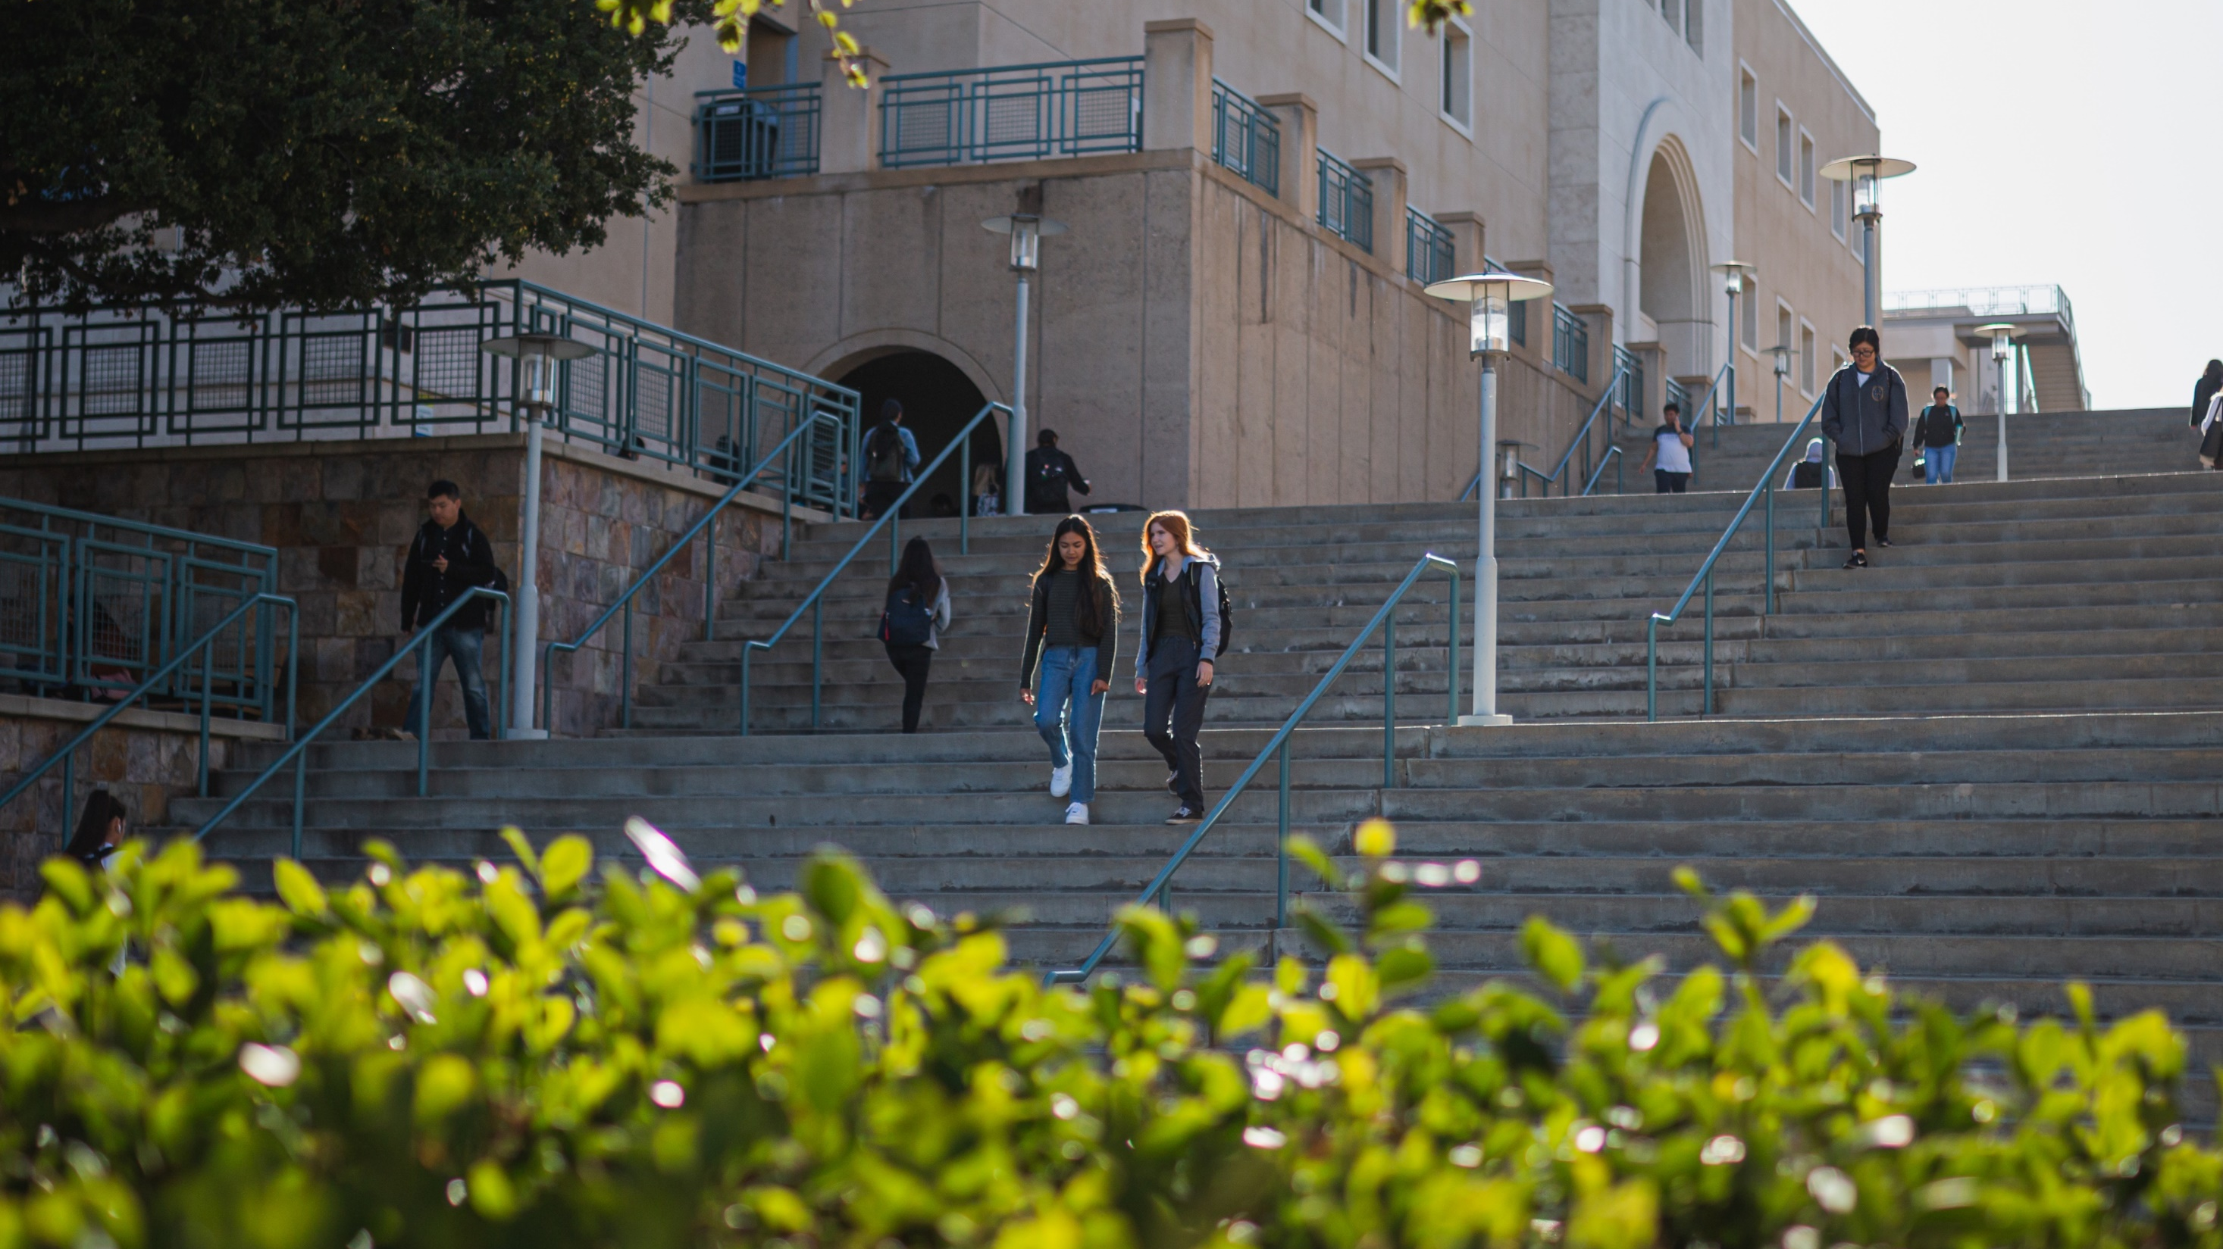
Questions?

