Slide 1
Serving Undocumented Students
Webinar

Slide 2
Welcome
Introductions
House-keeping items
About TTC

Slide 3
Today’s Agenda
History and legality of the issue
A look at the past and current actions taken by states
A note on admissions and financial aid
DACA
Formulation of a plan to serve these students
Beyond higher education
Question and answer session

Slide 4
What is our purpose
We need to discuss the background of this issue to move forward
We need to develop admissions and advising policies that serve these students
We need to be advocates for these students as higher education professionals

Slide 5
“Illegal Aliens?”
Debate over use of this term continues to be a controversial issue
Term “Alien” means any person not a citizen or national of the US
“Illegal Alien” is any alien whose most recent entry was without inspection or whose initial valid status has expired
US Code, Title 8
Undocumented Students vs. Students out of Status (Visa Overstays)

Slide 6
Forget the verbiage…
Despite terminology, our mission as educators should be our concern
Maximizing the service we provide within current law should be our focus
Understanding that the issue is ongoing and ever changing

Slide 7
Facts
Approximately 65,000 Undocumented Students are graduating from U.S. High Schools each year
Estimation is that only 5-10% of these students pursue post-secondary education
Many may not even realize the barriers that they will face when pursuing postsecondary education
The future is relatively unclear as to how the United States will approach their status

Slide 8
The Biggest Myth
In NO FEDERAL law or policy does it state that it is unlawful to admit and allow to study an undocumented immigrant.
Notice the emphasis on FEDERAL
We are not ICE agents
We cannot be held at fault for advising these students on their potential pathway

Slide 9
The Second Biggest Myth
Federal law does not prohibit states from offering in-state tuition
Section 505 of the Illegal Immigrant Reform and Immigrant Reconciliation Act of 1996 (IIRIRA) prohibits states from providing any higher education benefit based on residency to undocumented immigrants unless they provide the same benefit to U.S. citizens in the same circumstances, regardless of their residence.

Slide 10
Clarification
States who offer in-state tuition require a certain amount of time in-state at secondary education institutions to qualify for residency.
Since they can apply this same requirement to a U.S. citizen in order to establish state residency, then an undocumented student may do this as well.

Slide 11
The Misconception
The thought has been out there that state specific legislation was overruling federal law.
The way that the federal law was written was intentionally vague to give states the authority to handle this issue themselves.
This put more spotlight on the state regarding this issue and less on the federal government.
The thought of an all encompassing piece of federal regulation has been on the table for years

Slide 12
An Example of Change
The next slides portray a small part of the story
Change or proposed changes are occurring nearly daily across the states
Keeping up with these changes will allow us to maximize our service within the law

Slide 13
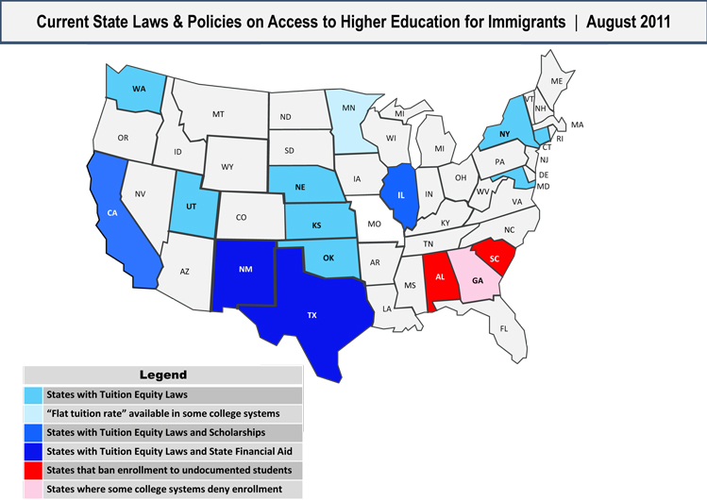
nilc.org

Slide 14
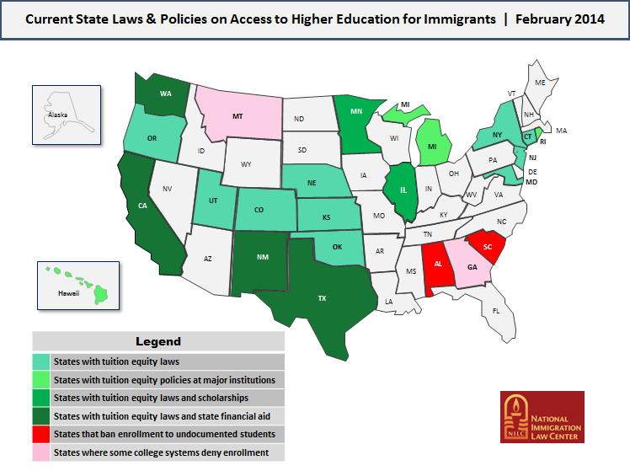

Slide 16
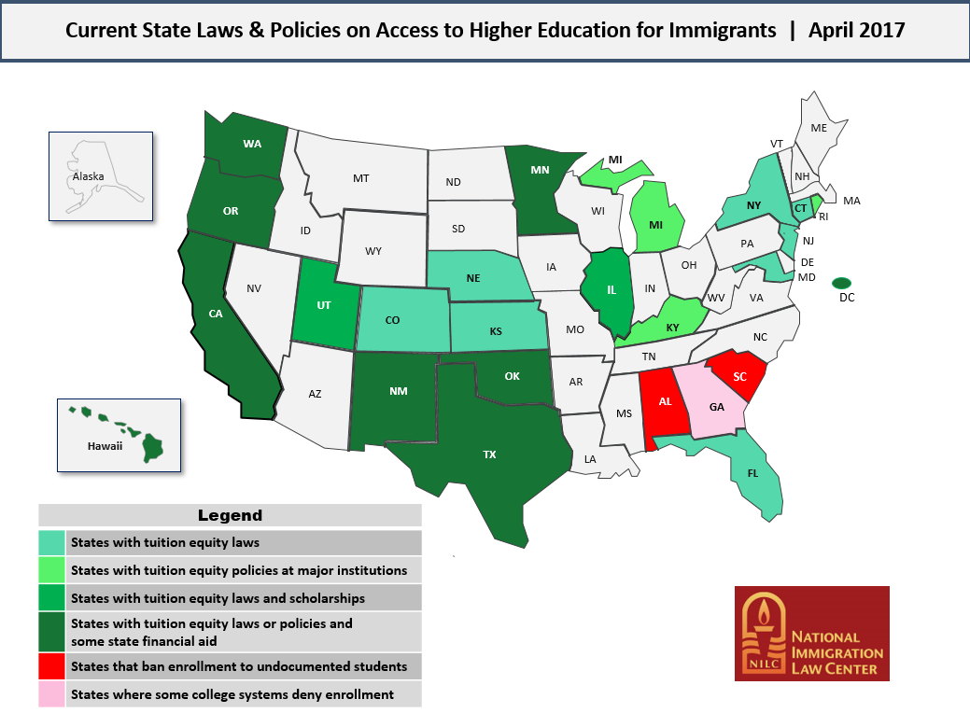

Slide 17
Admission of Students
Banned enrollments at public higher education institutions
Alabama – 2 DACA exception schools
Georgia – DACA is eligible for in-state tuition
South Carolina – DACA exception at all schools

Slide 18
Admission of Students
Admission of students at Private Institutions is permissible nationwide
Admission at all Public Institutions nationwide is permissible aside from the previous exceptions
Some have made institutional decisions to ban enrollment of undocumented students
Many who choose to do this have, or will have, potential scrutiny from immigration law organizations and student groups

Slide 19
Admission of Students
Access and community education are key
Know your demographics
Formulate an application that promotes inclusion
The most common addition to the application is a status option called “Not a citizen, permanent resident, or active status non-immigrant”
Although you could use “undocumented” as a status option, most do not.
Undocumented students should not be classified as international

Slide 20
Financial Aid
Undocumented students cannot legally receive any federally funded student financial aid, including loans, grants, scholarships, and work-study programs.
DACA students may use their SSN to fill out the FAFSA in order to receive a student aid report.
Many states are pushing through ‘miniature’ DREAM acts to provide potential state aid, in-state tuition, employment benefits
This opens up more options for scholarships and institutional aid

Slide 21
Financial Aid
An example of a few states such as California, Washington, New Mexico, Texas, and Oklahoma have their own way of determining financial need and may not require a FAFSA
This list continues to grow as more legislation is pushed through
Undocumented students who are not under DACA cannot fill out the FAFSA, but may be able to complete some state’s internal financial need calculators.

Slide 22
Scholarships and other aid
Multiple organizations throughout the US are providing increasing funding options for undocumented students
For lack of a better term…an explosion of aid has occurred in the last 3 years
Non-profit organizations, private school dollars, community access organizations are just a few
Legislation in many states are opening up grants, loans, and scholarships to anyone regardless of status

Slide 23
DACA and DAPA
DACA – deferred action for childhood arrivals – been in place since June 2012 – Future Unclear
DAPA - deferred action for parents of Americans and lawful permanent residents – program was just denied due to a split in the supreme court.
This decision keeps DACA the same and DAPA is off the table for now.

Slide 24
DACA
Provides a lawful, but temporary, status in the US – executive order – may be in jeopardy
Expansion of program was denied
Benefits may include (based on state’s policy)
Establishing in-state residency
Work permits – is currently a 2 year permit-may change
Driver’s license
Professional licenses
Health care – www.phdreamers.org

Slide 26
Advance Parole
Travel request for those on unexpired DACA
Very risky at this point
May provide a legal reentry to the US
https://www.ilrc.org/sites/default/files/resources/prac_adv-daca_advance_parole_fam_pet-20160531.pdf
Limited reasons for travel include:
Humanitarian reasons
Educational reasons
Employment

Slide 27
Advance Parole
Students must fill out the I-131 form
Supply DACA approval notice
Include evidence that their trip fits within the guidelines
Pay $725 application fee
Recognize that this can be risky for students, as return to the US is no guarantee.
Some have been granted a change of status upon return

Slide 28
What is our duty?
As higher education institutions, we should be advocates for any students success.
We should promote admission of these students into our institutions as federal law does not take ability from us that.
Despite our opinions on immigration law within the U.S., we are, at our core, educators.

Slide 29
Where to start?
The process of enhancing your services begins with community education on the topic
The complexity of this subject is not always the easiest to keep up with
Again, knowing your community demographics is crucial to making institutional decisions to move forward with a plan

Slide 30
How do we serve these students?
Safe space is crucial
Providing blanket knowledge to our community about the benefits available to undocumented students is the start
Families are crucial in the beginning phase and throughout
Abide by FERPA
Undocumented students are protected under FERPA just as our other students

Slide 31
Programming
Community Involvement
Understand your communities and engage
Off site informational sessions to funnel to campus
High School engagement
Partner with school counselors to promote informational family sessions
Initial contact may not be direct recruitment
The college and financial planning session is a good start
Bilingual Brochures for parents

Slide 32
Programming
Start small and let the word get out
Assess your pilot programs and implement needed change
Hard recruitment is…well hard
Utilize your off campus programming to promote visits to campus
Involve student organizations in on and off campus recruitment
Building trust by knowing your facts

Slide 33
Retention
Not unlike any other student…engagement with campus is key to retention
Train your team
Students affairs, faculty, athletics, advisors, career services etc…all should be educated on the ins and outs of working with undocumented students
Training sessions

Slide 34
After Higher Ed…
As with any student…we should begin the discussion of what happens after graduation early in the process
Know the career options for undocumented students
Research the ability to work within a field
Professional license
SSN requirements
Future outlook

Slide 35
Summary
Be diligent
This issue changes constantly
Be aware of the actions taken in your state and an eye on changes in the federal programs DACA and DAPA
Watch for negative legislation at the state level and be a proponent of positive change

Slide 36
Open for questions
I will answer as many questions from the chat board that I can
Contact me with any assistance you may need
Chad Teman
chad@temantraining.com
419-230-4798

Slide 37
Resources
The College Board
MALDEF
United States CFR
NILC- https://www.nilc.org/wp-content/uploads/2015/11/state-education-bills-2016.pdf
USCIS

