Slide 1
OU Campus Accessibility
Amanda Umphrey
Content Strategist & Accessibility Specialist

Slide 2
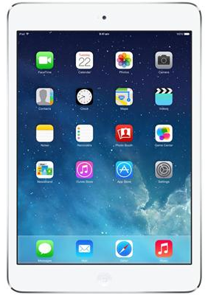
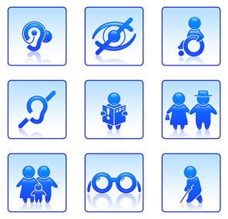

What is web Accessibility?
Accessibility = good site design so all audiences are able to read your content!
Impacts:
    People with disabilities
      Vision impairment
      Hearing impairment
      Cognitive disabilities
      Physical disabilities
    Different browsers
    Mobile device users
    Non-native English speakers

Slide 3
How is accessibility enforced?
All OU Campus pages are checked for accessible content.
This includes:
    General page content/layout
    PDFs
    Word Documents
    Images
    Videos
    Tables
Once an accessibility weak point is identified – it will either be fixed for you (minor errors that do not impact page content), or the content owner will be contacted.

Slide 4


Commonly missed on OU Campus
Headings within page content
  Helps users navigate your page
  Keeps uniform look
Descriptive links
  No “Click here”s!
  Should be stand alone
Alternative text on image
  Helps non-visual users
  Page load issues
Videos
  Must be captioned!
Documents (PDF/Word)
  Need headings, alt. text, & should not be scanned images
Images of text on pages
  Do not use images of text and/or pictures of fliers on your page
  Hard to read on mobile devices and excludes non-visual users
“To learn more about campus web accessibility Click Here”
-vs-
“Learn more about campus web accessibility”

Slide 5
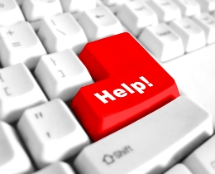
I’ve Been told I have accessibility issues, now what?
I will work with you to come up with a solution to the identified issue(s).
Guides are available online of the most common accessibility issues
One-on-one Meetings
Department Meetings
Phone assistance
Contact Info:
Amanda Umphrey
Content Strategist & Accessibility Specialist
web@csusm.edu

Slide 6
Log in to OU Campus
Go to: www.csusm.edu/training/
The rest of the training will be hands-on in a training area created for you in OU Campus.

