Slide 1
Integrating Sources
Putting Quotes in Your Paper

Slide 2
Why Quote?
The purpose of using quotes may change a little bit depending on the assignment, but ultimately, you should use quotes as supporting evidence of the claims you are making in your paper
You should quote when you cannot put the information in your own words
You should quote if you are analyzing the author’s words

Slide 3
How to set up the quote
DO:
- Introduce the quote
- Use the author’s name or article title to introduce the quote
DON’T:
-Drop quotes
-Forget to cite it!

Slide 4
Explain/Analyze the Quote
You are using a quote in order to support your argument or help prove your point. Don’t forget to explain the quote itself and its significance to your paper or presentation. Quotes without explanation do not help you further your argument.

Slide 5
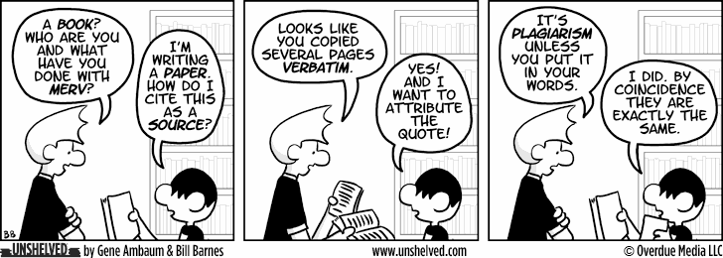
Quoting and Paraphrasing
versus Plagiarizing

Slide 6
Excerpt from Alexis De Tocqueville’s “How Americans Understand the Equality of the Sexes”:
“American women never manage the outward concerns of the family, or conduct a business, or take a part in political life: nor are they, on the other hand, compelled to perform the rough labor of the fields, or to make any of those laborious exertions which demand the exertion of physical strength” (De Tocqueville 408).

Slide 7
Plagiarizing (Bad)
Original:
“American women never manage the outward concerns of the family, or conduct a business, or take a part in political life: nor are they, on the other hand, compelled to perform the rough labor of the fields, or to make any of those laborious exertions which demand the exertion of physical strength” (De Tocqueville 408).
Paraphrased:
American women stay home and keep house and don’t take a part in political life. But the good part of this arrangement is that they don’t have to do the same rough labor of the fields that the men do.

Slide 8
Plagiarizing (Bad)
American women stay home and keep house and don’t take a part in political life. But the good part of this arrangement is that they don’t have to do the same rough labor of the fields that the men do.
The example shows exact words from the source, without giving the author credit for their ideas.

Slide 9
How to fix plagiarized writing
Put quotation marks around the author’s words.
Put the author’s ideas into your own words.
Be sure to include the correct citation.

Slide 10
Quoting (Good)
American women stay home and keep house and don’t “take a part in political life.” But the good part of this arrangement is that they don’t have to do the “same rough labor [in] the fields” that the men do (De Tocqueville 408).
The words from the source are enclosed in quotes
The page number is given at the end
Brackets are around the words the writer changed from the original text (to make it grammatical or understandable)

Slide 11
Paraphrasing (Good)
Tocqueville claims that even though American women can’t participate in politics and must confine themselves to working around the house, they at least have the advantage of not having to do the kinds of hard manual labor men have to do (408).
All of the language is the writer’s, and it captures the point Tocqueville was making while still letting the reader know that the ideas are Tocqueville’s.
Notes:
http://webwriting2013.trincoll.edu/wp-content/uploads/2013/08/serious-cat.jpg

Slide 12
Review:
Quote sparingly
Explain your quotes
Tie quotes to significance
Always give credit to your sources
Notes:
http://ninapaley.com/mimiandeunice/wp-content/uploads/2010/07/ME_109_Thief.png

