Slide 1
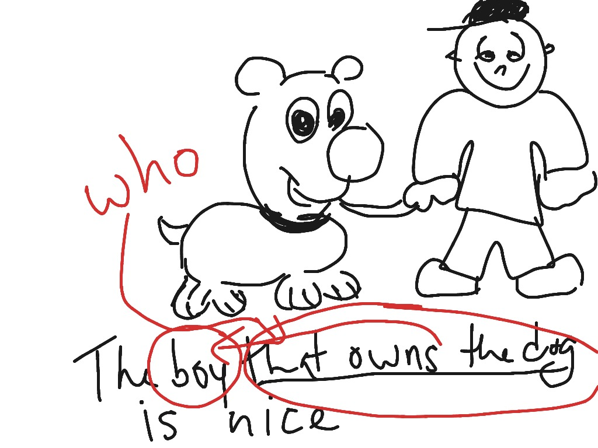
Adjective Clause
Presented to You by the writing center

Slide 2
Introduction
Green Eyes by Coldplay
Honey, you are a rock... Honey you are the sea...
That green eyes, you’re the one...
And anyone… must be out of their mind.
Honey you are a rock…
1. What do adjective clauses describe?
2. What is the position of adjective clauses in sentences?
3. What pronouns connect adjective clauses to the nouns/pronouns they describe?

Slide 3
Adjective Clauses
Info
Examples
Describes or identifies a noun or pronoun in a sentence.
Must be placed as close as possible to the noun/pronoun it describes.
The company that supplies plastic bags for us is in China.
Facebook, which is used by 1.65 billion people, was founded in 2004.
Nazi emblems were found among the "personal effects" of the man who was killed in Houston on Monday after injuring nine people in a mass shooting.
Everyone who likes ice cream knows Häagen-Dazs.

Slide 4
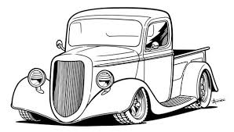
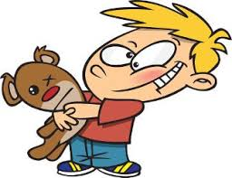
Relative Pronouns That Introduce Adjective Clauses: who, whom, which, that, whose, when, why, and where.
~Who/that (subject)
Example: Those who/that studied Otzi were not sure how he died.
~Whom/that (object)
Example: The man (whom/that) the hikers found had been killed.
~Which/that
(subject or object)
Example: Otzi carried fire materials (which) he could ignite with a flint (that) he carried in his pocket.
~Whose+ noun
(people or things)
Example: Otzi’s bow, whose ends were unfinished, was almost ready to use.

Slide 5
Relative Adverbs
Where
(places)
When
(time)
Why
(reason)
Example: Otzi was named for the valley where he was found.
Example: No one is sure of the year when he died.
Example: No one knows the reason why he died, either.

Slide 6
Adjective Clauses After Prepositions, Quantity Expressions,& Nouns
The area in which Otzi was found was remote.
The period during which Otzi lived had some basic technology.
He met the person to whom she had written.
Otzi had a quiver with arrows, some of which were ready to use.
My friends, many of whom studied abroad, are successful businessmen.
Otzi’s bow, the ends of which were unfinished, was almost 6 feet long.
The attackers, the nature of whose weapons was unknown, followed Otzi into the mountains.
a preposition + which, whom, or whose
a quantity expression + preposition + which,
whom, or whose + noun (use commas)
a noun + preposition + which/whom
a noun + preposition + whose + noun

Slide 7
Formal vs Informal
Whom is used in formal writing.
Whom is often replaced with who or that in speaking.
Whom/who/that can be omitted in informal speaking.
I know the person whom he hired. formal
I know the person who he hired.
I know the person that he hired.
I know the person he hired. informal
In formal English, the preposition should always precede the object relative pronoun.
formal
He met the person to whom she had written.
He met the person whom she had written to.
He met the person who she had written to.
He met the person she had written to.
informal

Slide 8
(continued)
WHERE: Otzi was named for the valley where he was found.
(preposition+ which)=formal
(that+ … preposition)=informal
WHEN: No one is sure of the year when he died.
(preposition+ which)=formal
(that/0)= informal
WHY: No one knows the reason why he died, either.
(preposition+ which)= formal
(that/0)= informal

Slide 9
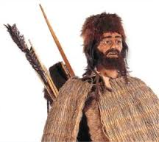
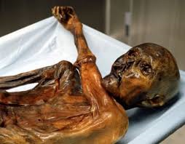
Restrictive and nonrestrictive adjective clauses
Restrictive
nonrestrictive
Essential to identify the noun that it describes.
If omitted, the sentence doesn’t mean the same thing.
No commas around it.
Example:
Hikers found a man who died in the Alps.
Hikers found a man.
Provides extra information about the noun.
If omitted, the sentence still identifies the same thing.
Punctuation: commas, parentheses, or dashes
Examples:
Hikers found Otzi, who lived 5,000 years ago.
Hikers found Otzi—who lived 5,000 years ago.
Otzi (who lived 5,000 years ago) was killed with an arrow.

Slide 10
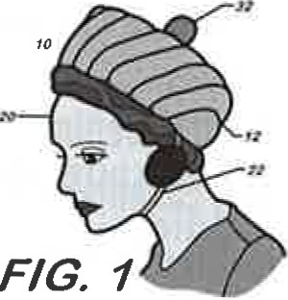
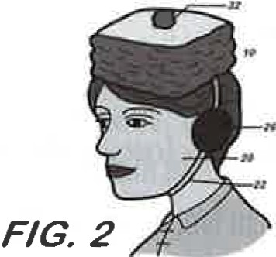
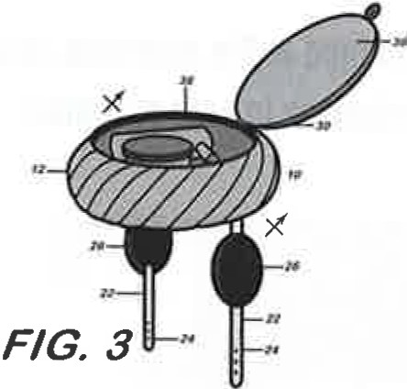
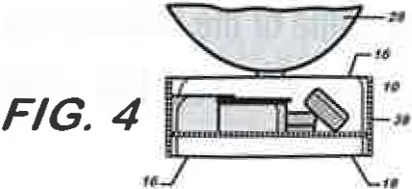
Final Practice
Example: The carry-all hat was probably invented for someone who does not want to carry a purse and who always needs her cosmetics nearby.

